Slide 1
Mesopotamia
AKA….. Fertile Crescent

Slide 2
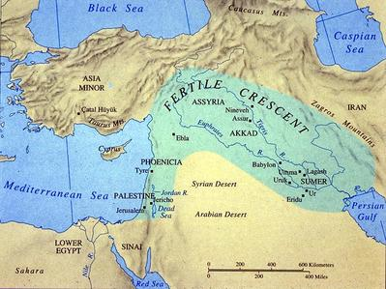

Slide 3
Location…..Location…..Location!!
Advantages | Challenges
Located between 2 rivers Fertile soil | Unpredictable flooding No natural barriers Limited natural resources
What problems will early civilizations have to solve in order to be successful?

Slide 4
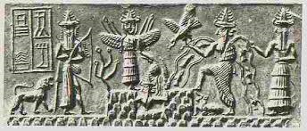
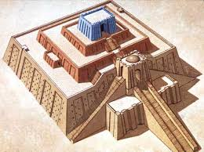
The Sumerians
One of the first people to create a civilization
Create City-States
Government: controlled by temple priests
Polytheistic
  Ziggurat was the focus of the city
Cities grew from a prosperous surplus of food
  Increased trade
    Cultural diffusion as new cities came in contact with each other

Slide 5
Life in Sumer
* Social Classes
Polytheistic
* highest: kings, priests, landholders
* merchants
* Ordinary people
* slaves
** Women could work, own land, and join the priesthood
Children attended school If they disobeyed, their parents could
sell them into slavery!!!!!

Slide 6
Technology
* Invented the wheel
* First to use bronze
* Developed a number system in base 60
* Architecture: ziggurat, arches, ramps, pyramids
* Cuneiform

