Slide 1
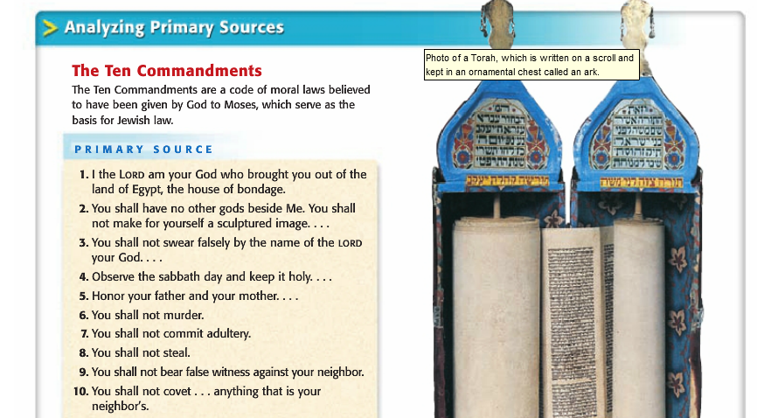
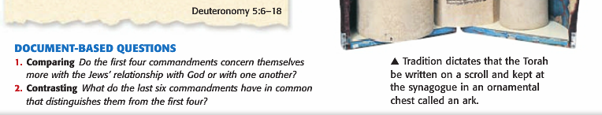
BELL RINGER

Slide 2
Judaism

Slide 3
Setting the Stage…
The Phoenicians lived in a region known as Palestine. They were not the only people who lived in this region. Canaan was the ancient home home of the Hebrews (later called Jews).
Palestine is considered the cultural crossroads of the ancient world.

Slide 4
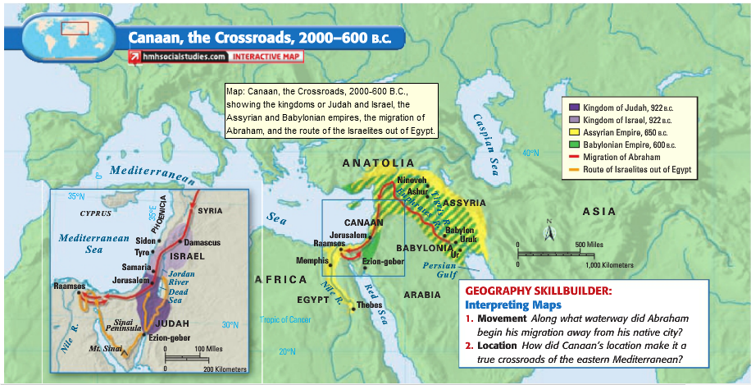

Slide 5
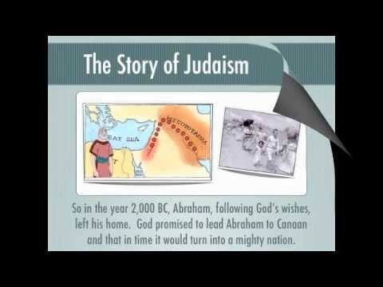

Slide 6
Who were the Hebrews?
One of the nomadic groups who lived in the Fertile Crescent
According to Hebrew tradition, the Hebrews became enslaved in Egypt
  Believe God helped them escape slavery
Around 1000 B.C., set up the kingdom of Israel, Jerusalem was the capital
  Believed that God has promised them this land
Over time, Hebrew beliefs evolved into the religion we call Judaism today

Slide 7
Basic Beliefs of Judaism
Monotheistic
  This is different from most other religions of the time (they were polytheistic)
  Believed God was their special protector (all-knowing, all-powerful, present everywhere)

Slide 8
Geography
Developed in the Middle East, in and around what is now Israel
Practiced Worldwide, primarily in Israel/US

Slide 9
Holy Books
Sacred scriptures
  Torah (known to Christians as the Old Testament/5 Books of the Bible)
  Talmud (collection of writings on Jewish law/tradition)
Moral code: The Ten Commandments
Final Goal: live a moral life through obedience to God’s law
Place of Worship: Synagogue

Slide 10
Important People
Abraham: God made a covenant with Abraham; God will bless Abraham and his descendants and in return they are faithful to God
Moses: led the Hebrews out of slavery in Egypt, “The Exodus”, God gave him the Ten Commandments at Mt. Sinai

Slide 11
Other Beliefs
Rabbis: conduct religious services, ensure Jewish laws are observed, act as spiritual guide for the community

Slide 12
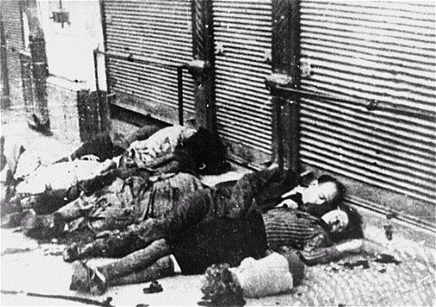
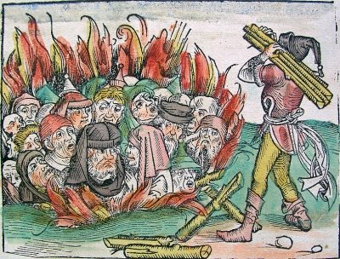
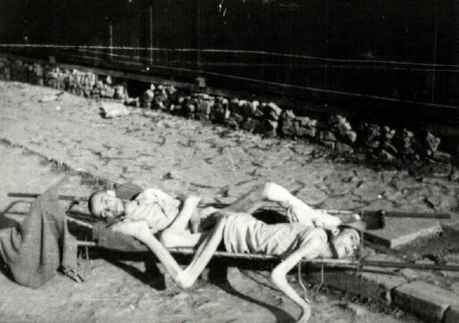
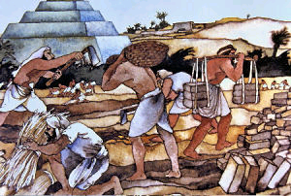
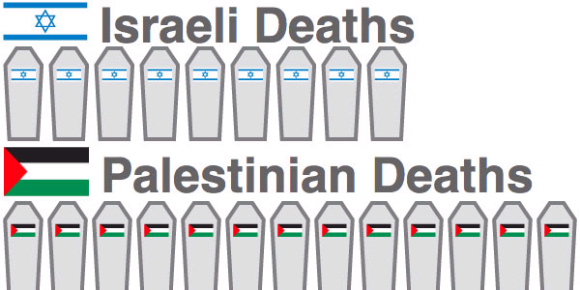
Conflicts with Judaism
From the beginning, Jews (Hebrews) were persecuted for their beliefs by many others
Hard Times:
Enslaved by Egypt (earliest slaves)
Blamed for the Black Plague that killed millions
In Russia, killed for being Jewish (Pogroms)
During WWII, Germans started genocide (tried to kill all Jews – killed 6 million)
Today: Israel (home of Jews) and Palestinians still fight over control over the “Holy Land” (JERUSALEM)
Through it all, Jews kept faith and survived.

