Slide 1
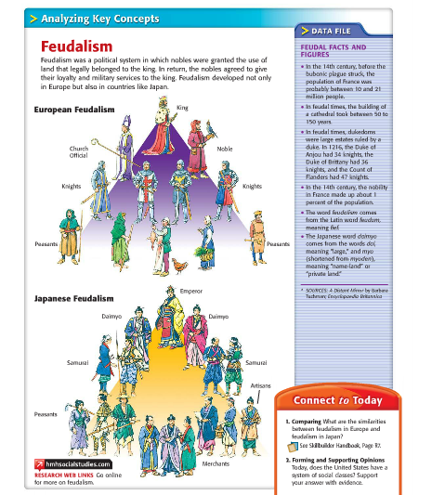
Bell Ringer

Slide 2
Feudalism in Europe

Slide 3
A New Social Order
Some enemies make agreements
  Example: Rollo was the head of the Viking army who had been plundering the Seine River valley for years. Charles the Simple (King of France) had little power. Charles gives Rollo a huge piece of French land. In return, Rollo swore a pledge of loyalty to the king.
Agreements like this continue to be made throughout Europe
Feudalism develops: system of governing and landholding based on rights and obligations.
Feudalism is a political system!

Slide 4
Manors: Economic System
Manor: Lord’s estate
Refer to the graphic organizer to understand relationships
Peasants rarely travelled more than 25 miles from the manor
Manor was usually only a few square miles of land
Typically consisted of a lord’s manor house, a church, and workshops
Self-sufficient community

Slide 5
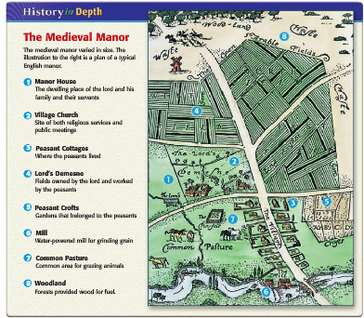

Slide 6
Life on a manor….
Peasants paid a tax on all grain found in the lord’s mill
Tax on marriage
All weddings had to have the lord’s consent
Peasant families had to pay the priest a tithe (church tax), this was 1/10 of their income
Serfs lived in crowded cottages
Average life expectancy was 35 years

Slide 7


Slide 8
Role of the Church
Christianity in the early Middle Ages
As society withered after the fall of Rome, Christianity was a constant
  Popes and church leaders would be able to use the power vacuum in Europe as a way to expand the power of Christianity throughout the Middle Ages
  Christianity was spread by:
    Missionaries who risked their lives to spread Christianity
    Clovis when he united the Franks through the use of Christianity
    Attacks by Muslims spurred people to convert to Christianity

Slide 9
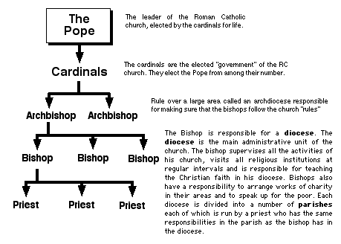
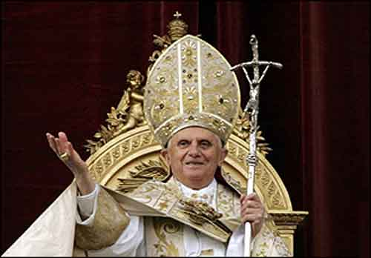
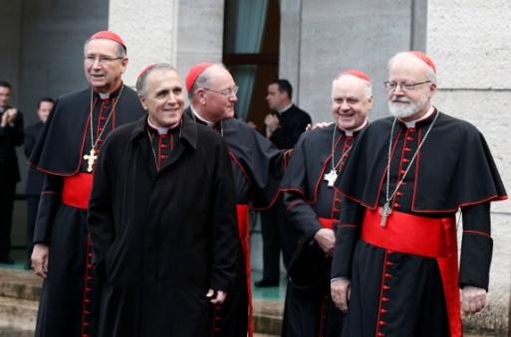
Structure of the Church
    The Church had different ranks of clergy, or religious officials
    Pope was head of Church
    All clergy, including bishops and priests fell under pope’s authority
    For most people, local priests served as the main contact with the Church

Slide 10
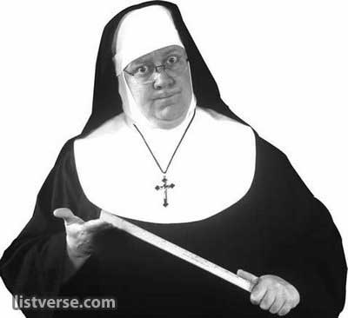
Power of the Church
  Religion as a Unifying Force
    Feudalism created division but Church teachings bonded them together
    Provided people with a sense of security and of belonging to a religious community
    Priests and other clergy administered sacraments (religious ceremonies)
    All were subject to canon law, or Church Law
Education
  The Church offered the only place to receive an education in the Middle Ages
  Monasteries were religious communities for men
  Men in monasteries were called monks and gave up possessions to devote a life serving God
  Women, or nuns, lived in convents
  St. Benedict wrote a book setting a practical set of rules for monasteries

Slide 11
Power of the Church
Far-Reaching Authority of the Church
  The Christian Church was becoming secular or worldly; extending its influence into all aspects of daily life especially politics
  Example of Secular: Pope Gregory I used church revenues to raise armies, repair roads, and help the poor
  The Church sought to influence spiritual and political matters when it crowned Charlemagne Roman Emperor in 800

Slide 12
Power of the Church
The Emperor Clashes with the Pope
  Church unhappy with use of lay investiture
  Lay investiture: Kings appointing church officials
  Pope Gregory VII banned lay investiture in 1075
  German Emperor Henry IV was furious with Pope Gregory VII
  Henry demanded the pope step down; Gregory excommunicated Henry
  Excommunication: taking away a person’s right of membership in the Church
  Henry approached Gregory for forgiveness and was forced to wait in the snow for 3 days
  Power of the Pope was much greater than German kings
  Future kings would attempt to exert power over the papacy (pope)
  These attempts would weaken German provinces in Europe

Slide 13
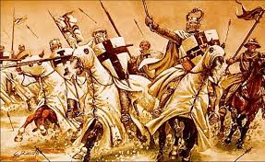
Result:
Throughout the Middle Ages, the power of the Church grew. It was able to provide unity, education, and strong empires even allowed popes to abandon morality and call for the bloody event known as The Crusades.

Slide 14
