Slide 1
Biotechnology
e-Reference for Living Environment

Slide 2
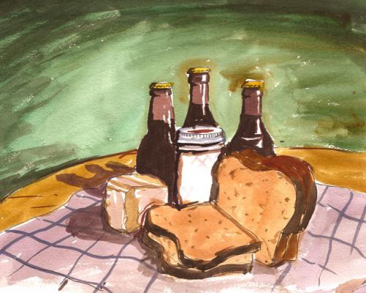
What is Biotechnology?
Biotech wasn’t always so technical
How can we benefit from biotech?
Overview- good notes + vocabulary
Biotech Cliffs notes
Oregon State Univ. course

Slide 3
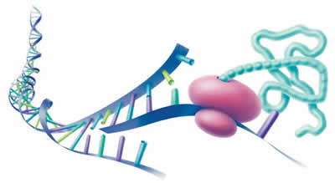
Genetic Engineering is born
With great power comes great responsibility
science ←→ tech ←→ society
History of Genetic engineering
Human genetics blog with links to GE and GM
First GM organism

Slide 4
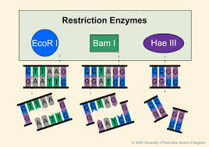
Restriction Enzymes
Without enzymes, DNA tech is not possible
Restriction Endonuclease- McGraw Hill animation
dna learning center animation
How they work

Slide 5
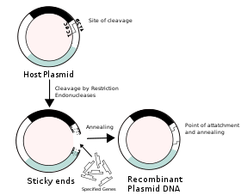
Recombinant DNA
How to genetically modify an organism- animation
Notes with good pictures
List of rDNA products for humans
Video (no sound)
Insulin for Diabetics
from Wikipedia→

Slide 6
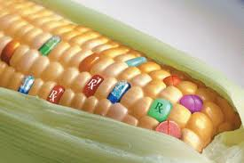
GM foods
Rewards and Risks of GM foods
Top 10 GM foods
Want to avoid GMO foods?

Slide 7
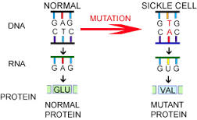
Genetic Diseases
sickle cell anemia
cystic fibrosis
Tay Sachs
Huntington's Disease
Phenylketonuria (PKU)
muscular dystrophy

Slide 8
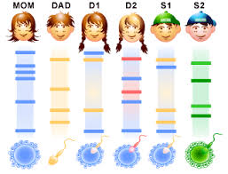
DNA fingerprinting
Q & A with Dr. Weir
PBS- Make your own DNA fingerprint (interactive)
Animation
Real life apps

Slide 9
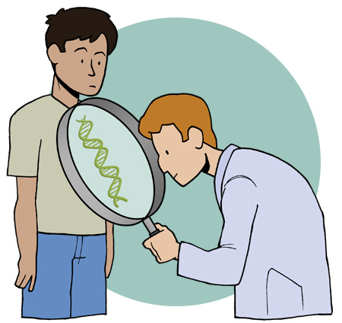
Genetic Screening
brief primer on genetic testing
Genetic testing FAQs
for parents (audio)
pros and cons
hunting for sickle cell

Slide 10
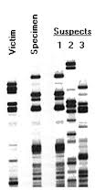

CSI- forensics
Which suspect was at the scene of the crime?

Slide 11
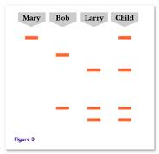
Paternity testing
Larry or Bob?

Slide 12
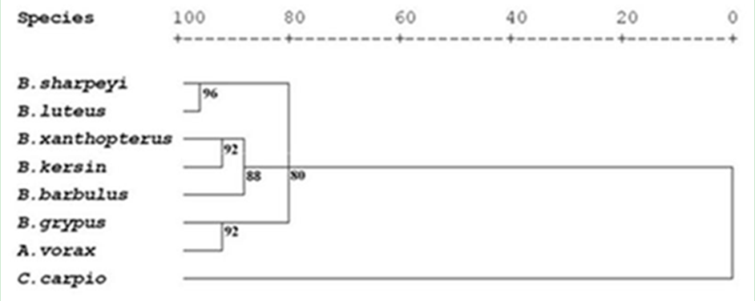
Studying evolutionary relationships
DNA fingerprinting can be useful in determining evolutionary history and taxonomic relationships. This is the evolutionary science of Systematics.
Fish Family tree study

Slide 13
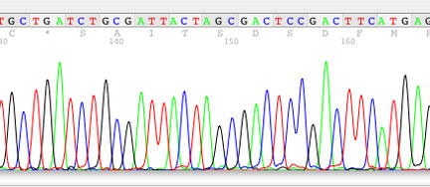
DNA sequencing
The base sequence of DNA cannot be seen… but it can be chemically determined.
JKimball describes Sanger Method
picture of DNA sequence data

Slide 14
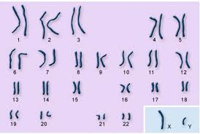
The Human Genome Project
What's a genome?
HGP FAQs
The payoff
Chromosome Atlas- what is your favorite gene

Slide 15
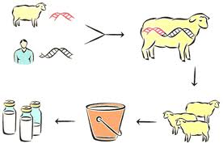
Pharming?
Pharmacy + Farming = Pharming
Wikipedia
Plant manufactured proteins (PMP)
List of animal manufactured proteins
Note: don’t confuse pharming (genetics) with pharming (internet advertising)

Slide 16
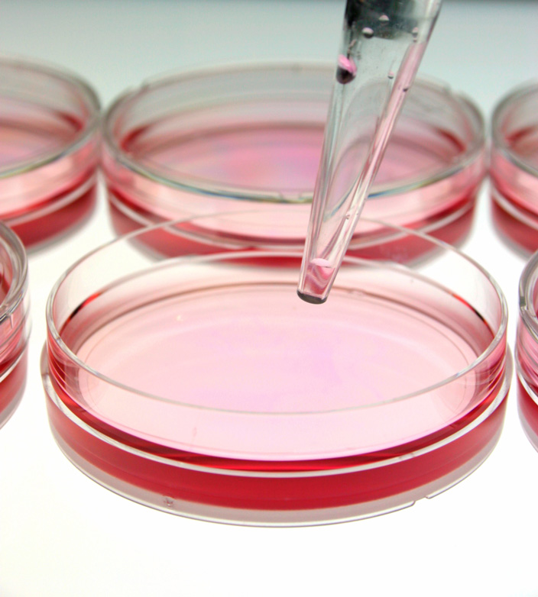
Gene Therapy
Can you add genes to your body? Maybe.
What is gene therapy?
How does GT work?
Tools of the trade (i.e. vectors)
Interactive case study
Wins and Loses
A medical promise
Fact sheet

Slide 17
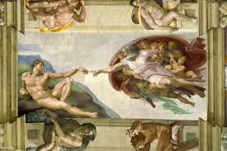
Isn’t this “playing God?”
ELSI- the Ethical, Legal, and Social Implications of biotechnology
A framework for ethical considerations of biotech
Concerns over animal cruelty
Top 5 concerns
Bioethics and Us

