Slide 1
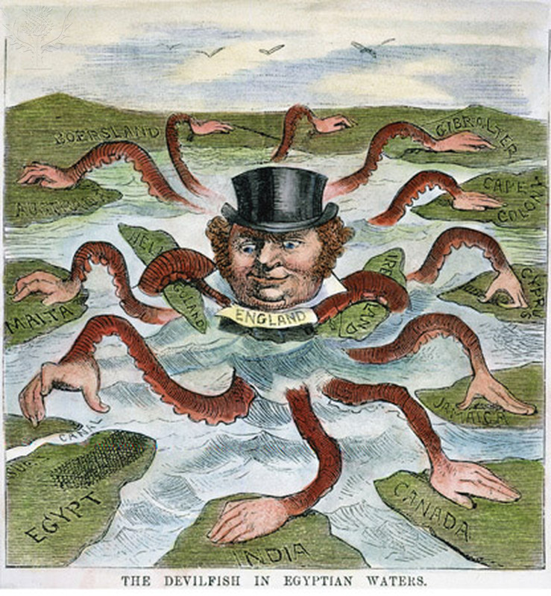
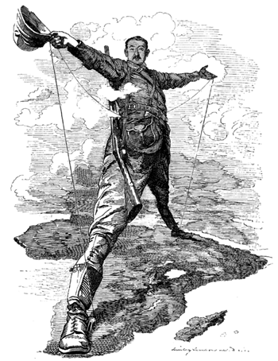
New Imperialism
New Imperialism: Characterizes a period of colonial expansion by European powers, the United States, and Japan during the late 19th and early 20th centuries. The period featured an unprecedented pursuit of overseas territorial acquisitions.

Slide 2
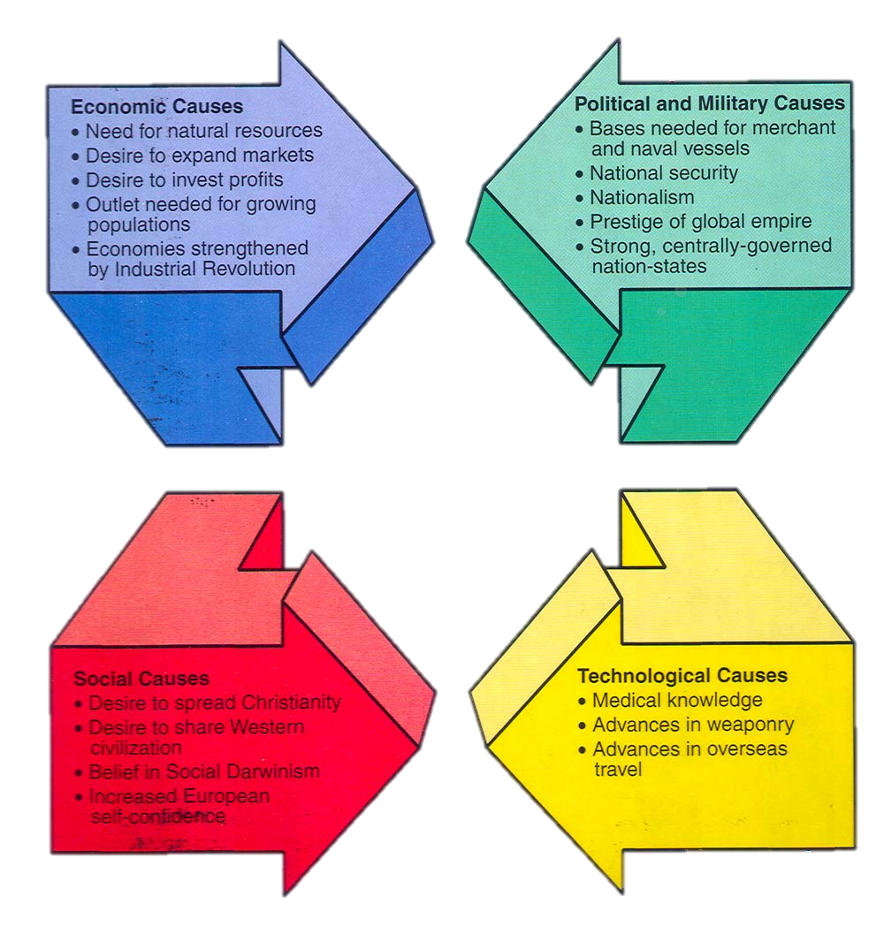
Causes of New Imperialism (1870 - 1914)

Slide 3
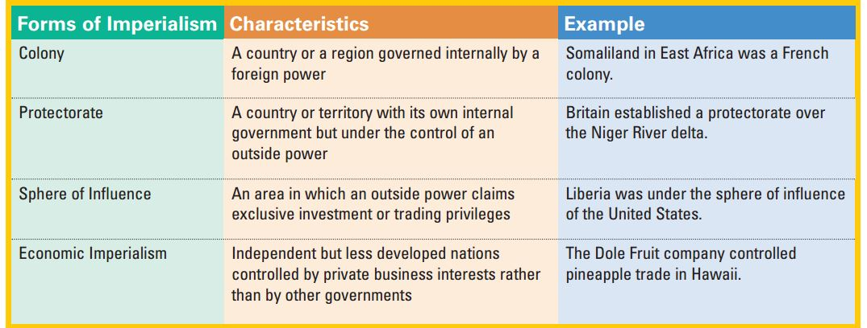
Forms of Imperialism

Slide 4
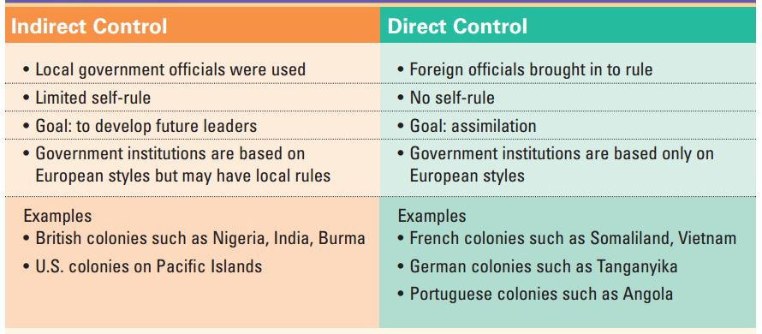
Management Methods of Imperialism

Slide 5
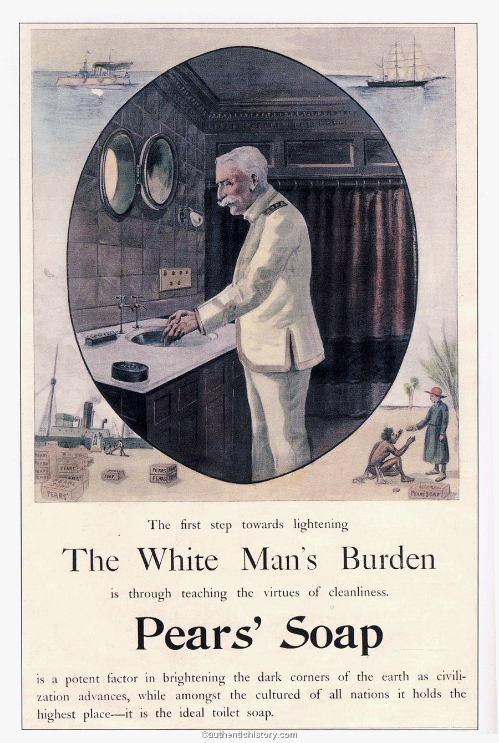
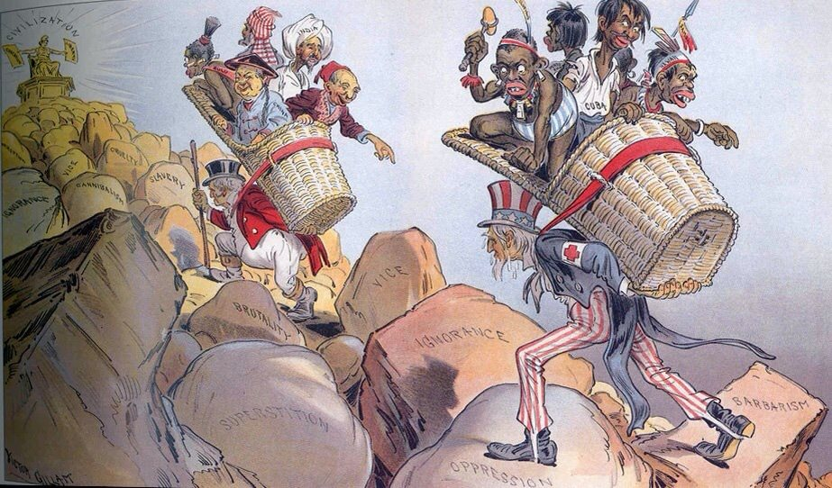
White Man’s Burden

Slide 6
“The White Man’s Burden” Kipling’s Hymn to U.S. Imperialism
Take up the White Man’s burden—
No tawdry rule of kings,
But toil of serf and sweeper—
The tale of common things.
The ports ye shall not enter,
The roads ye shall not tread,
Go make them with your living,
And mark them with your dead.
Take up the White Man’s burden—
And reap his old reward:
The blame of those ye better
The hate of those ye guard—
The cry of hosts ye humour
(Ah slowly) to the light:
"Why brought ye us from bondage,
“Our loved Egyptian night?”
Take up the White Man’s burden—
Ye dare not stoop to less—
Nor call too loud on Freedom
To cloak your weariness;
By all ye cry or whisper,
By all ye leave or do,
The silent, sullen peoples
Shall weigh your Gods and you.
Take up the White Man’s burden-
Have done with childish days-
The lightly proffered laurel,
The easy, ungrudged praise.
Comes now, to search your manhood
Through all the thankless years,
Cold-edged with dear-bought wisdom, The judgment of your peers!
Take up the White Man’s burden—
Send forth the best ye breed—
Go send your sons to exile
To serve your captives' need
To wait in heavy harness
On fluttered folk and wild—
Your new-caught, sullen peoples,
Half devil and half child.
Take up the White Man’s burden—
In patience to abide
To veil the threat of terror
And check the show of pride;
By open speech and simple
An hundred times made plain
To seek another’s profit
And work another’s gain.
Take up the White Man’s burden—
The savage wars of peace—
Fill full the mouth of Famine
And bid the sickness cease;
And when your goal is nearest
The end for others sought,
Watch Sloth and heathen Folly
Bring all your hope to nought.
Source: Rudyard Kipling, “The White Man’s Burden: The United States & The Philippine Islands, 1899.”

Slide 7
