Slide 1
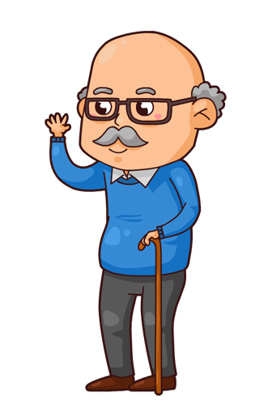
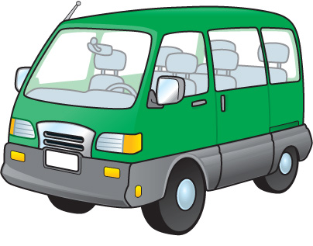
Papa’s Van
By Marie Ciota
From The Mindful Garden of Verses

Slide 2
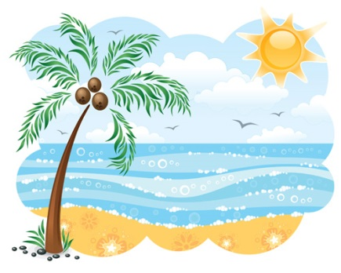


It’s Friday night and I’m happy as can be.
Would you like to know why? Well, listen to me.
Tomorrow my brothers and I are going to the shore.
We haven’t been there in a year or more.
We’ll all pile into my Papa’s van.
He really is such a great old man.
We’ll spend the whole day being sandy and wet.
And won’t come home till we see the sunset.

Slide 3
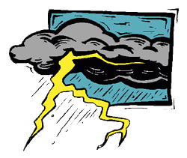
It’s Saturday night and I’m happy as can be.
Would you like to know why? Well, listen to me.
It rained all day long and there was even thunder.
Why am I happy then? You may ask and wonder.
My brothers and I went to Papa’s and helped work on his van.
He really is such a great old man.
We spent the whole day being grimy and covered with dust.
And didn’t come home till our mom said we must.

Slide 4


I don’t think it matters if there is rain or sun.
I think what matters is being able to have fun.

