Slide 1
BOUND BROOK
SCHOOL DISTRICT
2024-2025
BUDGET PRESENTATION
Presented by:
Dr. Alvin L. Freeman, Superintendent of Schools
Ms. Robyn Griffin, Director of Curriculum and Instruction
Mr. Michael C. Gorski, CPA, Business Administrator/ Board Secretary
Ms. Kristine Lee, CPA, Assistant Business Administrator/Grants Mgr.

Slide 2
Members of the Board of Education
Mr. Richard Jannuzzi, Board President
Mr. Michael Bal, Board Vice President
Mr. Roger Zupko
Ms. Lisa Guzzino
Ms. Joanna Musson
Mr. Gagandeep Minhas
Mr. Sidney Dawson
Ms. Therese Sue High
Mr. Donald Vollmer
Ms. Jennifer Carlton, South Bound Brook Representative
Student Board Representatives
Mr. Emanuel Munoz Cordero

Slide 3
Operations Committee
Mr. Roger Zupko, Chairperson
Mr. Donald Vollmer
Mr. Richard Jannuzzi
Ms. Lisa Guzzino
Ms. Jennifer Carlton

Slide 4
Mission Statement
The Bound Brook Public Schools is a supportive multicultural community that provides an innovative and academically challenging educational program while offering a variety of extracurricular and social opportunities that encourage life-long learning and citizenship.

Slide 5
Vision Statement
Our vision is to provide a comprehensive educational program that will:
Promote citizenship through tolerance and diversity;
Prepare graduates for their educational and vocational choices in life;
Develop motivated, life-long learners;
Provide opportunities for students to be users of technology;
Encourage finders and users of data to develop problem solving skills;
Provide educational opportunities both within and outside the classroom;
Provide opportunities for the community to be a resource and learning center;
Challenge students educationally;
Provide a positive learning environment;
Recognize student successes; and
Promote academic and personal growth.

Slide 6
Board Goals
Goal 2023-24: To develop a new five-year Strategic Plan to provide a framework that will shape and guide the District moving forward.

Slide 7
District Goals
Goal #1 2023-24: To continue to create a safe environment where students and staff feel comfortable taking risks and working collaboratively toward a common goal.
Goal #2 2023-24: To fully utilize data through professional development to inform instruction and strengthen student achievement.

Slide 8
Executive Summary
The Bound Brook School Budget for the 2024/2025 school year was developed within specific parameters set forth by the Board of Education:
To prepare a comprehensive budget, within revenue constraints:
  Meeting the needs of 45 projected additional students.
  Allocate an increased amount of resources to Programs and Instruction.
  Expansion of curriculum programs and staffing to broadly improve student performance by New Jersey Student Learning Standards and Performance Data.
  Budget for Capital Outlay Projects required for health & safety.
  Budget for inflation especially in the areas of Transportation-contracted routes, Maintenance- contracted janitorial services, and Energy.
  To develop a budget that supports an educational program that meets the learning needs of ALL students while giving strong consideration to fiscal efficiency and the impact on the local taxpayer.
The budget has been professionally constructed to afford every student an opportunity for an exemplary education by well-trained, committed staff in a safe and secure environment. Opportunity is made available through a comprehensive curriculum which offers diverse course offerings and co-curricular clubs and activities. We believe that our proposed budget continues to become more efficient as evidenced by a successful County Budget Efficiency Review.

Slide 9
Executive Summary- Continued
Under-Adequacy Status Improvement.
Fund | 2022-2023 | 2023-2024 | 2024-2025
General Fund Levy | $13,082,282 | $13,670,661 | $13,965,571
Equalization Aid | $22,232,004 | $27,742,287 | $31,381,837
Total Budget Adequacy Spending | $35,314,286 | $41,412,948 | $45,347,408
District Adequacy Budget | $38,741,501 | $42,943,601 | $46,782,357
Under Adequate Amount | ($3,427,215) | ($1,530,653) | ($1,434,949)
Adequacy is a state model which calculates what would be the necessary funding level to provide a “thorough and efficient” education to every pupil in the district.

Slide 10
What Is The Budget Creation Timeline?
Establishment of Budget Philosophy
Enrollment Patterns and Projections
Review of Staffing Needs
Budget Development
Budget Defense Rounds
Governor’s Budget Address
Award of State Aid
Adoption of Tentative Budget
Public Hearing

Slide 11
Where Does The Money Come From ? 23/24

Slide 12
Dollars and Cents
Sources of Revenue
See handout A

Slide 13
General Fund Tax Levy
23/24 Adjusted Tax Levy with $13,965,571
Enrollment Adjustment
Adjustment for Healthcare $-0-
24/25 Tax Levy Cap 13,965,571
23/24 Tax Levy Cap 13,670,661
Increase in General Fund Levy $294,910
Note: No prior years banked cap has been appropriated.
The optional Health care cap adjustment of $269,843, which would have increased cap, and taxes, was not applied to the levy and it will carry-over as banked cap.

Slide 14
School Funding Law NJ S-2 Modification of School Law SFRA 2008
Bill Summary:
The "School Funding Reform Act of 2008" (SFRA), P.L.2007, c.260, was enacted with the purpose of determining the amount of State school aid each school district would receive based on the needs of the student population and local fiscal capacity. However, the SFRA has not been fully implemented since the 2008-2009 school year, resulting in school districts receiving levels of State school aid inconsistent with their current circumstances. This bill makes two modifications to the SFRA with the intent of realigning the amount of State aid provided to school districts with their current needs. First, under the provisions of the SFRA, a school district's State aid may not increase from one year to the next by more than the State aid growth limit (10 percent for school districts spending above their adequacy threshold, and 20 percent for school districts spending below that threshold). The bill eliminates that cap beginning in the 2018-2019 school year. Second, the bill transitions school districts towards the amount of State aid that the school district would receive in the absence of the State aid growth limit and the adjustment aid that the school district received under the SFRA. The Phase in period for this law is over a six year period beginning in 2019-2020 and concluding in year 2024-2025.

Slide 15
Key Facts On State Aid
There are two types of State Aid:
Equalization Aid- Distributed by property wealth and income levels Bound Brook has been awarded $31,381,837 in this category.
Categorical Aid- Awarded by number of students who qualify for each individual aid category. Bound Brook qualifies for a few categories. but is limited in award due to over adequacy status.
General Fund State Aid is 64% of our total revenue to support the school budget. The District has been underfunded by the State and has been a beneficiary of the redistribution of school aid under S-2.

Slide 16
General Fund State Aid
2023/2024 2024/2025
Equalization Aid $27,742,287 $31,381,837
Categorical Aid:
Special Education Aid 1,574,377 2,241,787
Security Aid 784,650 1,049,044
Transportation Aid 124,699 155,401
Preschool Education Aid 1,602,405 2,050,796
School Choice Aid 86,598 126,344
Debt Service Aid 881,139 886,788
SDA Assessment for funding (9,836) (9,836)
Total $32,786,319 $37,882,161
Increase in General Fund State Aid $5,095,842
Percent increase vs. last year +16%

Slide 17
Where Does The Money Go?

Slide 18
Appropriations Detail
See handout B

Slide 19
Budget Appropriations Considerations
Budgets are driven by student enrollment
Enrollment Data from ASSA except projected year.
* Projected from Ross Haber Associates February 2023

Slide 20
What Programs Are In This Budget?
Curriculum and Instruction
For the 2024-25 school year, our focus is on enhancing curriculum and programs across all levels.
Enhancing curriculum and programs for the 2024-25 school year.
Procuring new and updates materials for Science, History, and Math courses at the high school level.
Ensuring alignment of curriculum maps with the latest ELA and Math Standards.
Extending updates to encompass ELA in grades K-8, ESL in grades K-12, French in grades 3-6, and 9-12, Spanish in grades 7-12, as well as high school Science, Math, Social Studies, and ELA.
Investing in academic coaching for teachers, including ESL and Bilingual coaches for grades K-6 and 7-12, instructional coaches for grades K-1, and Math coaching for grades 9-12.
Hiring ELA and Math academic interventionists for grades 9-12 to provide additional academic support for high school students.
Addition of a K-2 Gifted and Talented teacher.
Enhancements to summer and after-school enrichment opportunities for all students.

Slide 21

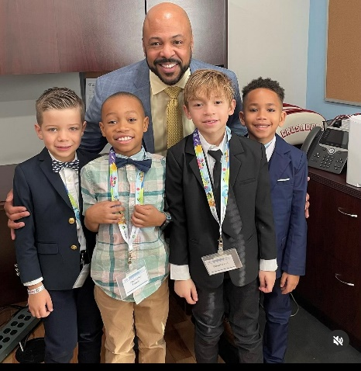

What Programs Are In This Budget?
Curriculum and Instruction
Additional Staff:
ELA Academic Interventionist 9-12
Math Academic Interventionist 9-12
Instructional Coach K-1
Gifted & Talented K-2
ESL/Bilingual Instructional Coach K-6
ESL/Bilingual Instructional Coach 7-12
Bilingual Math Teacher High School
PE Teacher High School
Bilingual LLD Aide 3-6
Resource Support Teacher (Bilingual preferred) Elementary
Bilingual Learning Consultant or Psychologist
Textbooks/Programs
HS Science: Physical Science, Biology, Chemistry, AP Environmental Science
HS History: AP US History, AP World History, AP Government, World History, US History
HS Math: Geometry, Algebra 1, Algebra 2
Curriculum Rewriting, Revisions, Updates:
K-8 ELA, K-8 ESL, 3-6 French, 7-8 Spanish, HS Science, HS Math, HS Social Studies, HS English, HS ESL, HS Spanish, HS French

Slide 22
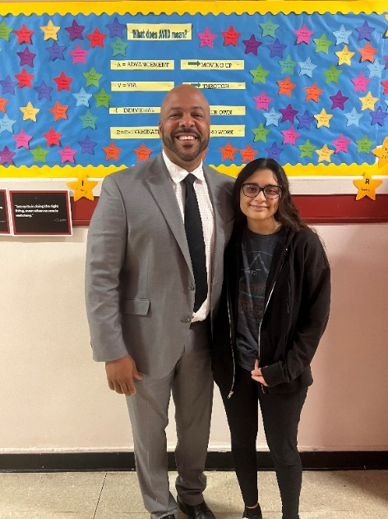
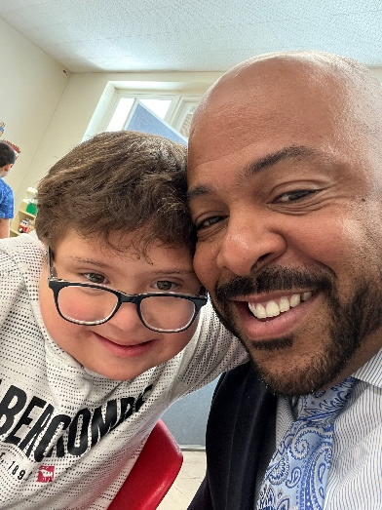
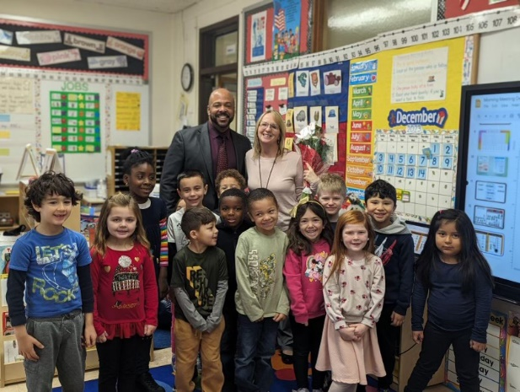
What Programs Are In This Budget?
Curriculum and Instruction
Maintaining 2020 New Jersey Student Learning Standards
Maintaining Curriculum Writing and Mapping
Multi-tiered Systems of Support
In-School, After-School, and Summer Support for Students
Textbook Replacement/Adoptions
Technology Replacement/Additional Online Programs
Gifted and Talented
English Language Learners
Assessment to Guide Instruction
LinkIt Data warehouse and Benchmarks
DRA3
Dibels
Key 3 Math
IXL
Professional Development
Professional Memberships
AVID

Slide 23
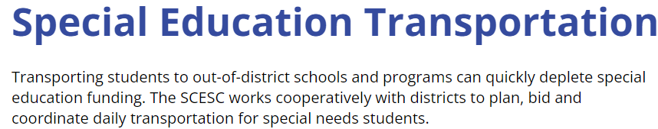

What is Included in
This Budget
Transportation Costs

Slide 24
What Is Included In This Budget
Capital Improvements & Equipment –
High School bathroom renovations & design $1,750,000
High School Field house paving $150,000
High School Flooring $2,200
High School Field Grooming Machine $40,000
High School Servers, Upgraded Cafeteria Sound System,- Retractable Backboards and Padding, Instructional Teaching Monitor $133,800
Snow Removal and Grounds Tractor $75,000
Replacement Truck $100,000
Security Equipment $46,000
IT Equipment (E-rate) $350,000
Community bleachers $ 80,000
Community two scoreboards $15,000
Community Retractable backboards and padding $70,000
Lafayette new sign, gate, and room patrician $54,600 Smalley new instructional copier $25,928
Smalley Travel AED $3,000
Lamonte Ipad’s, Interactive Panels $30,950
                Total $2,926,478

Slide 25
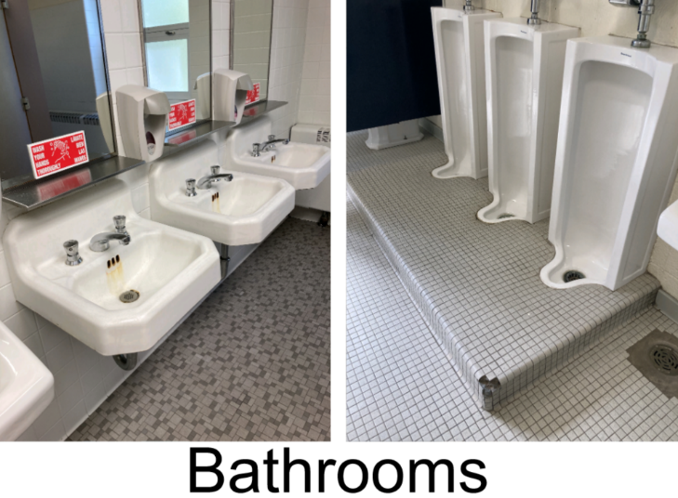

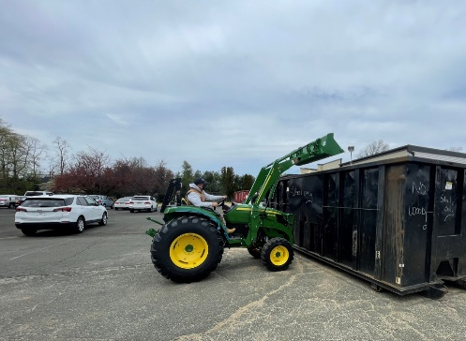
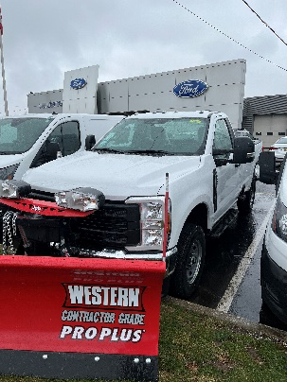
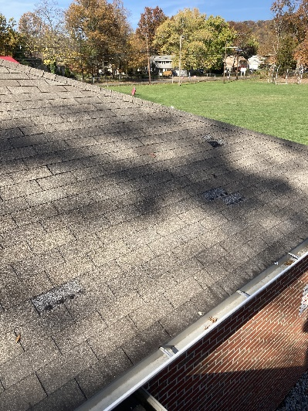
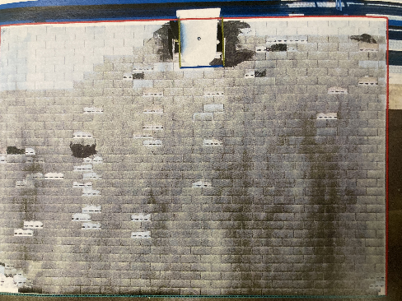
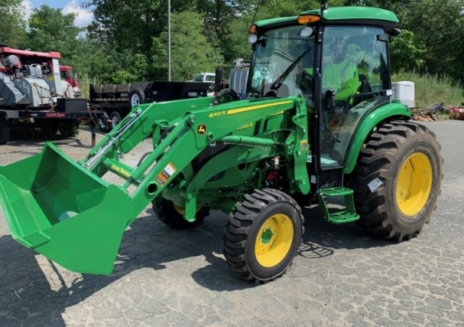
Aging Facility Needs
New Equipment
Roof

Slide 26
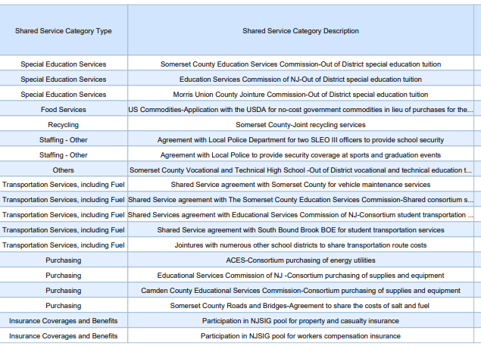
Cost Savings From Shared Services

Slide 27
What factors influence the tax rate?
State Aid
Fund Balance Applied
Ratables
Increased Student Enrollment effect on Appropriations

Slide 28

School District
Average Assessed Tax Levy Impact
2023/2024 School Tax Rate 1.20%
2024/2025 School Tax Rate 1.165%
The average assessed home of $418,501 will experience a 2024/2025 School Tax decrease of approximately $140.

Slide 29

Thank You To All Who Contributed
To Developing This Budget

