Slide 1

2015 Year End Celebration
Thank you for another successful year in the INDIAN NATION!

Slide 2
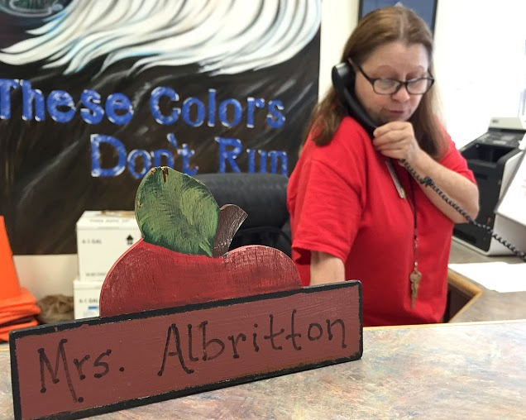
Janet Albritton, 26 years

Slide 3
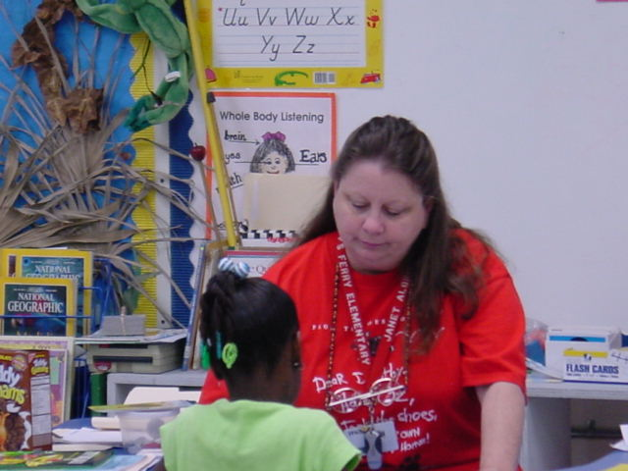
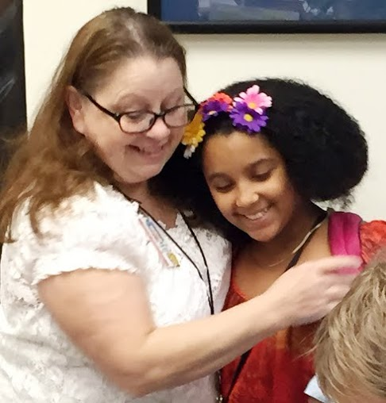
Janet Albritton, 26 years

Slide 4
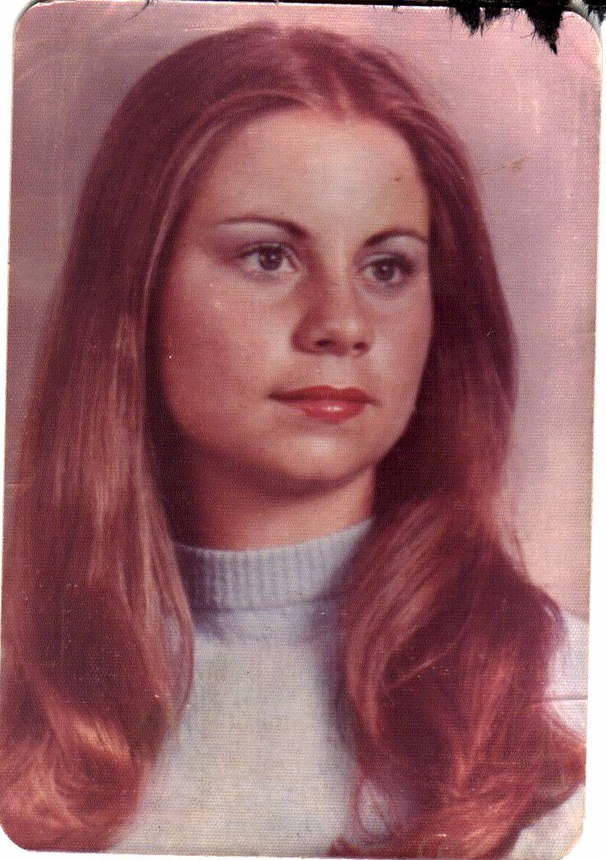
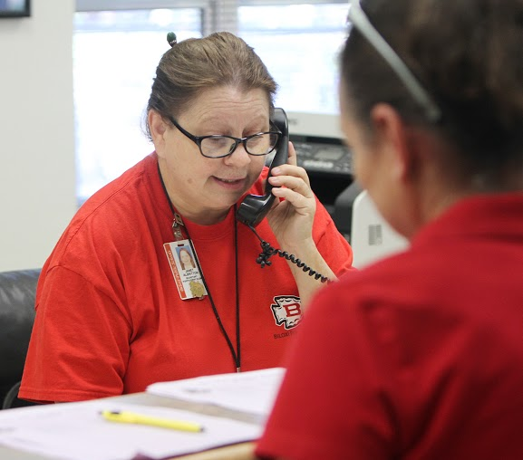
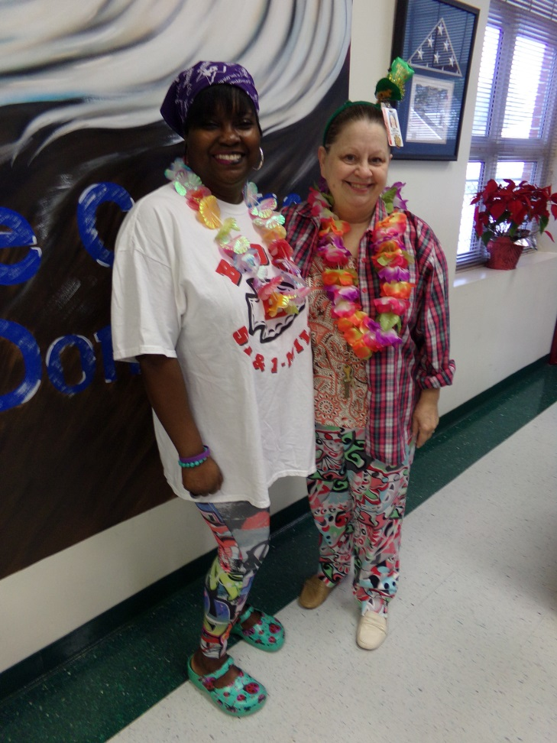
Janet Albritton, 26 years

Slide 5
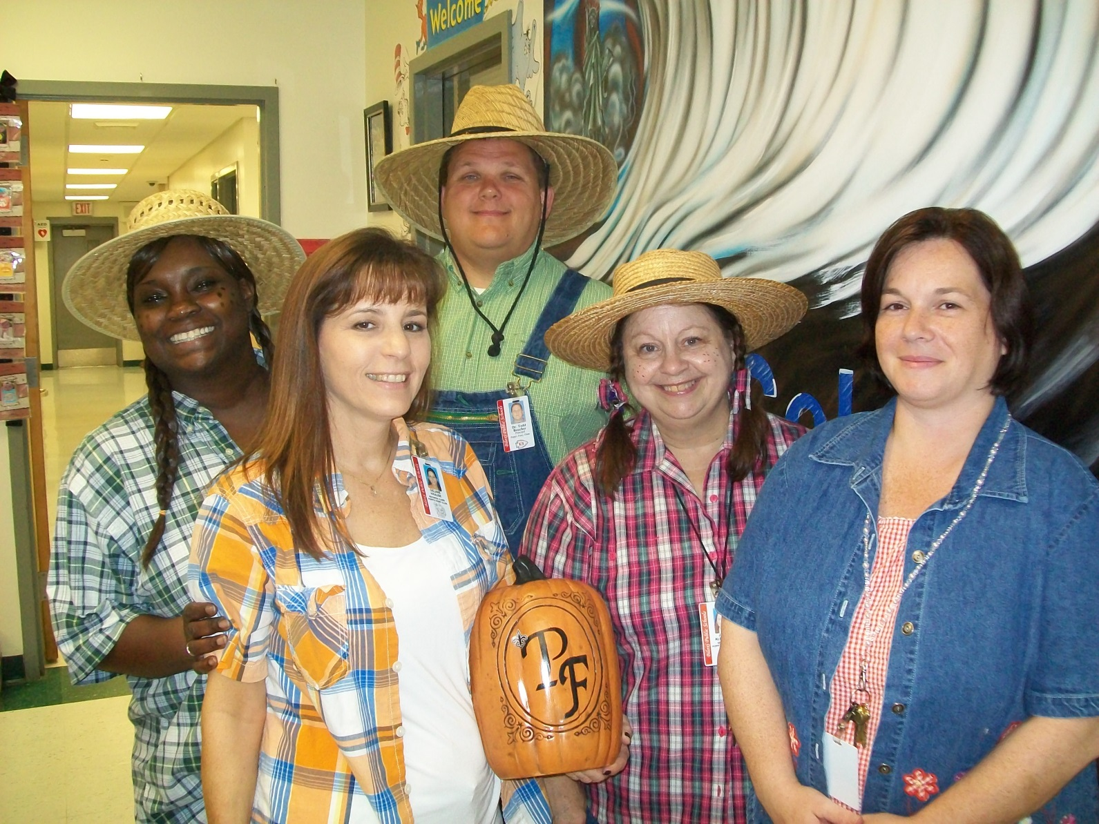
Janet Albritton, 26 years

Slide 6
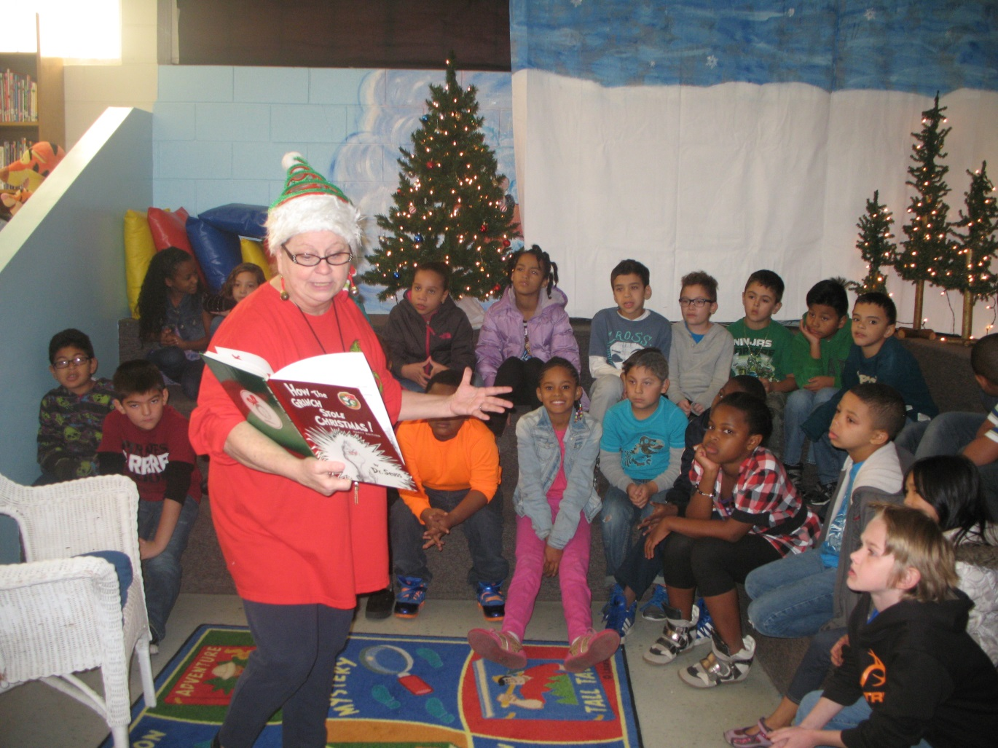
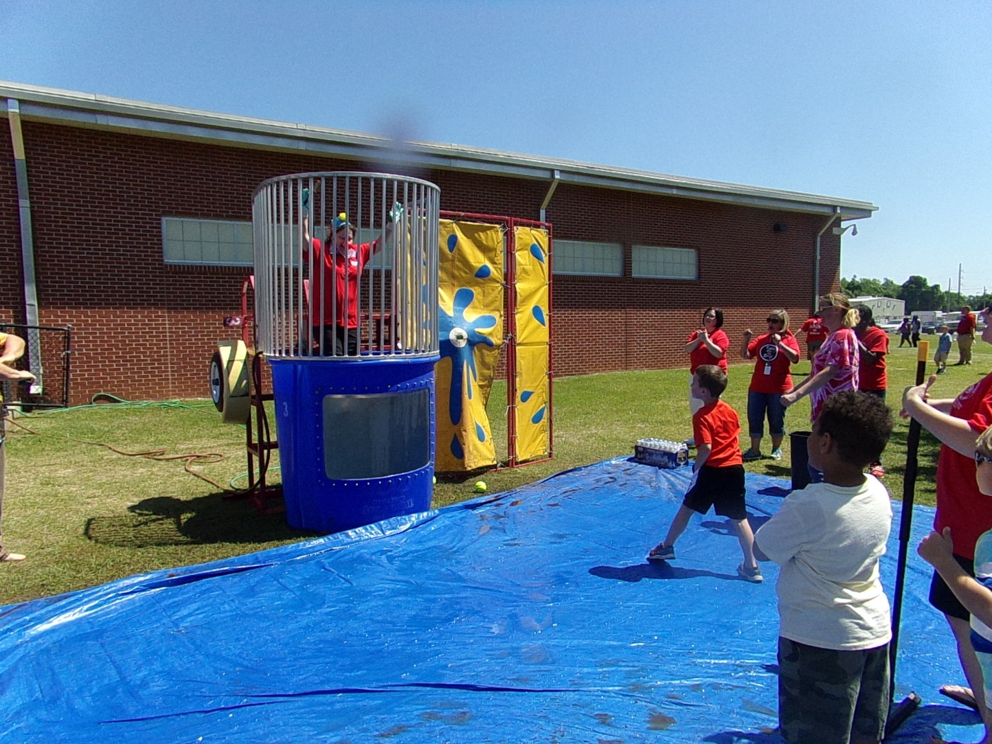
Janet Albritton, 26 years

Slide 7
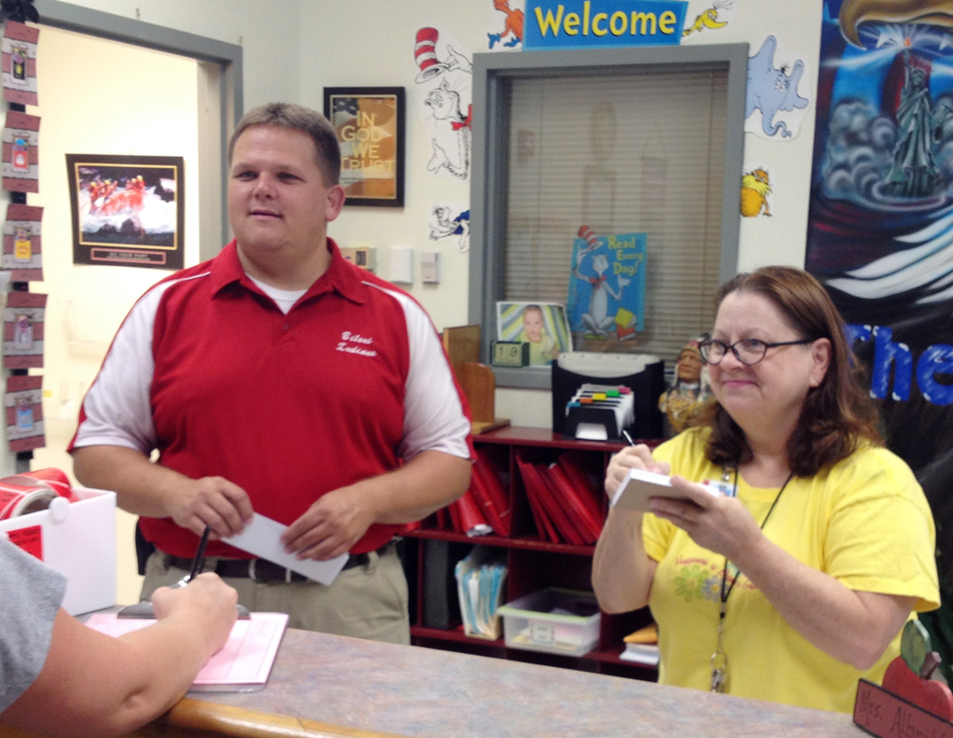
Janet Albritton, 26 years

Slide 8
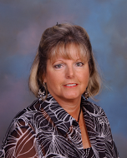

Diane Allen, 22 Years

Slide 9

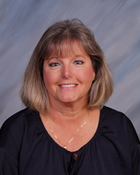
Diane Allen, 22 Years

Slide 10
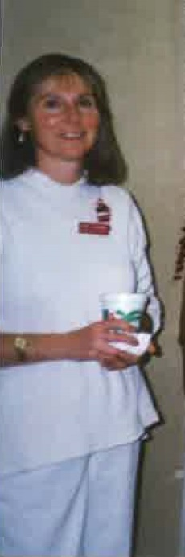
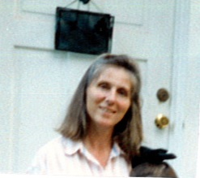
Janet Boehmer, 19 Years

Slide 11
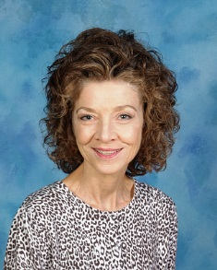
Patty Comer, 30 Years

Slide 12
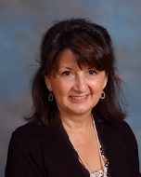
Donna Joachim, 18 Years

Slide 13
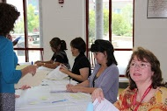
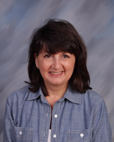
Donna Joachim, 18 Years

Slide 14
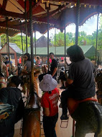
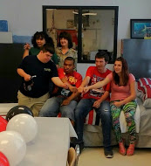
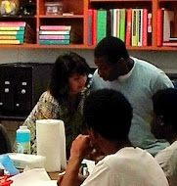
Donna Joachim, 18 Years

Slide 15
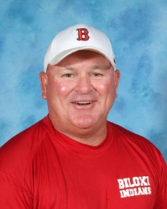
William Leach, 20 Years

Slide 16
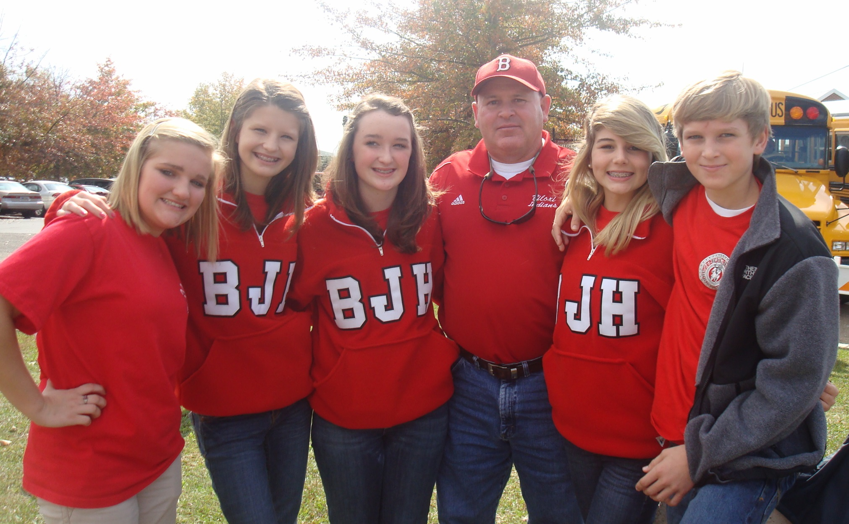
William Leach, 20 Years

Slide 17
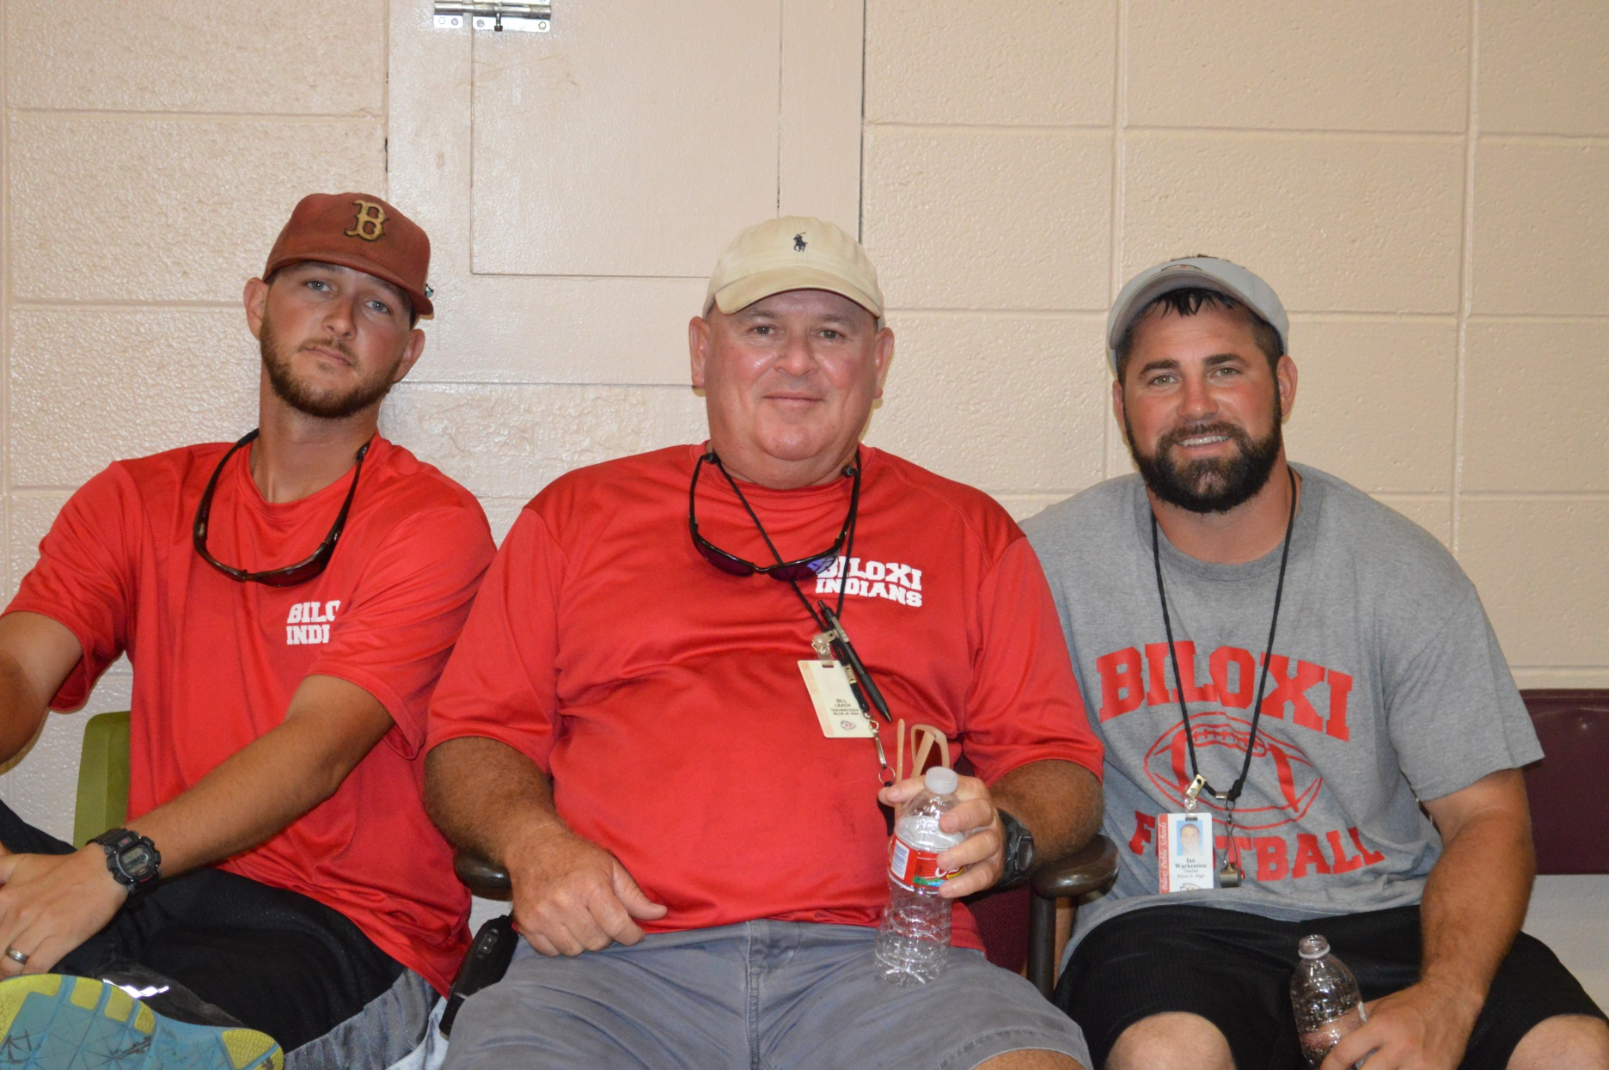
William Leach, 20 Years

Slide 18
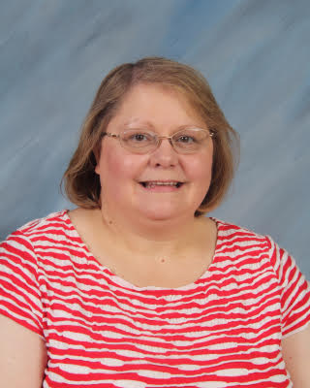
Marilyn Lee, 28 Years

Slide 19
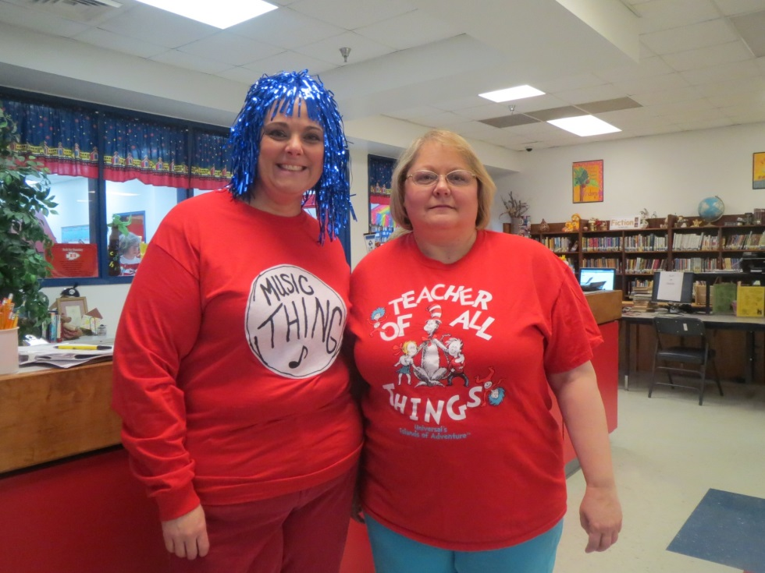
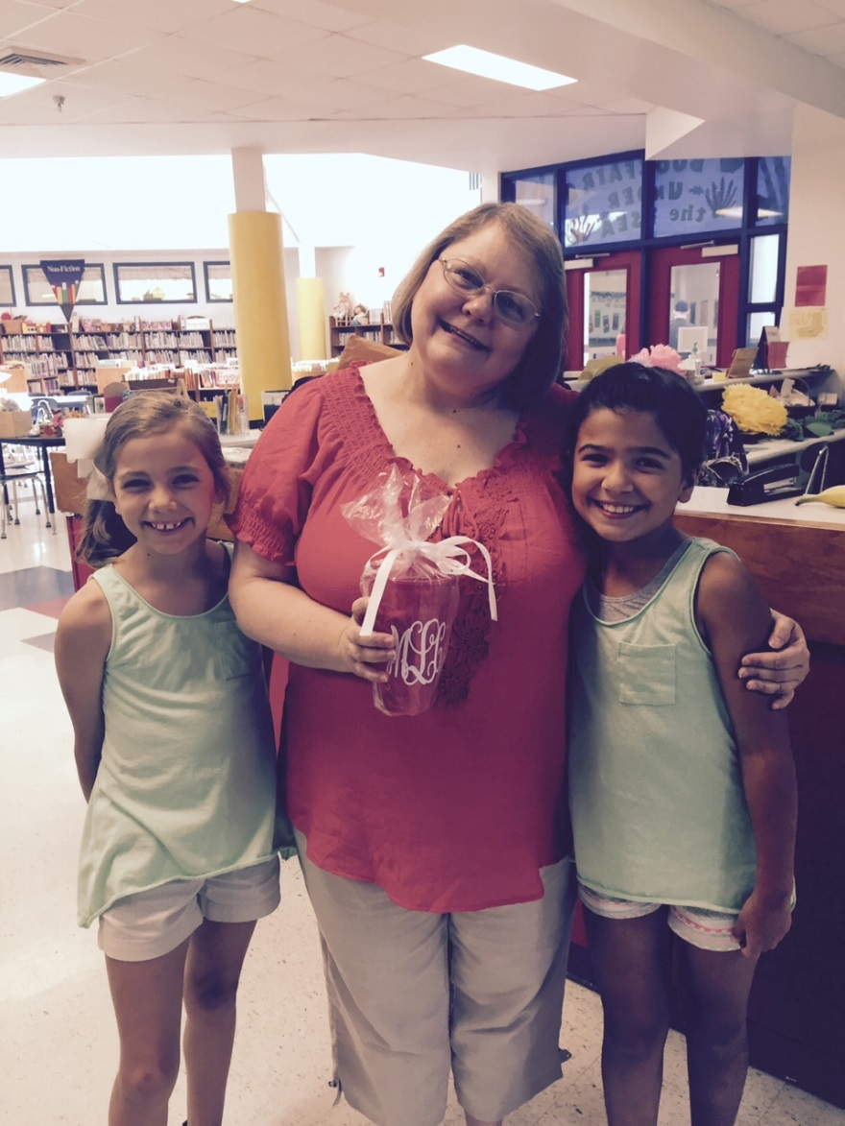
Marilyn Lee, 28 Years

Slide 20
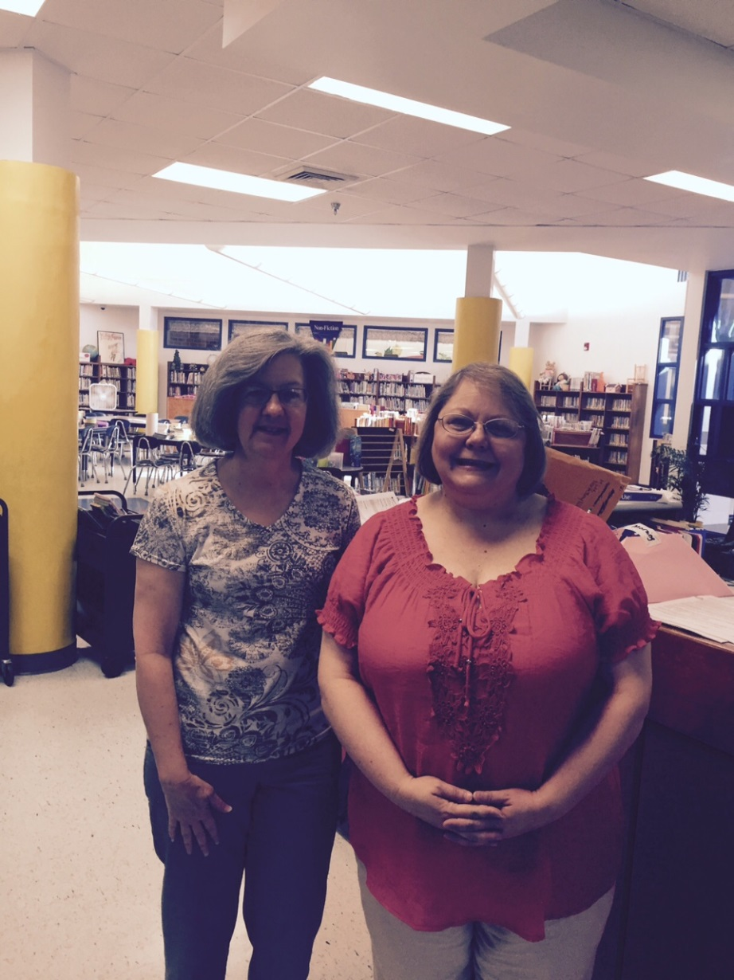
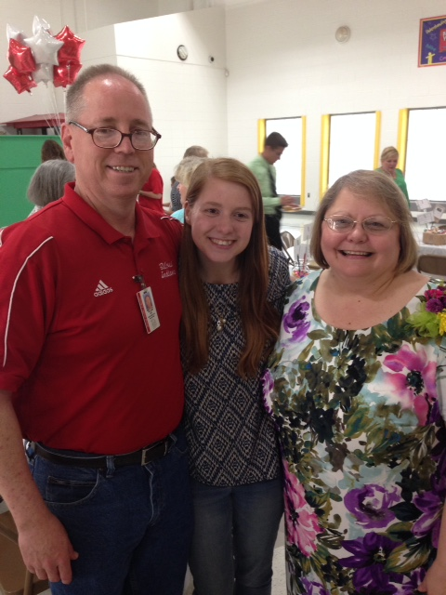
Marilyn Lee, 28 Years

Slide 21
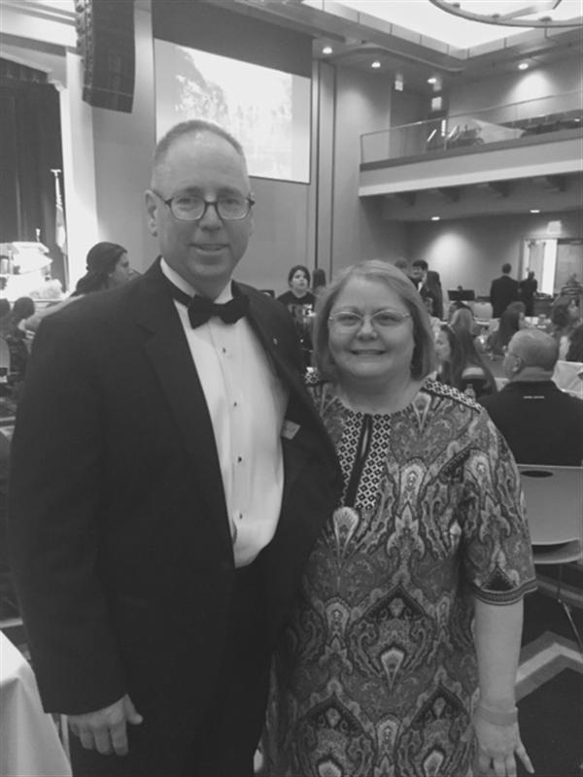
Marilyn Lee, 28 Years

Slide 22
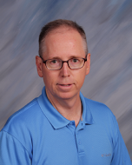
Bill Lee, 28 Years

Slide 23
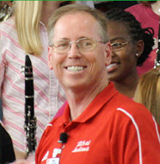
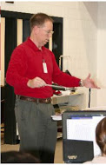
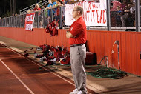
Bill Lee, 28 Years

Slide 24
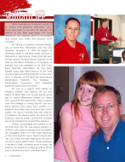
Bill Lee, 28 Years

Slide 25
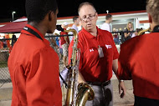
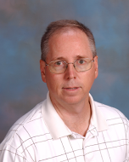
Bill Lee, 28 Years

Slide 26
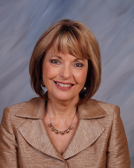
Pamela Manners, 28 Years

Slide 27
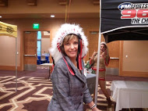
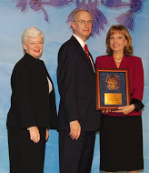
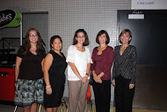
Pamela Manners, 28 Years

Slide 28
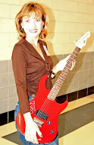
Pamela Manners, 28 Years

Slide 29
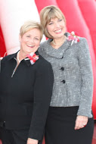
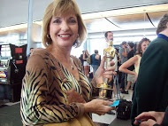
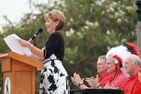
Pamela Manners, 28 Years

Slide 30
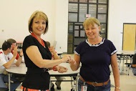
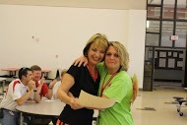
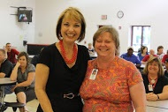
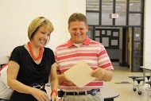
Pamela Manners, 28 Years

Slide 31
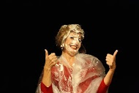


Pamela Manners, 28 Years

Slide 32




Pamela Manners, 28 Years

Slide 33

Terese Nicovich, 26 Years

Slide 34


Terese Nicovich, 26 Years

Slide 35


Terese Nicovich, 26 Years

Slide 36

Mary Ireson Pringle, 35 Years

Slide 37


Mary Ireson Pringle, 35 Years

Slide 38


Mary Ireson Pringle, 35 Years

Slide 39

Paula Rutland, 22 Years

Slide 40


Paula Rutland, 22 Years

Slide 41

Paula Rutland, 22 Years

Slide 42

Marianne Sherman, 16 Years

Slide 43


Marianne Sherman, 16 Years

Slide 44


Marianne Sherman, 16 Years

Slide 45

Cynthia White, 8 Years

Slide 46


Cynthia White, 8 Years

