Slide 1

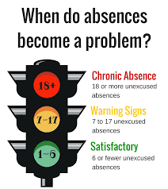
Attendance and Tardies
Excessive Tardies
Tardies equal missed learning
Can interrupt individual learning and other students’ learning
Can impact the student’s behavior, self esteem, and school success
Disrupts morning routine
Impacts important time for building classroom community & socialization
Some may miss interventions or special services that are scheduled first thing in the morning
We are here to help. Reach out if…
Your child has severe separation anxiety, and you’re worried that he/she may miss too much school
Your child has a major chronic health issue or COVID related
Your child misses more than 2 consecutive absences
Your child experiences the loss of an immediate family member
There’s a crisis that affects attendance such as homelessness
Call or email the Records Clerk or School Social Worker
When attendance becomes a problem…
3 absences: Parental Contact
5 absences: Must have a meeting in person with the Principal/Assistant, or School Social Worker. Reported to State Attendance Office.
10 or more: Intervention put in place, formal meeting required, and report made to Child Protective Services (CPS).
12 unexcused absences or more: student will receive a 50/F in applicable classes.
Absences
Parent Written Notes will only excuse 6 absences per academic year (3 parent notes per semester) Documentation must be turned in within 5 school days of the absence.
***Please include the student’s full name, teacher, the reason, date, and parent/guardian name***
Turn in excuses to the office or in your child’s folder

