Slide 1

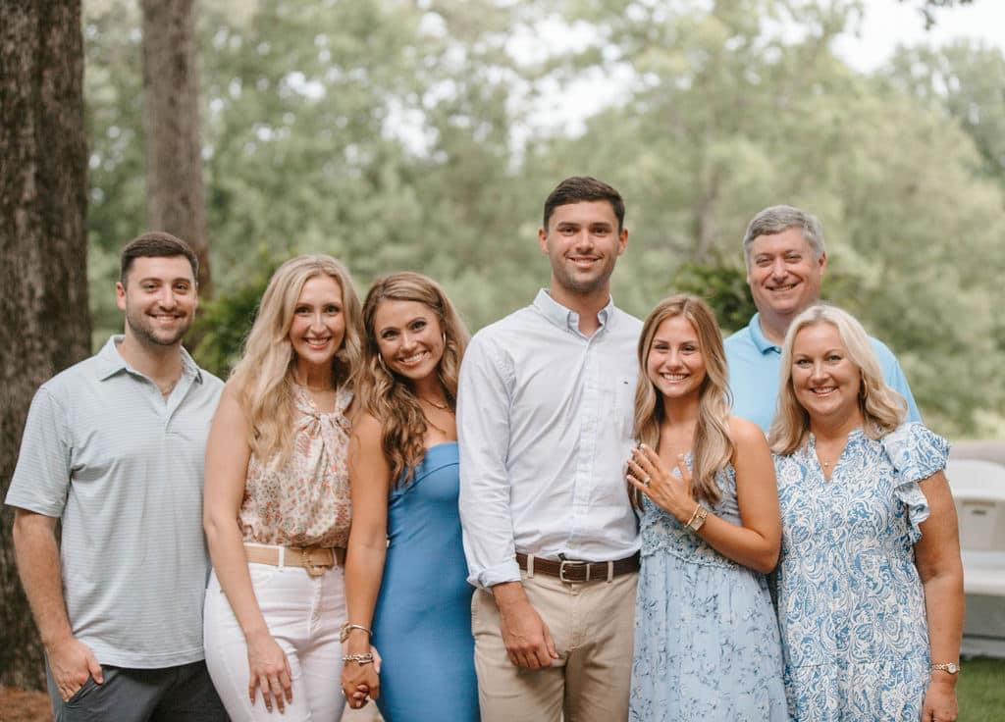
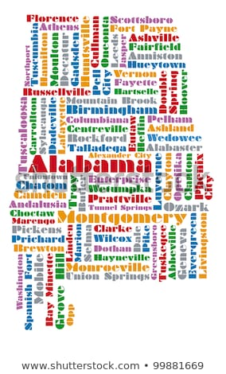


Mrs. Kaye Rhodes
A LITTLE ABOUT ME
Hello! Welcome to Third Grade! My name is Mrs. Kaye Rhodes. I am thrilled that your child is in my class this year. I taught 2nd grade for seven years and 4th grade for twelve years in Mississippi. This is my ninth year teaching third grade at Pick! I’m so proud to be a part of such a great community and awesome school!
MY HISTORY
I was born in Mobile and then moved to Monroeville, Alabama where I finished high school at Monroe Academy. In June of 1986, I began college at the University of Alabama. After college, I married Mike, and we moved to Brandon, MS for him to attend law school. We lived in MS for twenty-two years before moving back to Alabama.
We have three children. Our oldest son, Morgan, is married to Claire and they live in Birmingham. They are both in the medical field. My daughter, Victoria is a nurse. My youngest son, Matthew is a senior at the United States Military Academy in NY and plays football for Army.
MY FAVORITES
Food: Seafood
Movie: The Sound of Music
Book: Charlotte’s Web
Color: Red
Drink: Coke or Smoothie
Season: Summer
Sports: Football
Fast Food: Chick-fil-a
Music: Country
Hobby: Gardening & Crafts
Subject: Math
Store: Hobby Lobby
Dessert: Cheesecake
Snack: Ruffles and Ranch Dip
Restaurant: Mexican
Flower: Hydrangea
MY EDUCATION
In May of 1990, I received my Bachelors Degree in Interior Design and Marketing. Then in May of 1998, I graduated with another Bachelor’s Degree in Elementary Education from the University of Alabama. In December 2016, I earned my Master’s Degree in Educational Leadership from Arkansas State University, and last year a received my Specialist Degree in Reading.
CONTACT ME
Email: mkrhodes@auburnschools.org
Class Webpage: https://www.auburnschools.org/Domain/1656
Pick Elementary Phone #: (334) 887-2110
You may also write a note in your child’s planner, or send a
Class DOJO message.

