Slide 1
REOPENING ALVORD SCHOOLS
Continuity of Learning
2020-2021
Originally Presented to the Board and Community on June 25, 2020

Slide 2
PLAN PRINCIPLES
Adaptable
Responsive to the Conditions Changing
Informed by Public Health Guidelines
Informed by Stakeholders
Inequity are products of design. They can be redesigned.

Slide 3
Framework Equity. Access. Coherence.
The shared depth of understanding about the nature of this work.
Continuous Improvement and Monitoring and Communicating.
Reopening/Continuity of Learning goals are rooted in practical, not just philosophical, equity.
Notes:
This is related to the

Slide 4
TIMELINE
May 22, 2020 | Task Force Formed
June 5, 2020 | Task Force Assembles Focus Groups and Identifies Assumptions to Guide Work
June 19, 2020 | RCOE Releases Guidelines for Schools in Riverside County
June 20-29 | Focus Groups Meet
June – July 8 | Community Updates
July 9 | Board Study Session: Task Force Recommendations
July 10-15 | Special Meetings of the Board of Education TBD
July 16 | Regular Meeting of the Board of Education
Notes:
This is related to the

Slide 5
TASK FORCE FOCUS GROUP | FACILITATOR
Communications and Public Information | Alejandro Cisneros, Coordinator, Family Engagement
Curriculum and Instruction | Emily M. Devor, Ed.D.,Director III, Elementary Education
Business and Operations | Kevin Emenaker, Administrative Services
Student Support Services | Ian Fish, Assistant Director Student Services
Personnel and Risk Management | Bob Presby, Ed.D., Asst Supt, HR
Technology Supports | Michael Willingham, Director of IT
Early Learning/Preschool Support | Francine Ramirez, Elementary Principal.
Policy and Governance | Sherri Kemp, Ed.D., Asst Supt, Educational Services
Notes:
This is related to the

Slide 6


Notes:
This is related to the

Slide 7
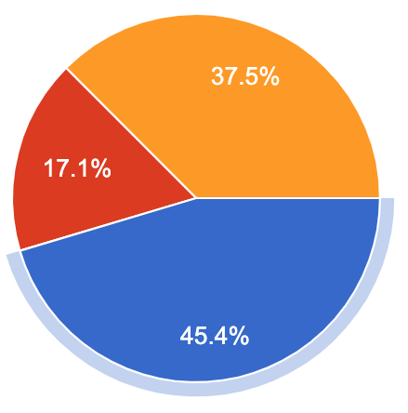
PARENT SURVEY UPDATE
Question: In thinking about return to school scheduling there are many options being considered for how students will be scheduled. Which makes the most sense to you and your family? AS OF JUNE 27,2020
Prefer Full In-Person, Monday - Friday: 1,337/2,914 (46%)
Prefer a Blended Model, with some days/times in person & other days/times learning online: 1,078/2,914 (37%)
Prefer Full On-line Learning: 499/2,914 (17%)
Notes:
This is related to the

Slide 8
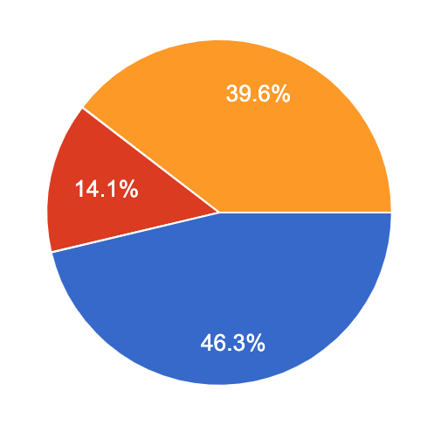
STUDENT SURVEY UPDATE
Question: How would you prefer to learn in August? AS OF JUNE 27,2020
Back to School, Monday - Friday: 788/1,702 (46%)
Hybrid model: some days/times in-person and other days/times learning online: 674/1,702 (37%)
Full On-line Learning: 240/1,702 (17%)
Notes:
This is related to the

Slide 9
HEALTH & SAFETY Facilities
Intensify the level of sanitizing, disinfecting, and routine cleaning Follow CDC recommendations for schools, workplaces, and community locations
Increase disinfecting frequently touched surfaces and objects
Ensure HVAC units are maintained to operate effectively and efficiently
Provide or install protective shields when social distancing is not achievable
Install COVID-19 safety signage with vital health and safety information
Notes:
This is related to the

Slide 10
HEALTH & SAFETY Facilities (continued)
Provide and install hand sanitizer in every classroom, conference room, library, computer lab and the main administration office
Work with site administrators to identify at least one isolation room and restroom to isolate students that exhibit COVID-19 symptoms
Prepare a plan for cleaning and disinfecting in the event of a confirmed or suspected case(s) of COVID-19 at a facility.
Notes:
This is related to the

Slide 11
HEALTH & SAFETY Students & Staff & Visitors
Teach and reinforce handwashing, avoiding contact with one's eyes, nose, and mouth, covering coughs and sneezes
Implement distancing inside and outside the classroom to the greatest extent possible
Check daily for signs and symptoms. Take temperature.
Provide training for families for best practices and intensify communications
Engage staff in professional development to learn how to identify symptoms/concerns and refer students to services
Work closely with Riverside County and State authorities to determine current disease levels and control measures
Notes:
This is related to the

Slide 12
HEALTH & SAFETY Students & Staff & Visitors
Utilize a universal screener for early identification and referral for services
Increase communications related to stigmatizing behaviors
Coordinate through Student Services a consortium of mental health agencies to provide services on the macro and micro level
Expand, provide, and communicate mental health and wellness services and resources
Implement and communicate the plan for when child, staff or visitor gets sick
Limit sharing (equipment, computers, utensils, etc…)
Notes:
This is related to the

Slide 13
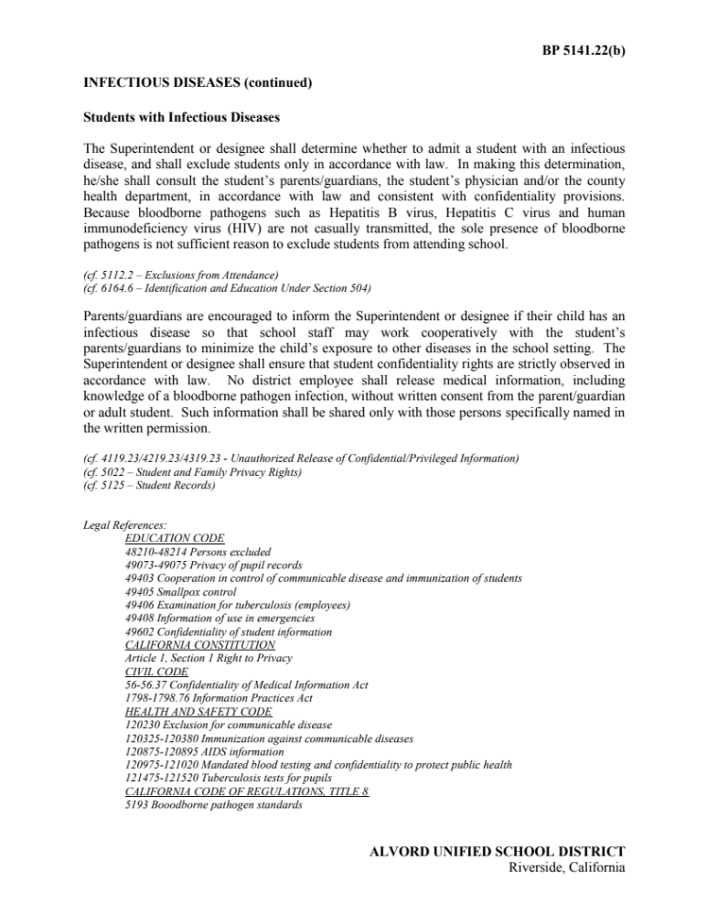
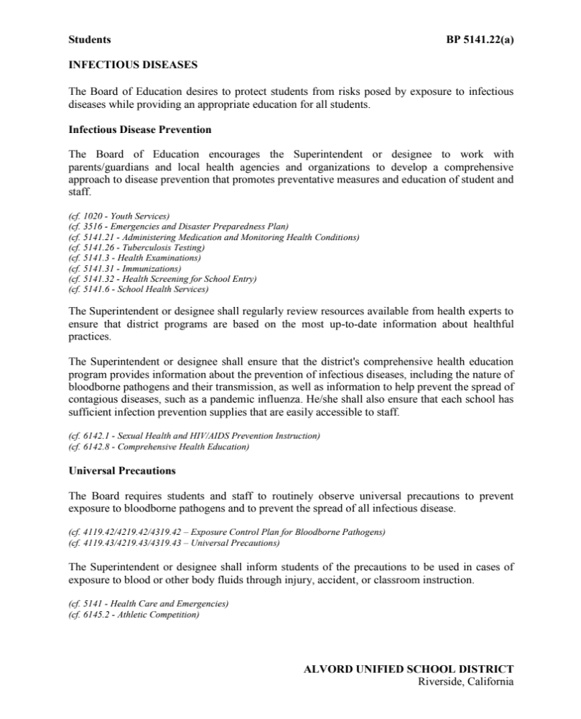
Notes:
This is related to the

Slide 14
STUDENT SUPPORT
Continue to strengthen Multi-Tiered System of Support (MTSS) as a framework to provide targeted support
Universal screen all students immediately
Teachers, counselors, psychologists and other specialists work as a team to build an integrated plan for targeted assistance (academic, behavioral, social and emotional needs)
Provide professional development when necessary so staff can deliver interventions and monitor progress effectively
Refer to consortium of mental health agencies to provide services on the macro and micro level
Notes:
This is related to the

Slide 15
ATTENDANCE
Develop attendance improvement plans by school
Follow new instructional minutes and attendance protocols for apportionment
2019-20 Instructional Minutes | 2020-21 Instructional Minutes
K: 36,000 = 200/day | K: 32,400 = 180/day
1–3: 50,400 = 280/day | 1-3: 41,400 = 230/day
1–3: 50,400 = 280/day | 1-3: 41,400 = 230/day
9–12: 64,800 = 360/day | 9-12: 43,200 = 240/day
Notes:
This is related to the

Slide 16
CHILD CARE & AFTERSCHOOL PROGRAMS
Support families with child care needs before, during, and beyond the school day
Utilize our After School Education and Safety (ASES) program
Seek out and support students who will return having experienced extreme social disconnection, trauma and significant learning gaps
Notes:
This is related to the

Slide 17
WHAT MIGHT SCHOOLS LIKE LIKE?
Notes:
This is related to the

Slide 18
Designing an Instructional Program Within the Constraints Imposed by the COVID-19 Pandemic
Notes:
This is related to the

Slide 19
CONSIDERATIONS
MOST RESTRICTIVE FULL DISTANCE LEARNING: NO STUDENTS PRESENT
LIMITED RESTRICTIONS A COMBINATION OF IN-PERSON AND REMOTE INSTRUCTION
LEAST RESTRICTIVE FULL IN-PERSON INSTRUCTION
Notes:
This is related to the

Slide 20
OVERARCHING DESIGN PRINCIPLE Inequity are products of design. They can be redesigned.
Notes:
This is related to the

Slide 21
DESIGN PRINCIPLES
Close collaboration between district leadership and employee groups to optimize instructional programs and safety
Use most current guidance
Every aspect of the school day must be rethought
Equity-Based Scheduling* *Taking into account the diverse learning needs, languages, and living situations of our students
Notes:
This is related to the

Slide 22
ASKING THE RIGHT QUESTIONS
Notes:
This is related to the

Slide 23
GOAL SETTING
QUESTION How will we support all students, including those who have been disproportionately impacted by school closures?
Notes:
This is related to the

Slide 24
SCHEDULING MODELS
QUESTION How will the needs of all students, including those who were most significantly impacted by shelter-in-place and those and who may not be able to provide home support, tech access or a quiet place to work, will be met?
Notes:
This is related to the

Slide 25
COMMUNICATE PLAN
QUESTION How do we provide information in various languages and through various channels to ensure information is shared to all with opportunities for feedback. Is it two-directional?
Notes:
This is related to the

Slide 26
ASSESSMENT
QUESTION How do we intentionally disaggregate data for all subgroups across the spectrum of achievement levels, to uncover potential pockets of greater need, including At-Promise Youth, Socially/ Economically Disadvantaged families, Special Populations, Homeless families, Foster youth, and LGBTQIA+ students.
Notes:
LGBTQIA refer to lesbian, gay, bisexual, transgender, queer or questioning, intersex, and asexual or allied

Slide 27
TRAUMA-INFORMED SEL
QUESTION How do we identify ways in which equity, social, emotional learning, and academic development can reinforce each other rather than being pursued separately?
Notes:
LGBTQIA refer to lesbian, gay, bisexual, transgender, queer or questioning, intersex, and asexual or allied

Slide 28
BUILDING CAPACITY
QUESTION How do we plan and prepare staff to develop culturally-responsive strategies as we toggle between emergency response to intentional distance and hybrid learning?
Notes:
LGBTQIA refer to lesbian, gay, bisexual, transgender, queer or questioning, intersex, and asexual or allied

Slide 29
ENGLISH LEARNERS
QUESTION How do we gain a greater understanding of culture and elevate home languages to honor families and improve the parent and caregiver connection to school as students spend more time learning from home?
Notes:
LGBTQIA refer to lesbian, gay, bisexual, transgender, queer or questioning, intersex, and asexual or allied

Slide 30
STUDENTS WITH DISABILITIES
QUESTION How do we leverage technology and remote learning in ways that ensure equity is not equality?
Notes:
LGBTQIA refer to lesbian, gay, bisexual, transgender, queer or questioning, intersex, and asexual or allied

Slide 31
SUPPORT PROGRAMS
QUESTION How do we create a hive mentality and leverage service providers and community programs that also embrace an equity mindset and have experience serving those who have been disproportionately impacted by COVID-19 to expand the support team available to our learners?
Notes:
LGBTQIA refer to lesbian, gay, bisexual, transgender, queer or questioning, intersex, and asexual or allied

Slide 32
SCHEDULING EXAMPLE MODELS TOTAL DISTANCE LEARNING Traditional Schedule Model Block Schedule Model Elementary K-5 Model
Notes:
LGBTQIA refer to lesbian, gay, bisexual, transgender, queer or questioning, intersex, and asexual or allied

Slide 33
ASSEMBLY BILL (AB77) PASSED JUNE 26, 2020 DISTANCE LEARNING REQUIREMENTS
Confirmation or provision of access for all pupils to connectivity and devices adequate to participate in the educational program and complete assigned work.
Content aligned to grade level standards that is provided at a level of quality and intellectual challenge substantially equivalent to in-person instruction.
Academic and other supports designed to address the needs of pupils who are not performing at grade level, or need support in other areas, such as English learners, pupils with exceptional needs, pupils in foster care or experiencing homelessness, and pupils requiring mental health supports.
Notes:
This is related to the

Slide 34
ASSEMBLY BILL (AB77) PASSED JUNE 26, 2020 DISTANCE LEARNING REQUIREMENTS (continued)
Special education, related services, and any other services required by a pupil’s individualized education program pursuant to Section 56341, including the requirements of subparagraph (A) of paragraph (9) of subdivision (a) of Section 56345, with accommodations necessary to ensure that individualized education program can be executed in a distance learning environment.
Designated and integrated instruction in English language development pursuant to Section 11300 of Title 5 of the California Code of Regulations for English learners, including assessment of English language proficiency, support to access curriculum, the ability to reclassify as fully English proficient, and, as applicable, support for dual language learning.
Daily live interaction with certificated employees and peers for purposes of instruction, progress monitoring, and maintaining school connectedness. This interaction may take the form of internet or telephonic communication, or by other means permissible under public health orders. If daily live interaction is not feasible as part of regular instruction, the governing board or body of the local educational agency shall develop, with parent and stakeholder input, an alternative plan for frequent live interaction that provides a comparable level of service and school connectedness.
Notes:
This is related to the

Slide 35
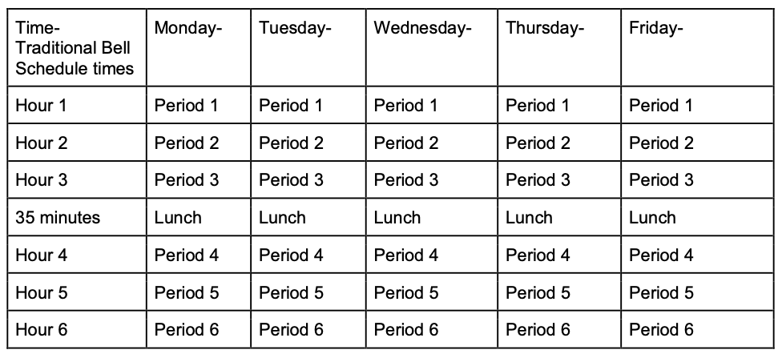
TOTAL DISTANCE LEARNING: TRADITIONAL SCHEDULE SECONDARY
EXAMPLE DRAFT

Slide 36
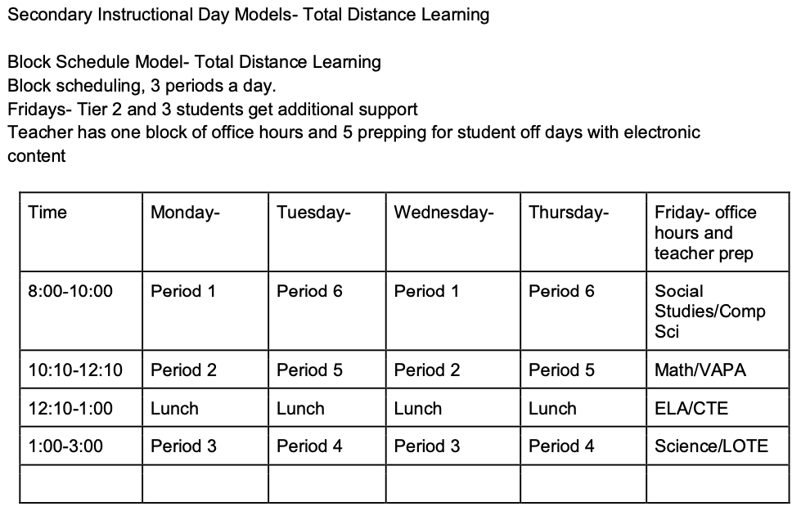
TOTAL DISTANCE LEARNING: BLOCK SCHEDULE SECONDARY
EXAMPLE DRAFT

Slide 37
PRIMARY ELEMENTS OF DISTANCE LEARNING TRADITIONAL SCHEDULE MODEL 6-8 & 9-12
Highly Structured
Meet Instructional Minute Requirements
Student (and families) Cohorted Into 2 Groups
Either 6 Periods Meet Per Day (Traditional) or 3 Periods Per Day (Block)
Intervention Support Services Built-In
Teachers Have One Period Office Hours
Notes:
This is related to the

Slide 38
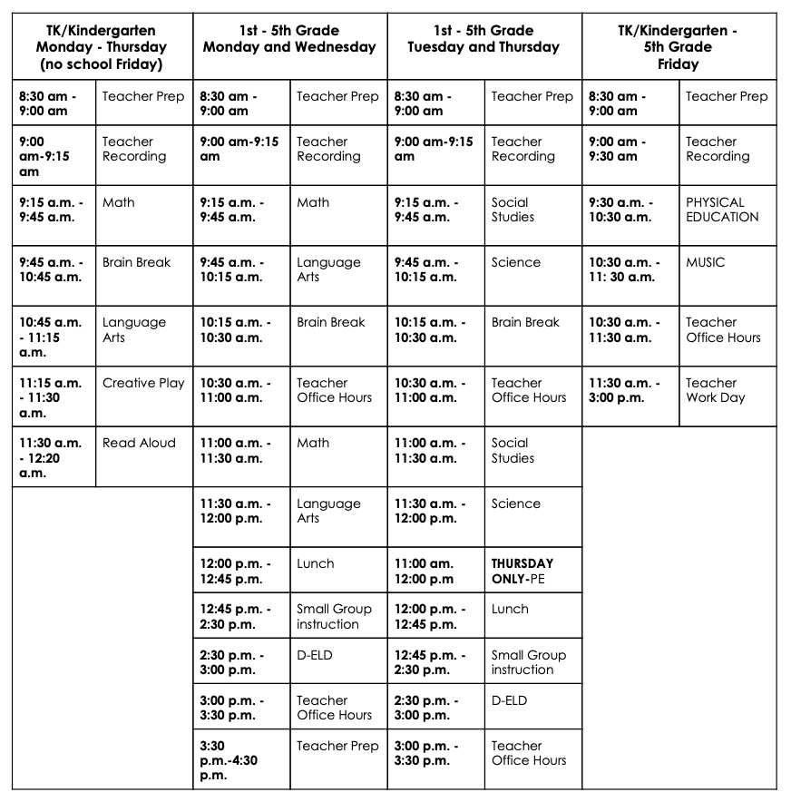
TOTAL DISTANCE LEARNING: ELEMENTARY K-5
EXAMPLE DRAFT
EXAMPLE DRAFT

Slide 39
PRIMARY ELEMENTS OF DISTANCE LEARNING ELEMENTARY MODEL – K-5
Highly Structured
Meet Instructional Minute Requirements
All Subjects and PE and Music
Teacher Office Hours to Support Parents and Teachers
Intervention Support Services Built-In
Notes:
This is related to the

Slide 40
SCHEDULING EXAMPLE MODELS HYBRID/BLENDED MODEL Secondary Block Schedule Model Elementary K-5 Model
Notes:
LGBTQIA refer to lesbian, gay, bisexual, transgender, queer or questioning, intersex, and asexual or allied

Slide 41
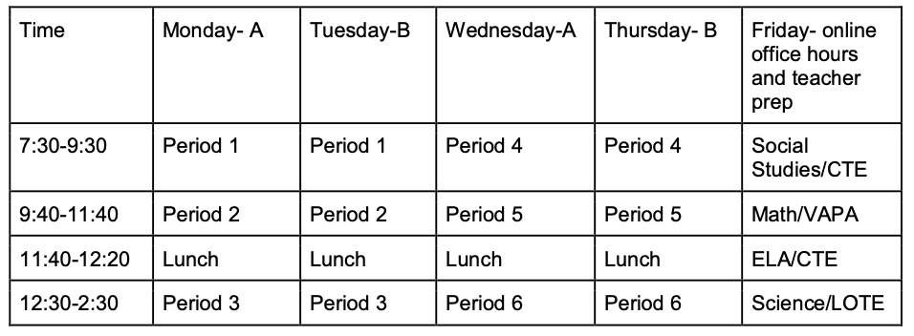
SECONDARY INSTRUCTIONAL HYBRID MODEL 1
EXAMPLE DRAFT

Slide 42
PRIMARY ELEMENTS OF HYDRID MODEL 1: 6-8 & 9-12 BLENDED IN-PERSON AND DISTANCE
Meet Instructional Minute Requirements – 3-Period Day
Student (and families) Split into A/B cohorts.
In-Person M-W or T-TH - Distance Learning Other 3 Days
Alternate days In-Person and Distance Learning
Fridays Intervention Support Services
Remote learning on days not present
Teachers Have One Period Office Hours to Prep for Electronic Content
Notes:
This is related to the

Slide 43
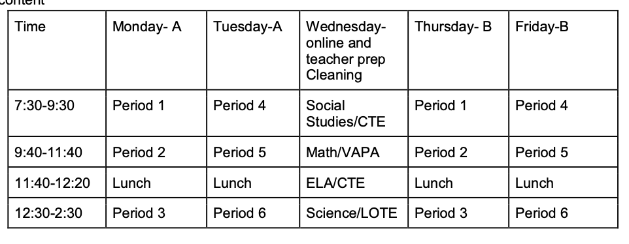
SECONDARY SCHEDULE HYBRID MODEL 2
EXAMPLE DRAFT

Slide 44
PRIMARY ELEMENTS OF HYDRID MODEL 2: 6-8 & 9-12 BLENDED IN-PERSON AND DISTANCE
Meet Instructional Minute Requirements – 3-Period Day
Student (and families) Split into A/B cohorts.
In-Person M-T or TH-F - Distance Learning Other 3 Days
Consecutive Days In-Person and Distance Learning
Wednesday Intervention Support Services
Remote learning on days not present
Teachers Have One Period Office Hours to Prep for Electronic Content
Notes:
This is related to the

Slide 45
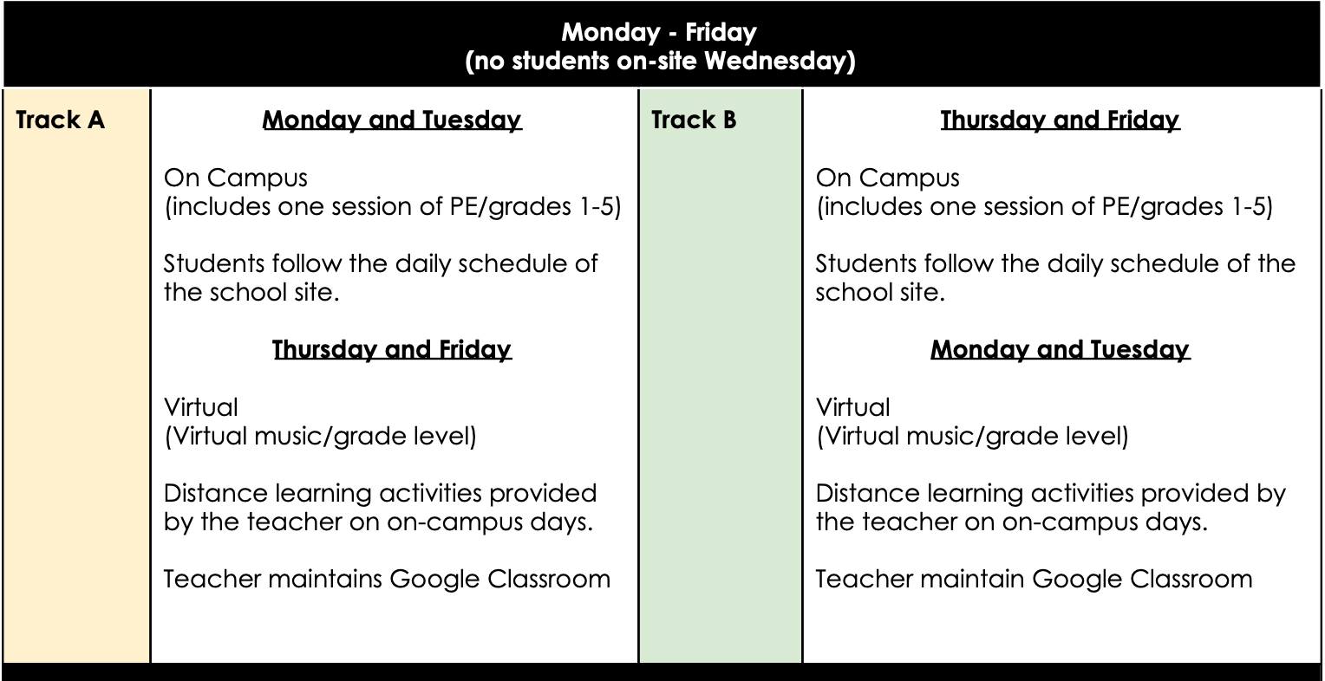
ELEMENTARY K– 5 SCHEDULE HYBRID MODEL

Slide 46
PRIMARY ELEMENTS OF ELEMENTARY K– 5 SCHEDULE HYBRID MODEL
Meet Instructional Minute Requirements
Student (and families) Split into A/B cohorts.
In-Person M-T or TH-F - Distance Learning Other 3 Days
Wednesdays Teacher Office Hours (No students on campus)
Remote Learning on Days Not Present
Selected Virtual Activities TBD on Wednesday
Notes:
This is related to the

Slide 47
TEACHING & LEARNING IN A BLENDED MODEL
Driven by Assessment
Intervention Focus on Literacy and Math
Potential Distance Learning Options Learning Management System – Odysseyware Learning Platform Google Classroom, Class Dojo, Zoom On-line hybrid Instructional Model Homeschool Model
The educational philosophy of the model varies depending on needs to structure of the days from least structured to highly structed
Notes:
This is related to the

Slide 48
NEXT STEPS
Task Force recommendations brought to the Board of Education on July 9, 2020 for a Public Study Session
Determine if additional Study Sessions are necessary
Determine a Board Meeting date to take action on the model
Continue to work with labor partners
Notes:
This is related to the

Slide 49
QUESTIONS?
Email: 2superintendent@alvordschools.org
Take the Secondary Student Survey here
Take the Elementary Student Survey here
Take the Parent Survey
Notes:
This is related to the

