Slide 1

Universidad Johns Hopkins

Slide 2
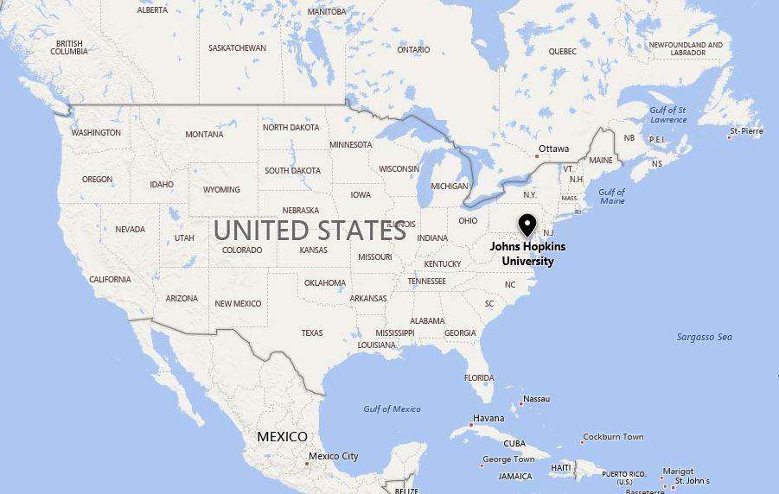
Baltimore, Maryland
Valley View Elementary

Slide 3
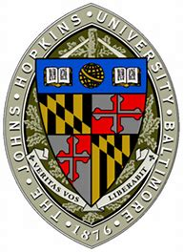
Establecido / Established 1876

Slide 4
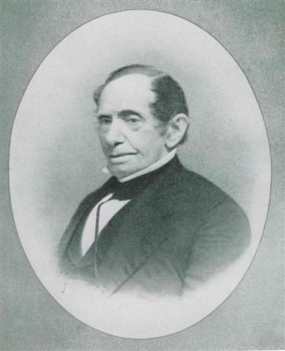
Johns Hopkins
Notes:
Born on an Anne Arundel County tobacco plantation in 1795, Johns Hopkins made a fortune as a merchant supplying settlers on the western frontier.
Hopkins then turned to banking, and was an early investor in the B&O Railroad — twice using his personal fortune to save the railroad from bankruptcy.
After Hopkins’ death on Christmas Eve 1873, his $8 million fortune was left to establish a university and hospital.

Slide 5
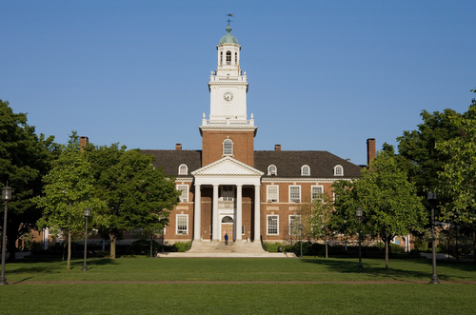
Johns Hopkins University

Slide 6
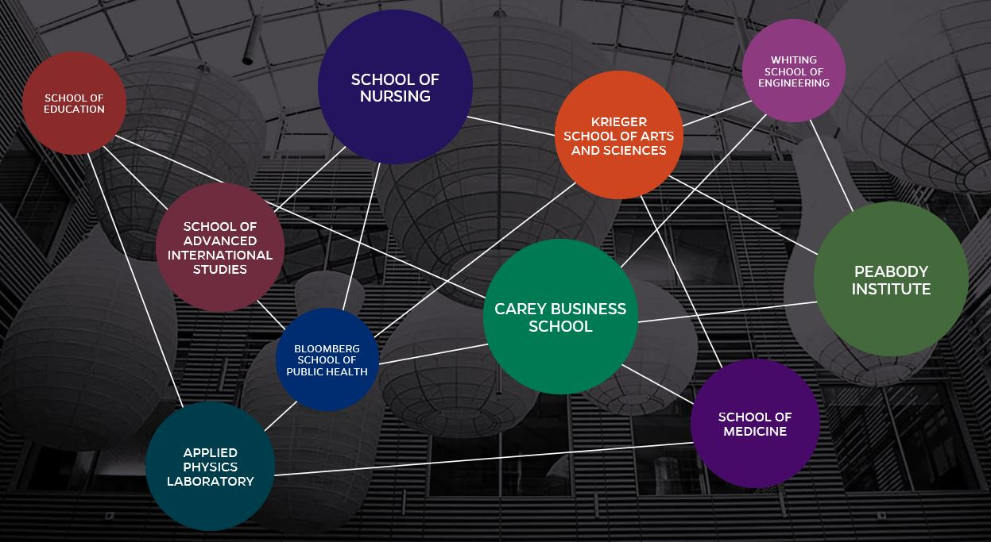

Slide 7
Especialidades Más Populares / Most Popular Majors
Estudios de Salud Pública
Estudios Internacionales
Neurociencia
Ingeniería Biomédica
Economía
Public Health Studies
International Studies
Neuroscience
Biomedical Engineering
Economics

Slide 8
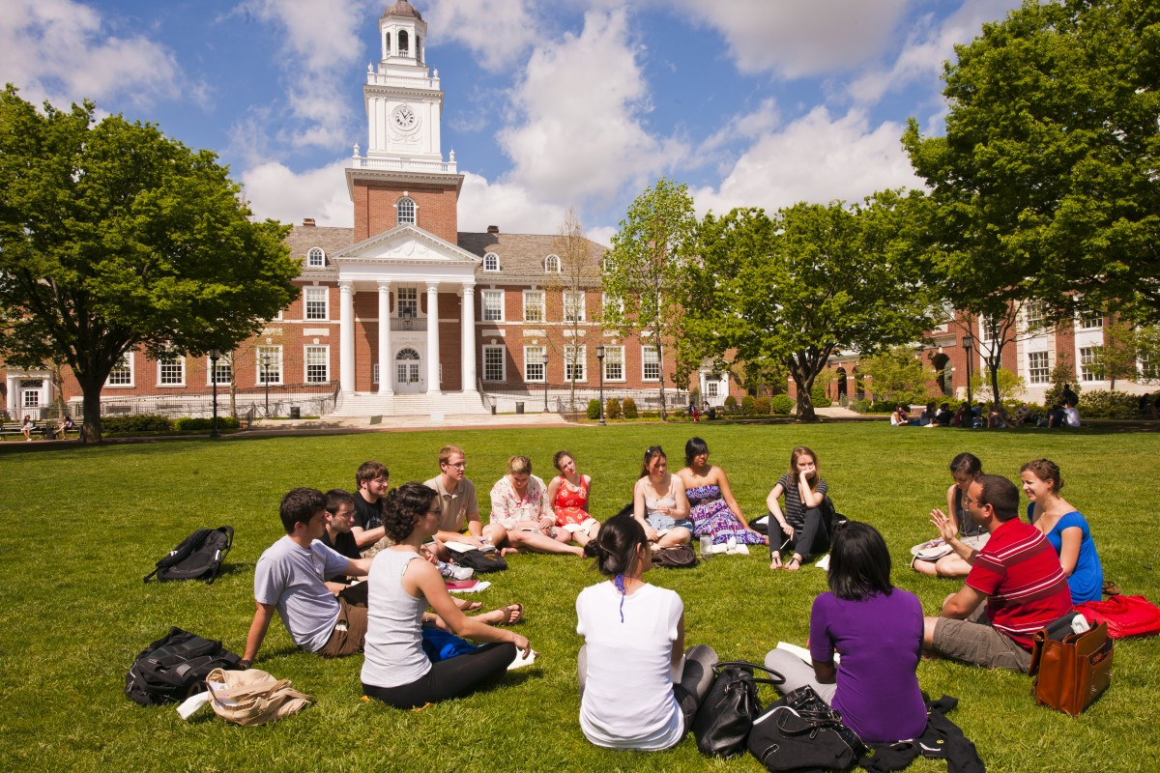

Slide 9
Selectividad de la admisión del estudiante de primer año / Freshman Admission Selectivity (2017)
Solicitantes: 26.578
Admitido: 3.116
Inscrito: 1.346
Admitidos: 12 por ciento
Applicants: 26,578
Admitted: 3,116
Enrolled: 1,346
Admit rate: 12 percent

Slide 10
Estudiantes / Students
La Universidad Johns Hopkins inscribe a más de 24.000 estudiantes a tiempo completo y a tiempo parcial a través de nueve divisiones académicas.
Johns Hopkins University enrolls more than 24,000 full-time and part-time students throughout nine academic divisions.

Slide 11
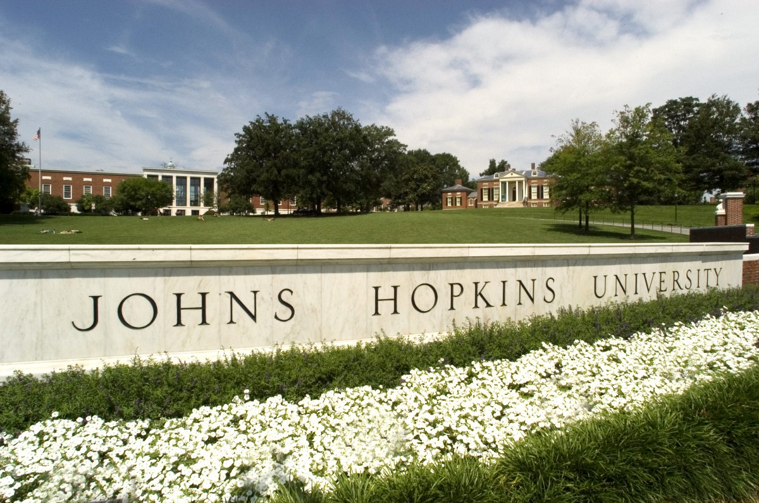

Slide 12
Costo y ayuda financiera / Costs and Financial Aid (2017-2018)
Matrícula: $52.170
Habitación y pensión (habitación doble, plan de comidas "Anytime"): $15.410
Promedio de subsidios por necesidad para estudiantes de primer año: $42.500
Estudiantes que reciben ayuda: 50 por ciento
Tuition: $52,170
Room and board (double room, “anytime” meal plan): $15,410
Average need-based grant for first-year students: $42,500
Students receiving aid: 50 percent

Slide 13
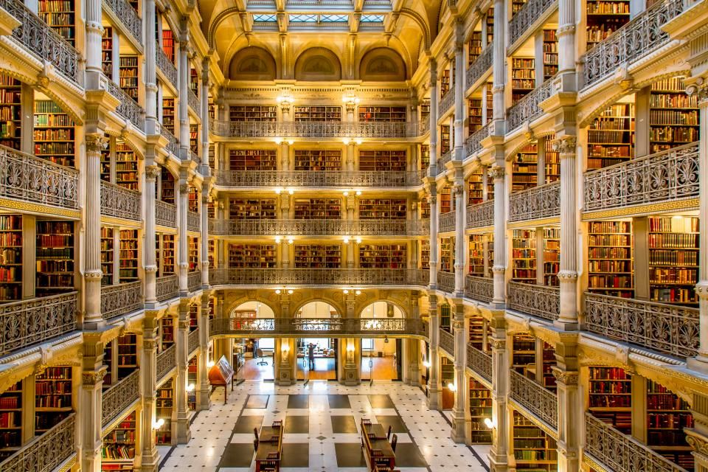

Slide 14
Éxito / Success
Los programas de posgrado de la Universidad en salud pública, enfermería, ingeniería biomédica, medicina y educación son considerados entre los mejores del país, según U.S. News & World Report.
The university’s graduate programs in public health, nursing, biomedical engineering, medicine, and education are considered among the best in the country, according to U.S. News & World Report.

Slide 15
Logros de la Investigación / Research Accomplishments
Inventó la técnica de primeros auxilios salvavidas resucitación cardiopulmonar en 1958.
Trabajó en el desarrollo de la primera vacuna contra el polio ampliamente utilizada.
Investigación sobre pruebas de cáncer y tratamientos.
Invented the lifesaving first-aid technique cardiopulmonary resuscitation (CPR) in 1958.
Worked on development of the first widely used polio vaccine.
Research on cancer tests and treatments.

Slide 16
Logros de la Investigación / Research Accomplishments
Desarrollo de naves espaciales e instrumentos utilizados en el espacio.
Desarrollo del sistema de purificación de agua por cloración
Developed spacecraft and instruments used in space.
Developed the system of water purification by chlorination

Slide 17
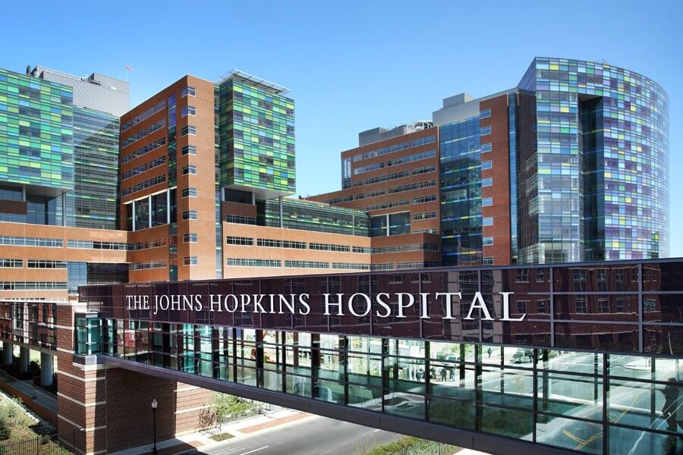

Slide 18
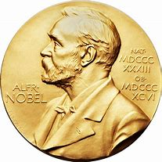
Premio Nobel / Nobel Prize
Han habido 27 ganadores del Premio Nobel asociados con la Universidad Johns Hopkins.
There have been 27 Nobel Prize winners associated with Johns Hopkins University.

Slide 19

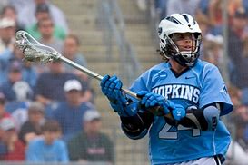
Deportes / Sports
Mascota / Mascot: Blue Jay
Deporte / Sport #1: Lacrosse

Slide 20
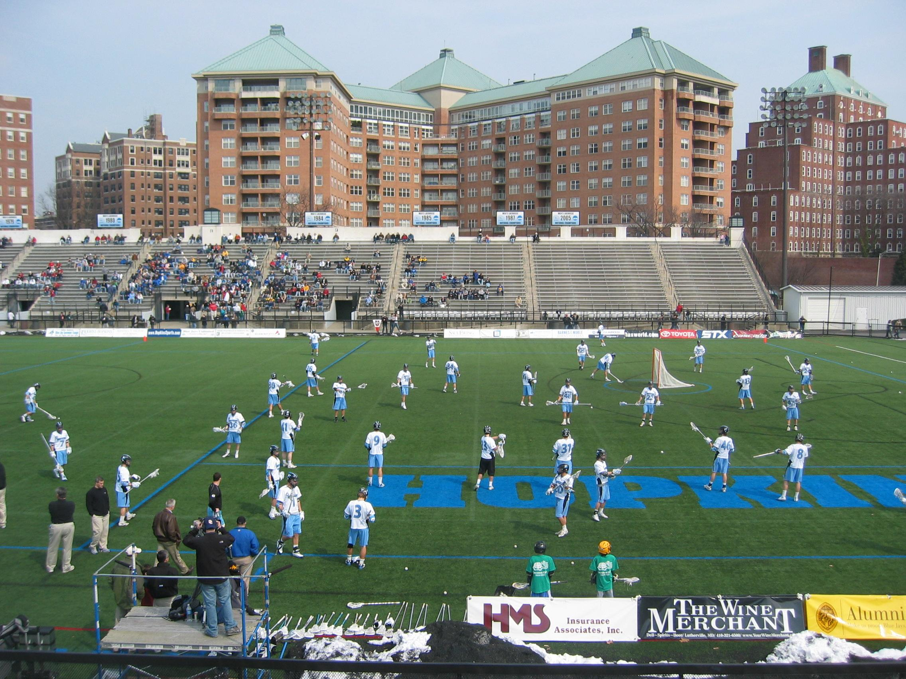

Slide 21
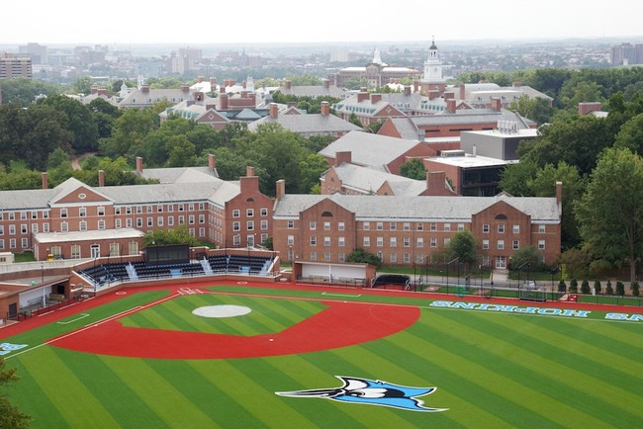

Slide 22
“Johnny Hopkins on to Victory”
Johnny Hopkins on to victory,
Johnny Hopkins play the game.
Johnny Hopkins fight the battle,
Winning name and fame.
Johnny Hopkins we're all with you,
Fighting, plunging onward, down the field and towards the goal.
It's the same old line,
It's the same old team,
If you win you'll hear the eagle scream,
Cheer, oh cheer again for Johnny Hopkins!

Slide 23
“Johnny Hopkins on to Victory” on SoundCloud

Slide 24

Recursos / Resources
Johns Hopkins Fact Book
https://www.jhu.edu/
http://welcometobaltimorehon.com/people/baltimoreans-past-and-present/johns-hopkins

