Slide 1
Working
With
Wifi
When do I need
A work order?
Making
YouTube
Work
Buying a Computer for Myself
E-Mail with
Microsoft Outlook
Fixing basic problems
On/Off Issues
Backing Up My Work
Being Nice to the District Techs
Outlook through the Internet
Smartboards
And
SmartNotebook
Schoolwires
My Own Website
Using the LCD Projector
My Computer won’t start
Network Problems
Is it me?
Scanning
Documents
Best Practices for student use
I forgot my
Password
509-5180
U Drive
P Drive
S Drive’s me crazy
Memory Sticks
In the
Classroom
Bonus
Round
GAFE

Slide 2


Working with Wifi
How to join the district Wifi.
How to get rid of wifi networks that might be messing up the district wifi. When I’m asked to fix wifi I begin by getting rid of all the extra wifi networks.
Erik and Mark used to work at Knotts Berry Farm as Stunt Men

Slide 3

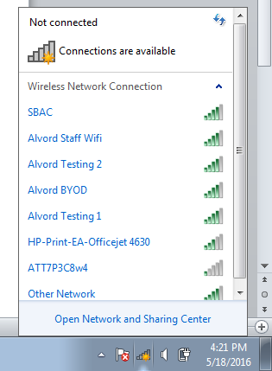
Working with Wifi
Adding the District Wifi
Click the Wifi Stairs
Click the SBAC Network

Slide 4
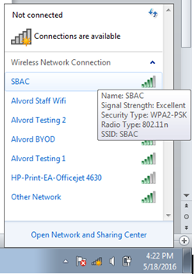

Working with Wifi
Adding the District Wifi
Click the SBAC Network.
Click Connect

Slide 5
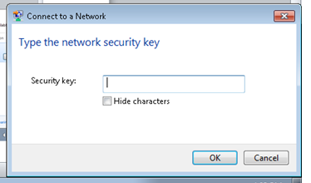

Working with Wifi
Adding the District Wifi
Type in the Security Key. Shhh – Don’t tell anyone it is 12345678
Click Ok – Ok. I mean to say are you ok with clicking Ok?

Slide 6
Working with Wifi
Fixing BASic Wifi Issues
Click on the wifi stairs again.
Click Open Network and Sharing Center

Slide 7
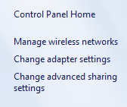
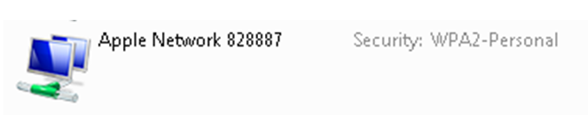
Working with Wifi
Fixing BASic Wifi Issues
Click Manage Network Settings
You will see a list of networks. Click on the one you don’t need. Normally BYOD is the one you have to remove.

Slide 8
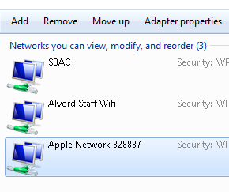
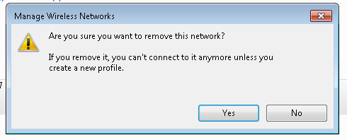
Working with Wifi
Fixing BASic Wifi Issues
When you click on the network you don’t want click Remove.
Click Yes.

Slide 9

E-Mail with Outlook
Having a positive Outlook is more than just checking your e-mail. It is a life choice between the Autobots and Decepticons.

Slide 10


E-Mail with Outlook
There 2 ways to check your e-mail.
Through your web browser.
Through Outlook

Slide 11
E-Mail with Outlook
Microsoft Outlook
Found on your computer’s desktop
Opens with one click – No Login
With your work laptop computer Outlook will work at school or at home.
Outlook Web App
Requires you to go the Internet and log into your e-mail
Attachments don’t work all the time
I only use this when I have to.

Slide 12

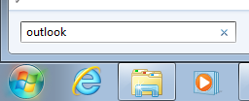
E-mail with outlook
Click Start
Type Outlook

Slide 13

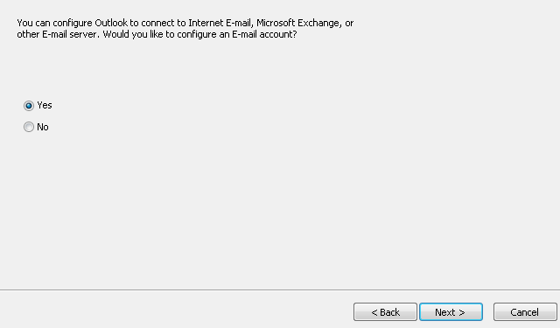
E-mail with outlook
Click Outlook
The Setup Process now begins. Leave the settings on Yes and click Next.

Slide 14
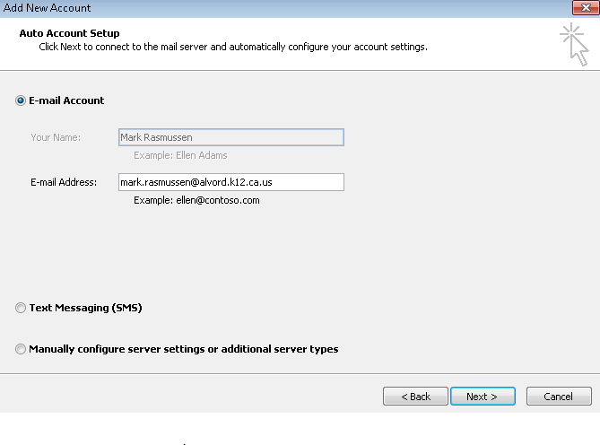
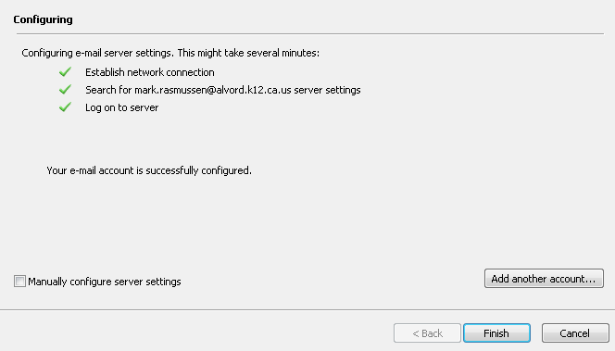
E-mail with outlook
Your Name will automatically show up. Click Next.
Click Finish

Slide 15
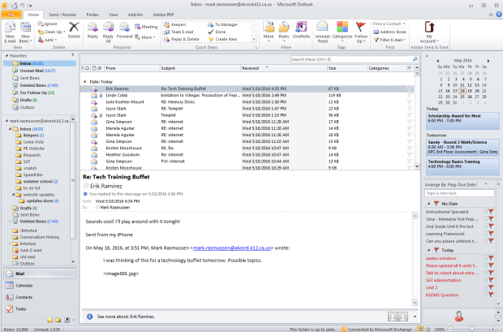
E-mail with outlook
Start Outlook by clicking Outlook
Now you can easily view your e-mails and send e-mails.

Slide 16
Outlook through the Internet
There are 2 ways to access your e-mail. Actually 3.
Through Outlook on your desktop
Through the Internet
Setup Your Phone (doesn’t always work)
Outlook through the Internet is called – Outlook Web App (OWA)
I only use the Outlook Web App when my desktop Outlook isn’t working.

Slide 17




Outlook through the Internet
Open a Web Browser
Go to www.alvordschools.org

Slide 18


Outlook through the Internet
Click on Staff.
Click E-mail

Slide 19
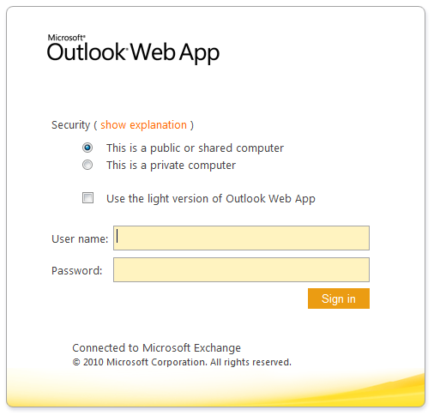
Outlook through the Internet
Enter your username and password.
You may find adding attachments difficult if you use Google Chrome. I use Internet Explorer.

Slide 20

My Computer Won’t Start
This is for the computer that worked the day before but isn’t working today.

Slide 21

My Computer Won’t Start
Here are some basic tips that might get your computer to start again.
Mark and Erik’s Summer Jobs
To Tech and Serve

Slide 22
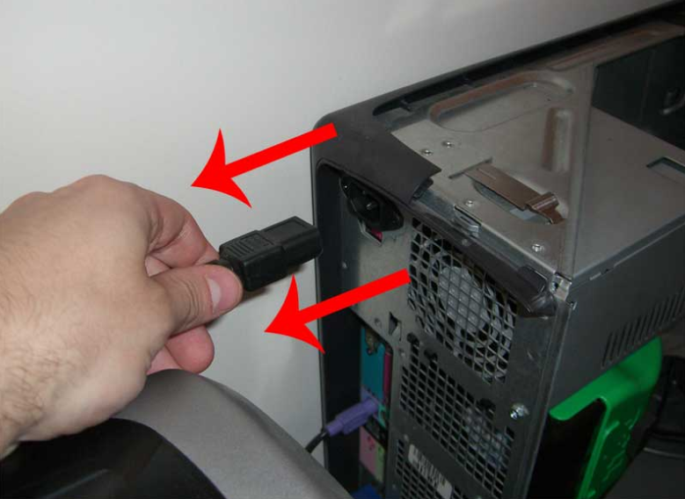
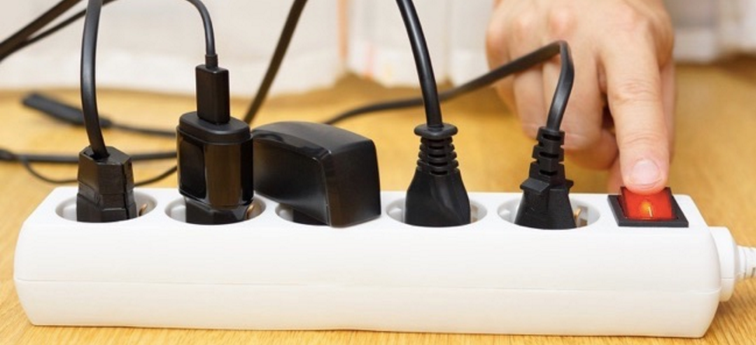
My Computer Won’t Start
Unplug the power cord from the computer and plug. Count to 20 and plug it back in.
Unplug the monitor for 20 seconds and plug it back in.
Turn the computer and monitor back on.
Check the Power Strip

Slide 23

I forgot my password
To forget a password is human; to recover the password, divine.
Call the IT Help Desk at (951)509-5180 and they will help reset your password
Mark and Erik Went to a Training at Alabama State University

Slide 24
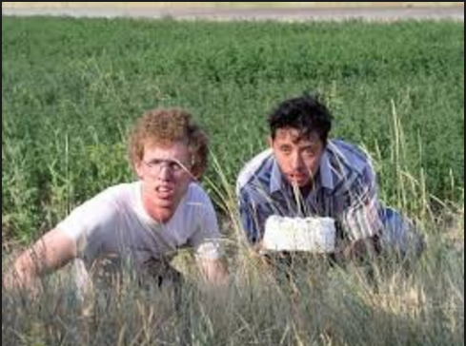
When do I need a work order
There comes a time in everyone’s life when you need to reach out for help. That is what work orders are for.
Taking a cake to Erik’s Prom date

Slide 25
When do I need a work order
For Installing:
Printers
Software
For Problems with:
Smart Board
Software not working
Virus or spyware problems
Telephone

Slide 26
When do I need a work order
How do I submit a work order?
Usually your school secretary or designated person has permission to submit work orders for you.
If your computer or other device is not fixed follow up in a friendly manner with the designated person. You don’t have to let months go by without getting something fixed.

Slide 27
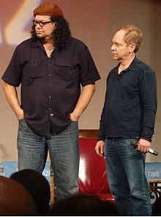
Fixing basic problems on/off issues
The sometimes magic trick that tech people have. Have you ever said, “Sure, it works whenever you are around.”
This is how the magic is done.
Erik and Mark tried their hand at magic. Check out Mark’s receding hair line.

Slide 28
Fixing basic problems on/off issues
An ON/OFF issue is when something was turned off. When it gets turned back on it begins working again.
To fix an ON/OFF issue.
Check to see if cords are plugged in. I unplug and plug back in.
Is the screen off. Maybe it just went to sleep. Tap the space bar.

Slide 29
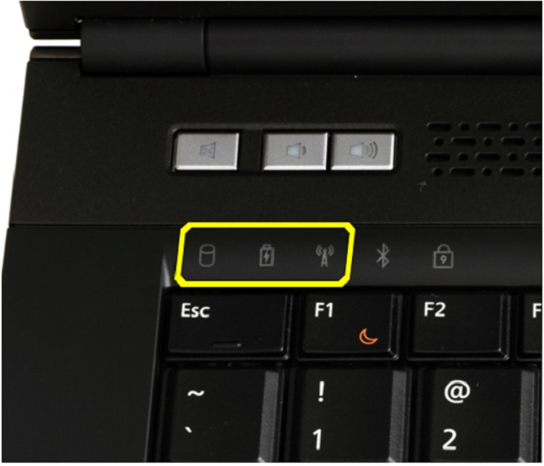
Fixing basic problems on/off issues
Try a different cord. Maybe the cord has gone bad.
Unplug the computer. Sometimes even if the computer is turned off there is enough electricity in the cord to keep the bug in the computer.
Is the Wifi off. If you have an amber light on the wifi it is turned off.

Slide 30
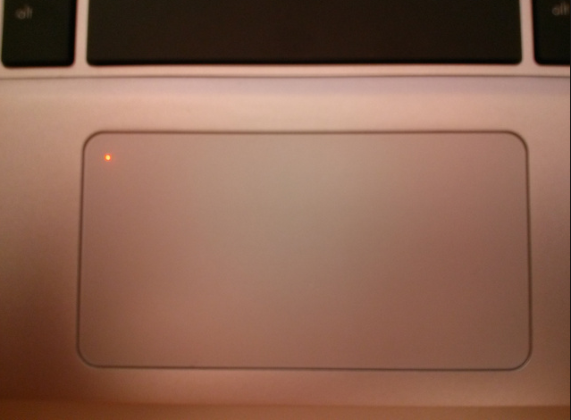
Fixing basic problems on/off issues
Is the touchpad on your laptop not working. See if it has been turned off. The touch pad is off when the amber light is on. Double tap the amber light and the touch pad will be turned back on.

Slide 31

Smart boards and smart notebook software
This is a demonstration of what is possible. Smartboards are cool but only half of the equation to teaching with tech. The other half is Smart Notebook.
Erik and Mark attended the 2015 Annual Star Trek Convention.

Slide 32
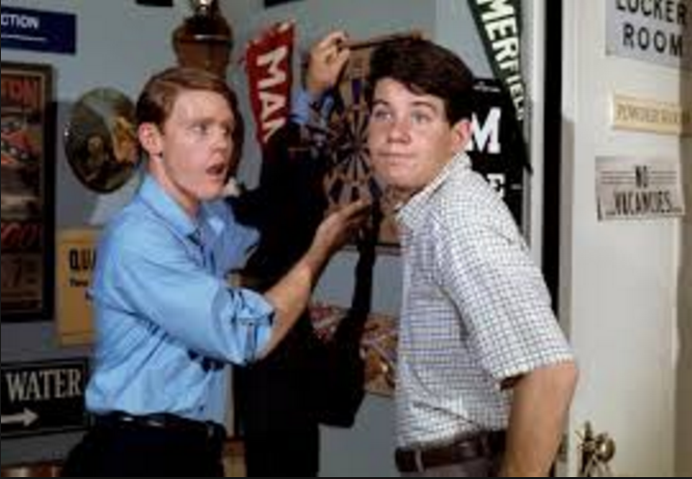
Network problems is it me?
Whenever I have a network issue I wonder if it is me or is it the entire school. This is how I figure it out. I have happy days when everything is working.
Mark and Erik in High School

Slide 33
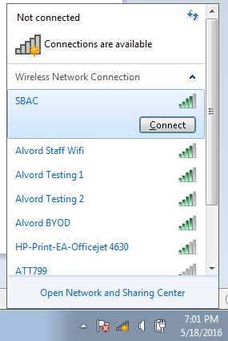
Network problems is it me?
Wifi Check:
Click on the Wifi stairs. (Does it say you are connected)
If it doesn’t click SBAC and then click connect. Sometimes I disconnect and then connect again.

Slide 34
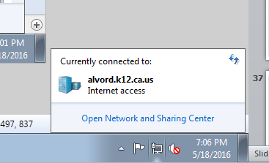
Network problems is it me?
Wired Check:
Click on the computer screen in the bottom right hand corner. It should say Internet Access.
If it doesn’t check your wires to see if they are connected.

Slide 35
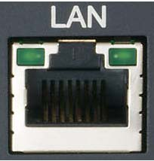
Network problems is it me?
Wired Check:
Click on the computer screen in the bottom right hand corner. It should say Internet Access.
If it doesn’t check your wires to see if they are connected.
You can also check the back of your computer. The lights should be flickering where the cord plugs in.

Slide 36
Network problems is it me?
If it is just with your classroom or the whole school you can let the office know.

Slide 37

U Drive – P Drive – S drive
The U Drive, P Drive, and S Drive are network drives we use only at school.
These are files we share with our school, district, and ourselves.
Any file on a network drive is only accessed at school.
Mark and Erik tried Singing
At the Mission Inn

Slide 38


U Drive – P Drive – S drive
The U Drive is for You.
It is a network drive. A nice place to store files.
If the network goes down you won’t have access to these files.
Click the folder.
Click your name under the Computer title.
Folder location
\\do-fs-02\users$\firstname.lastname

Slide 39
U Drive – P Drive – S drive
The P drive is Public for the entire school district.
You can share files with anyone within the district.
This is a nice place for resources to help you teach in your class.
Click the folder.
Click your drive labeled with a P:
Folder location
\\do-fs-02\public

Slide 40
U Drive – P Drive – S drive
The S drive is for your School
You can share files with anyone within your school.
This is a nice place for collaboration and keeping shared files.
Click the folder.
Click your drive labeled with a S:
Folder location
\\do-fs-02\school initials$

Slide 41

Making youtube work
Youtube is normally blocked so that only YouTube EDU gets through.
Here are directions on how to unblock YouTube.
When it is unblocked be aware that everything gets through.
Preload the videos before you show them.
Erik and Mark trying to look cool in the 1990’s

Slide 42

Making youtube work
Open the Google Chrome Browser.
Go to www.lsaccess.me/login
Log in as issstudent
The password is student.
Go to YouTube
Pre-load your YouTube videos. The videos that pop up initially may be the ones your students remember instead of the instruction you hoped for.

Slide 43

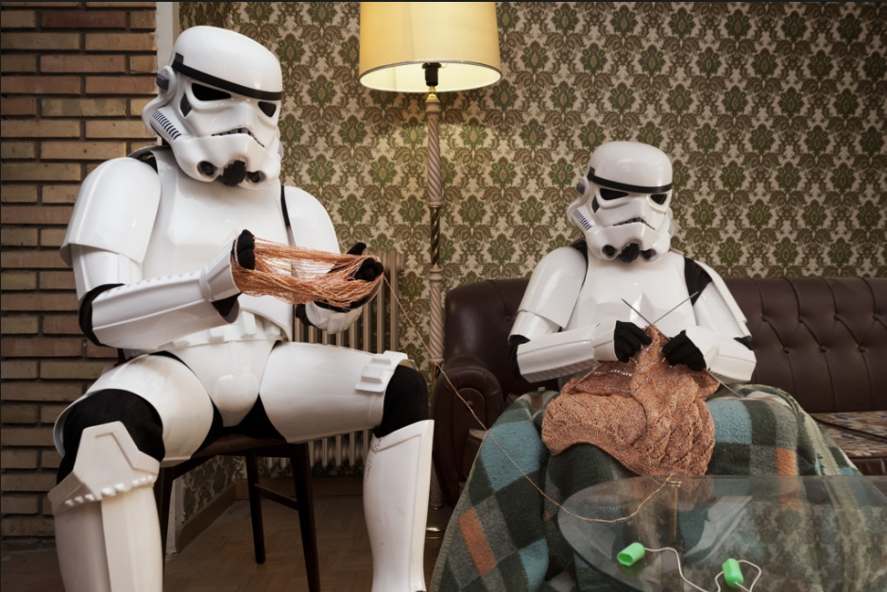
Backing up my work
Erik and Mark looking at different career paths

Slide 44
schoolwires
Schoolwires is the school district’s answer to creating websites for the classroom.
Although it takes a while to get used to Schoolwires can be useful.
Demonstration of how Schoolwires works

Slide 45
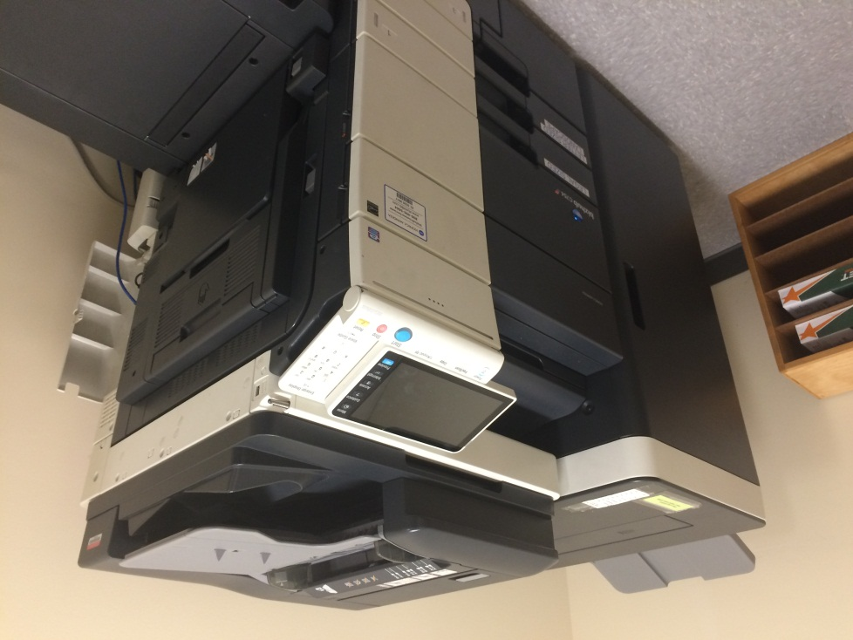
Scanning documents
Do you have one of these Printer / Scanner / Copiers at your school?
Then you can scan worksheets, student work, and other documents into .pdf documents

Slide 46
Scanning documents
Benefits
Instead of keeping bookcases worth of worksheets, project descriptions, or other materials you can keep digital records of whatever you need to.
Scan student work as well to show to future classes. Digital files don’t fade in color like paper.

Slide 47
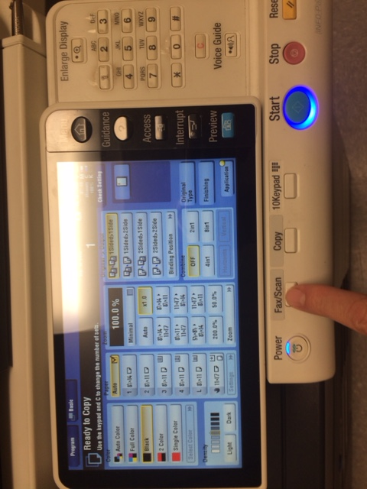
Scanning documents
How the magic is done
Locate the copier / scanner at your school.
Walk towards the copier / scanner.
Push the Fax / Scan button.

Slide 48
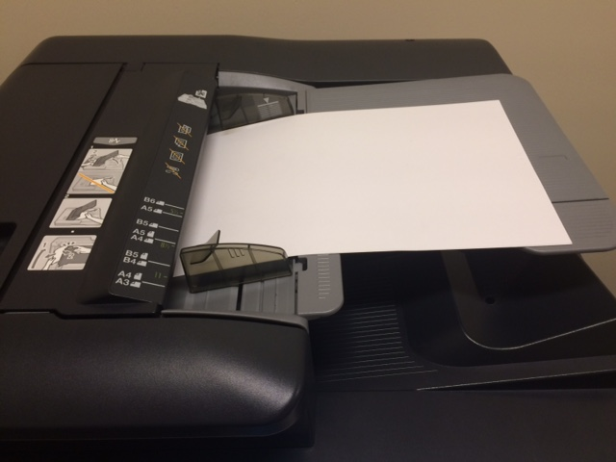
Scanning documents
Put the paper in the top tray.
Set the double sided or single sided.

Slide 49
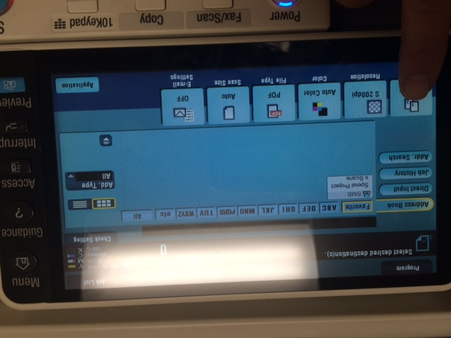

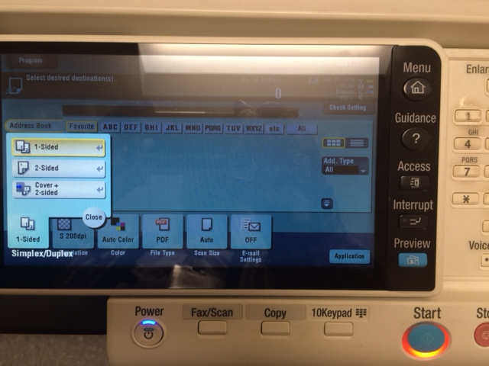
Scanning documents
Push the 1-Sided button
Push the 2-Sided button.

Slide 50
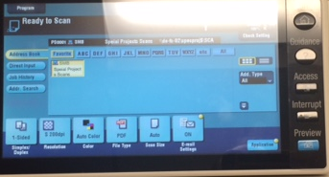
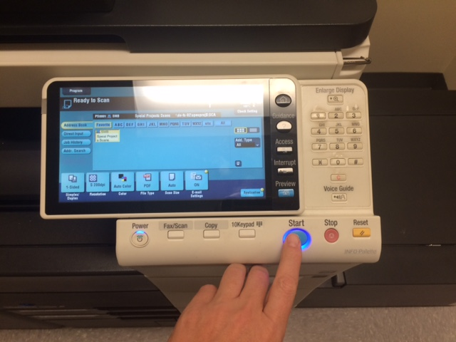
Scanning documents
The white box will tell you where to the scan files will be sent.
Push the Start Button. The scanning goes fast

Slide 51

Scanning documents
Now that the scanning is done where did my files go!!!
Back at your computer click the folder icon.
Slick Your S: Drive (School Drive)
Look for a folder named Scans
Double Click it

Slide 52

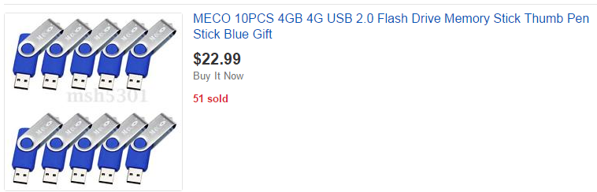
Memory sticks in the classroom
Memory sticks are an inexpensive way to move files.
From Amazon $22.99 for 10 of them.

Slide 53
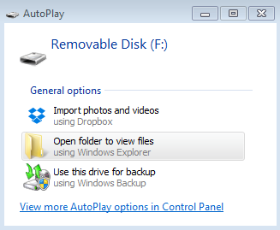

Memory sticks in the classroom
Put the memory stick in the computer.
Sometimes an automatic windows pops up.
If it does then click Open folder to view files.

Slide 54
Memory sticks in the classroom
If the window does pop up automatically click the folder button.
Look for the removable disk. It may have the letter E: or a different letter.

Slide 55
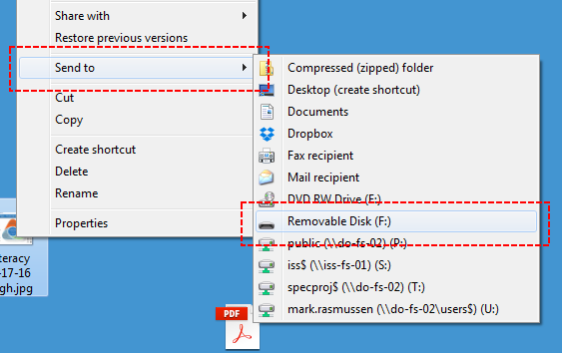
Memory sticks in the classroom
Now you can drag files to the folder.
When I find a file I want to send to a memory stick I like to right click and then send the file to the memory stick.

Slide 56
Buying a computer for myself
Go to Costco and spend the amount of money you want to.

Slide 57
Being Nice to the District Techs
The best way to get help from the IT department is to be nice. Nice than nice. The nicest.
Also be persistent. You shouldn’t have to wait a month to get something fixed.

Slide 58
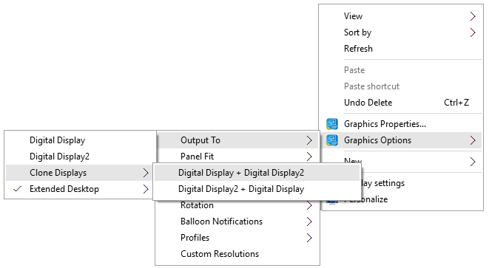
Using the LCD Projector
Check your cords
Check your input
Right click on your desktop
Click Clone Displays

Slide 59
Best practices for student use the first 3 things students should do
Turn the computer and log in
Check their sound
Check their Wifi connection

Slide 60
Bonus Round Gafe
Google Apps for Education is coming

