Slide 1
Advanced Technology
Mark Rasmussen and Erik Ramirez

Slide 2
Agenda
Introduction
SAMR
GAFE
Menu
Questions

Slide 3
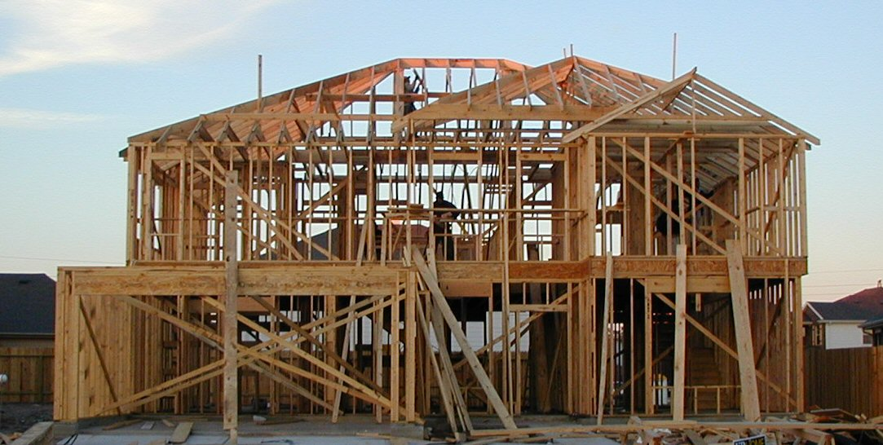
SAMR
A framework for understanding technology use in the classroom
Stages of implementation and progress
Nice way to build up as your skills and site’s technology grow

Slide 4
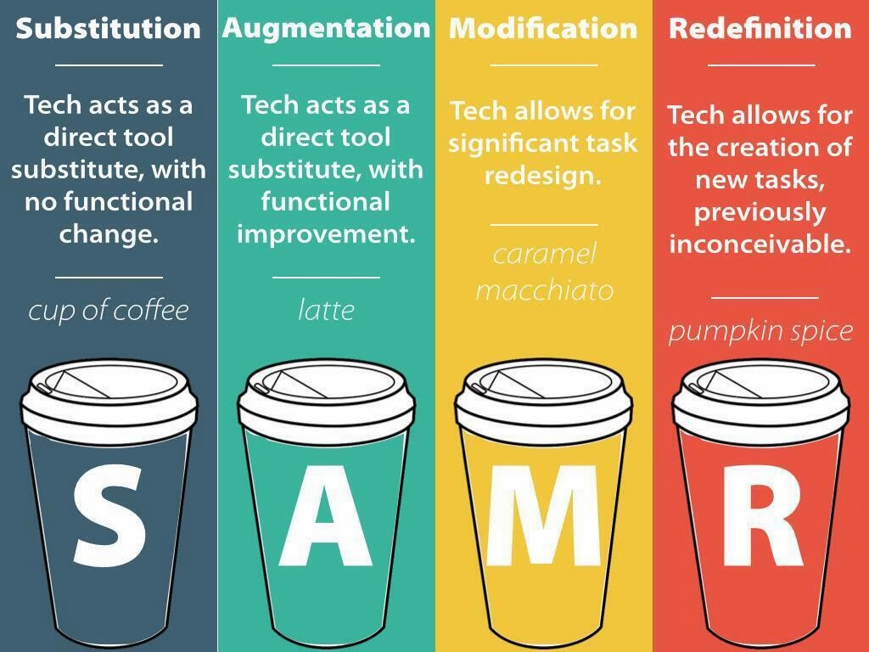
Enhancement
Transformation

Slide 5
The Assignment
The students will show what learned about the Industrial Revolution

Slide 6
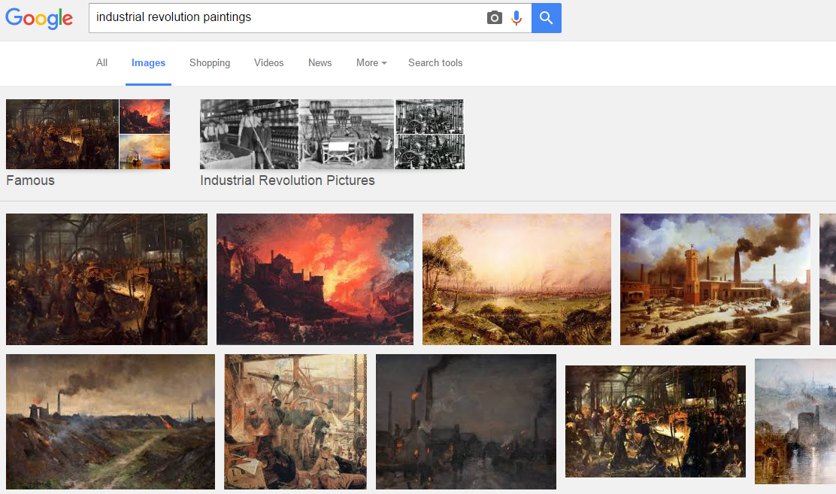
Substitution

Slide 7
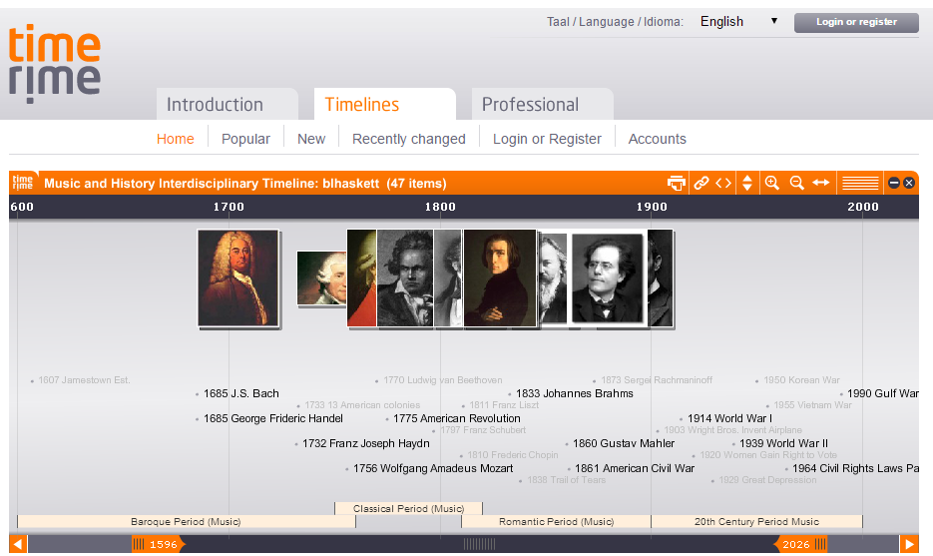
Augmentation

Slide 8
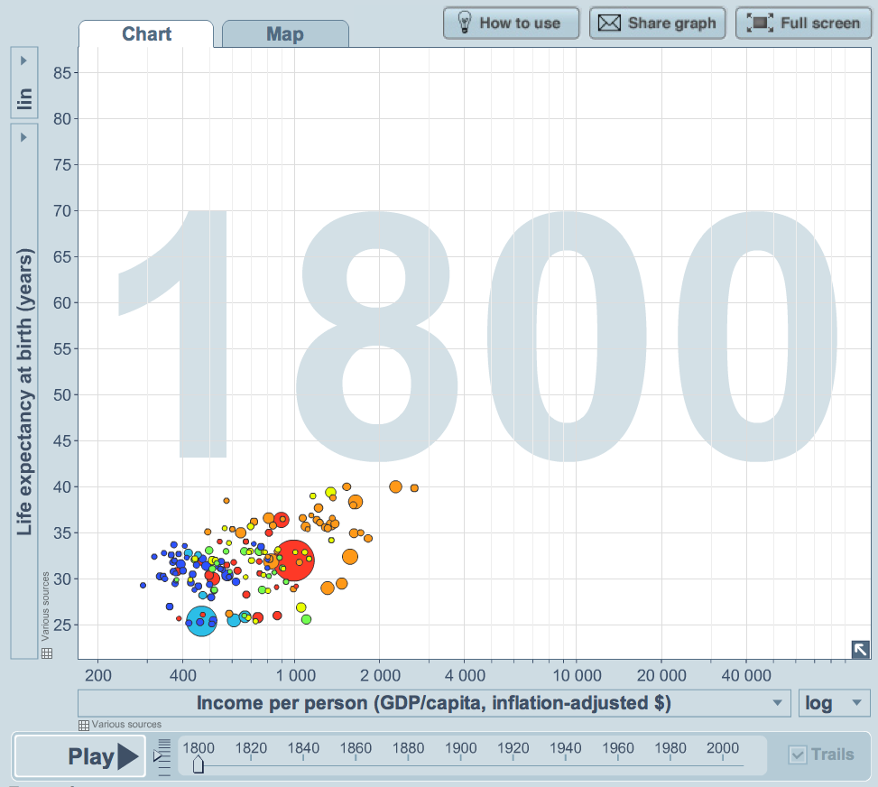
Modification

Slide 9
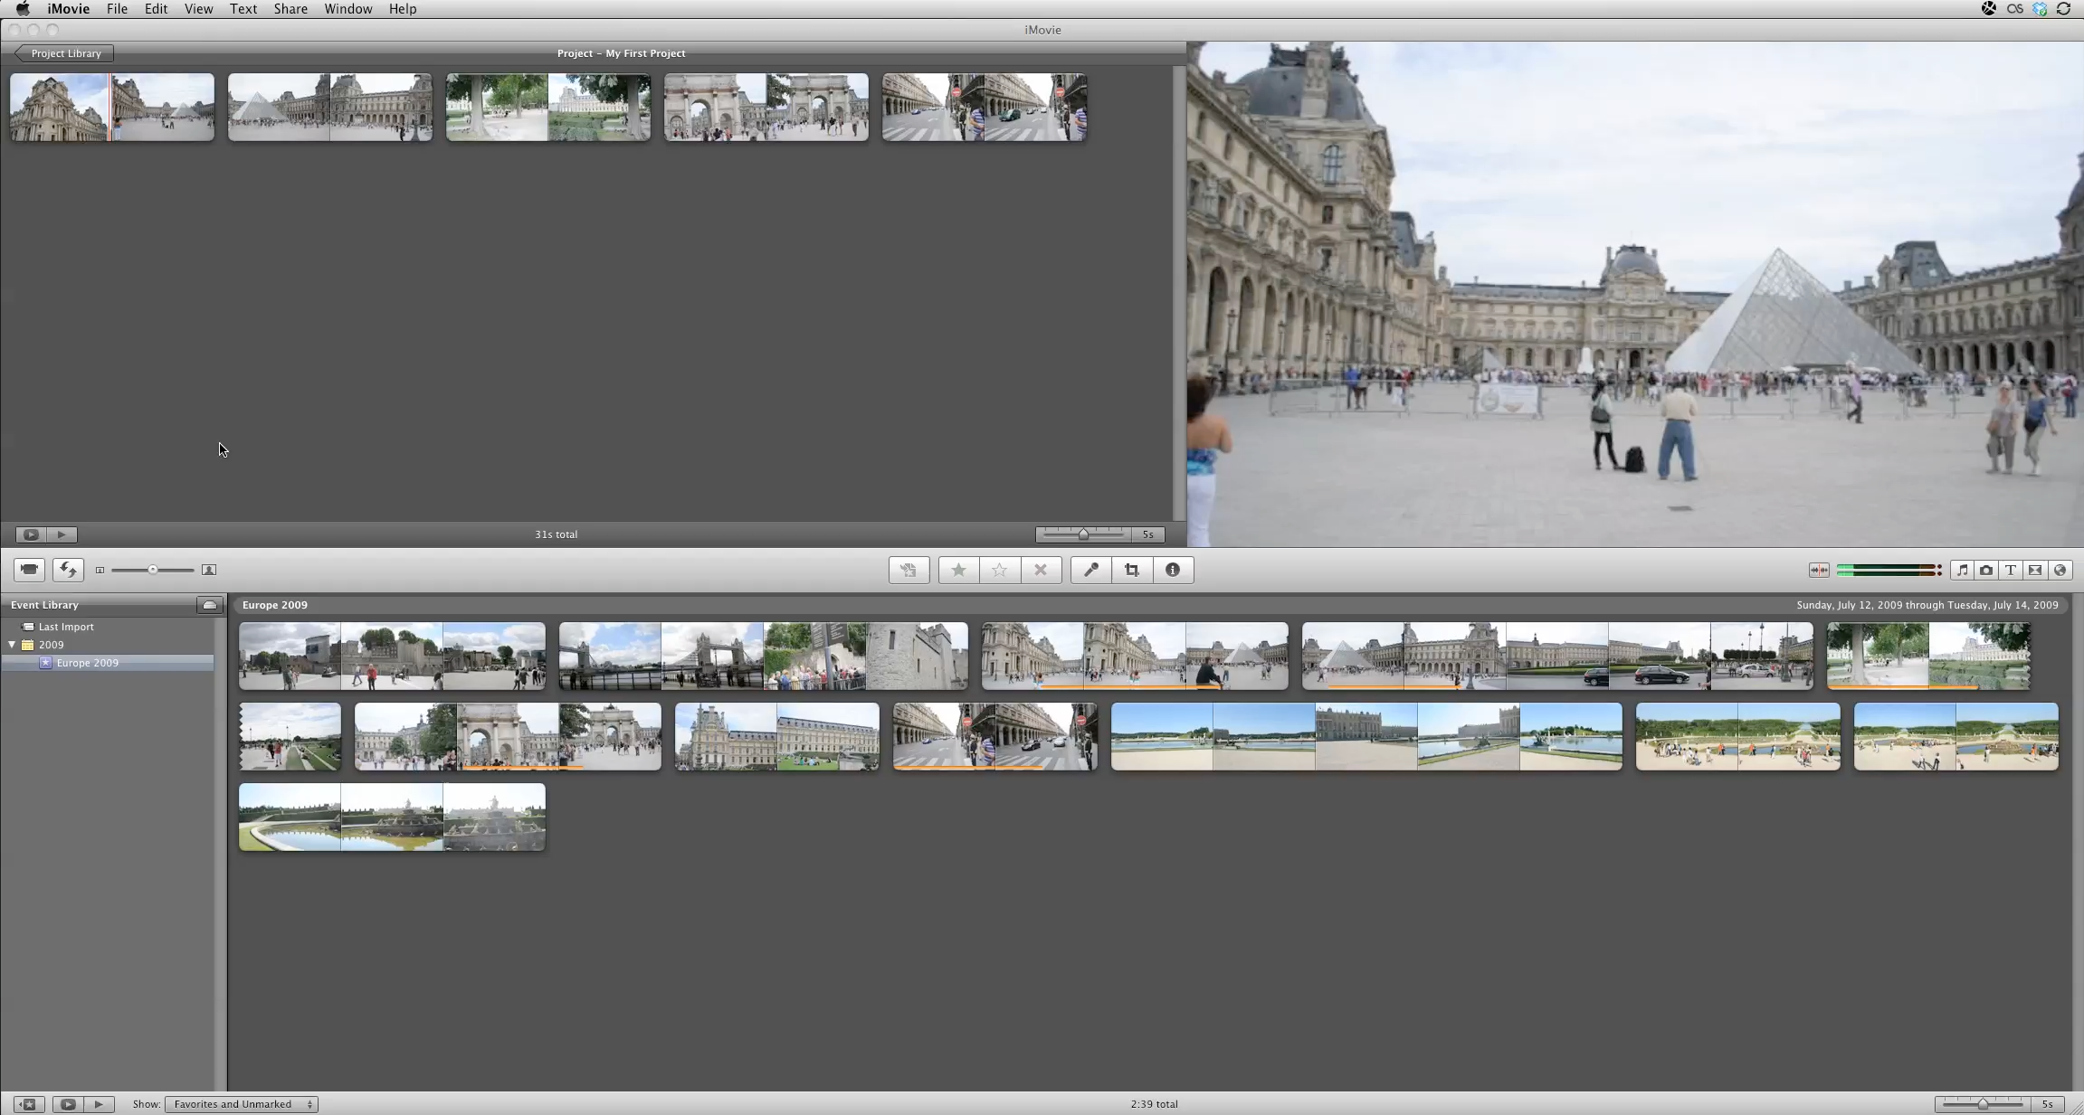
Redefinition

Slide 10
The Assignment
Extra SAMR Models – Continue on
Google Apps for Education Click Here

Slide 11
The Assignment
In a History Social Studies class you need to show the location of a city.

Slide 12
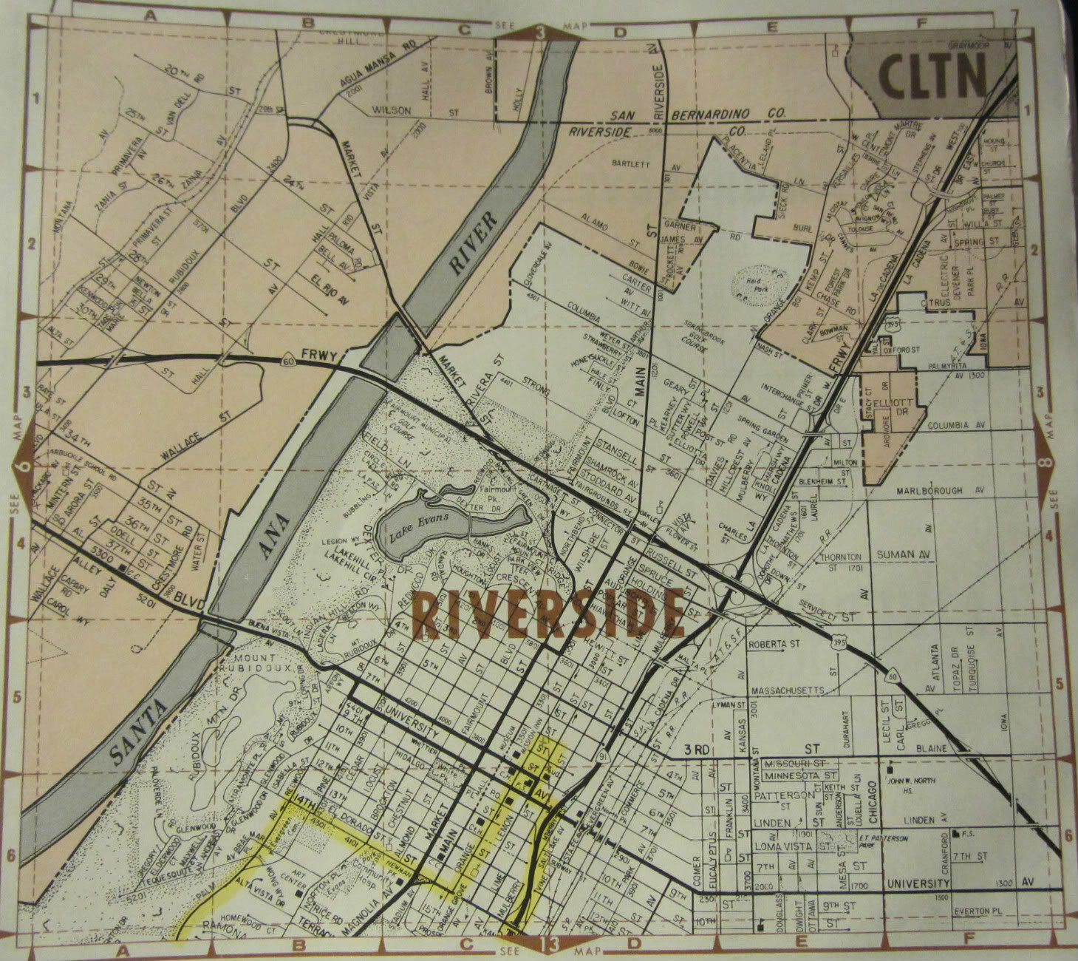
Substitution
Create a Power Point that shows a picture of map and the location of the city.

Slide 13
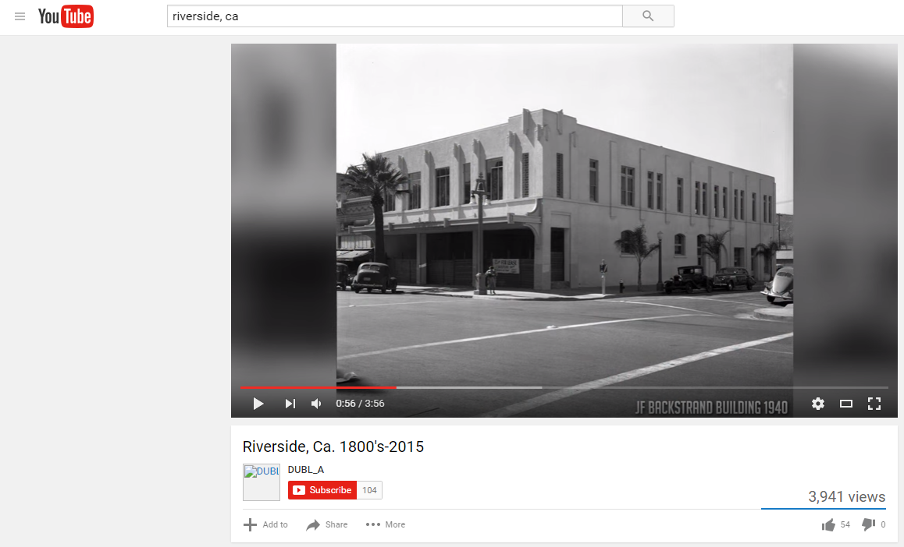
Augmentation
Augmentation – Incorporate multimedia like video and websites.

Slide 14

Modification
Create a digital travel brochure that incorporates multimedia and student created videos

Slide 15
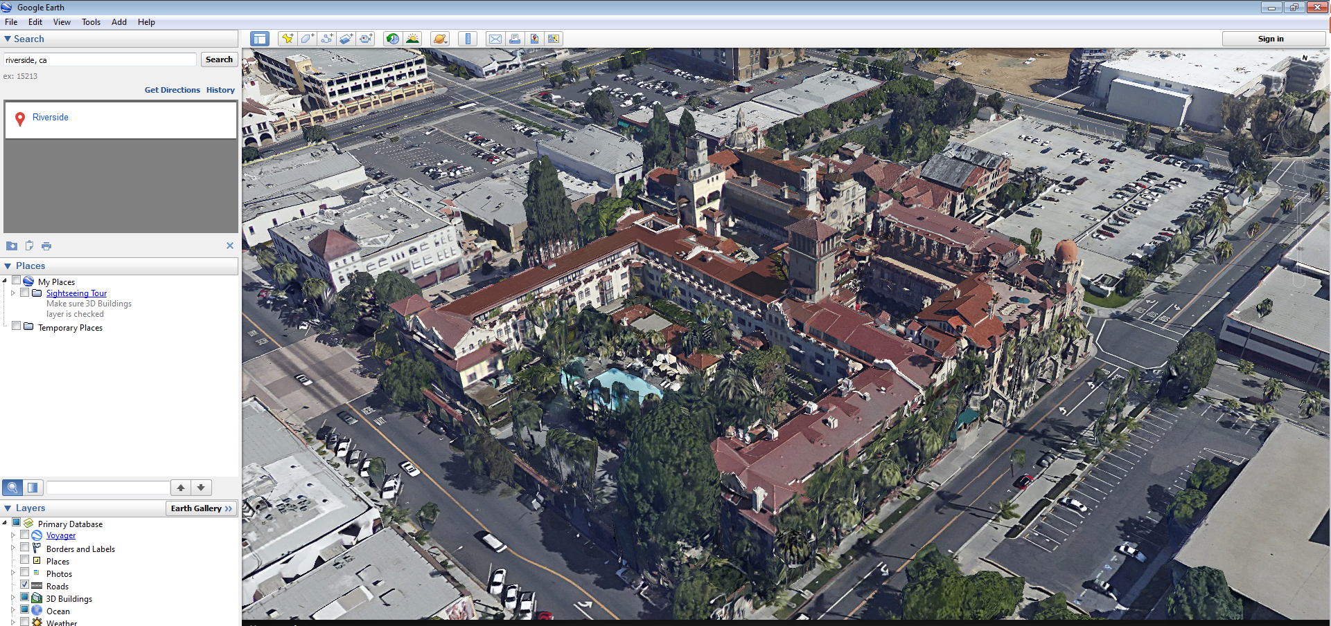
Redefinition
Explore the city with Google Earth and 3D models. Seek out and find interviews with people who have visited the city.

Slide 16
The Assignment
The students multiply and divide polynomials

Slide 17
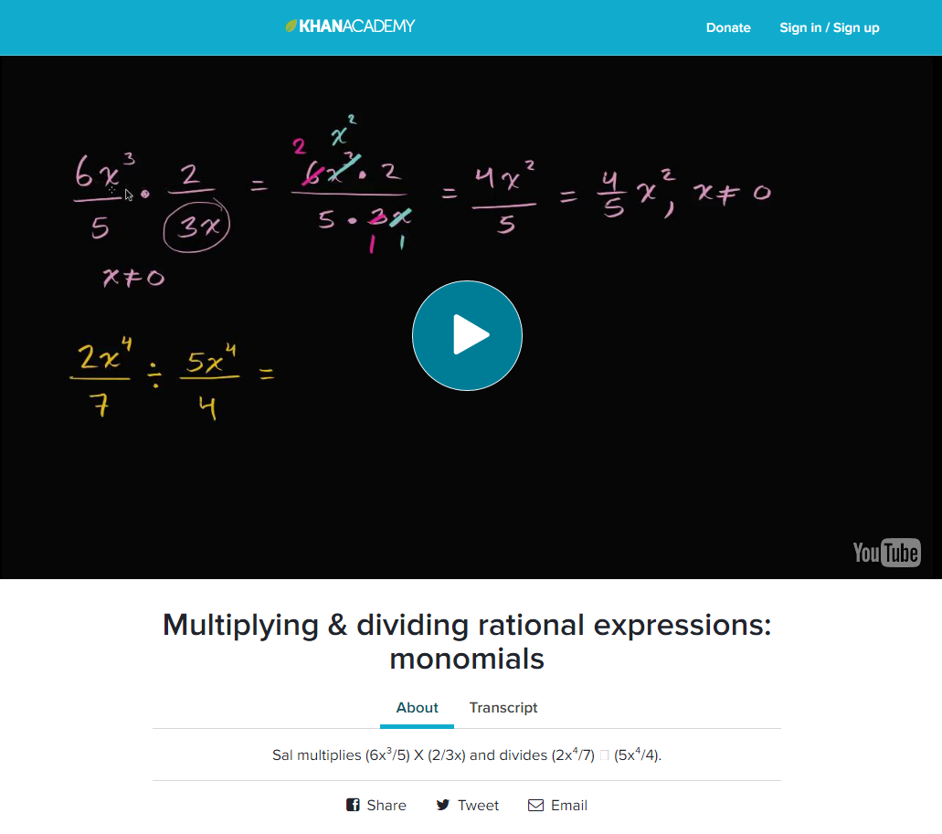
Substitution
The teacher shares the presentation they created in Power Point with the students. The students also uses Khan Academy to learn the process.

Slide 18
Augmentation
The teacher creates an online worksheet where students collaborate to complete it. The worksheet is then shared with another group to check the work.

Slide 19
Modification
Students collaborate and create their own worksheets, expanding their knowledge further than just knowing how to plug and chug numbers. They give the worksheet to another group to complete.

Slide 20
Redefinition
Students create videos and screen captures of the work they have done. They create tutorials that students from around the world could watch and learn from. They post the videos on YouTube, Instagram, Snapchat, Vimeo, Vine.co, TeacherTube, Break.com, Buzznet, Comedy.com, Dailymotion, EngageMedia, Flickr, Funnyordie.com, LeTV, MainStreaming, MetaCafe, MySpace, Facebook, Vimeo, or even your local Blockbuster (must be submitted on VHS Video tape.

Slide 21
Now you try – The Assignment is:
Students are assigned to respond to a piece of literature citing evidence for their opinion.
1. Go to www.alvordschools.org/erikandmark
2. Make your first attempt at thinking about how you would approach the 4 levels of the SAMR model. These are not graded in any way shape or form. There is no perfect answer in the SAMR model. Please respond comment on one of the levels.
We will share our possible answer to☺

Slide 22
Substitution
Students are given the piece of literature as a .pdf file so they can make and annotate what they are reading.
The students type their responses in a word process or Google Docs.

Slide 23
Augmentation
The students create a Google Presentation or Prezi about their response. Students comment on other students responses and cite evidence to agree or disagree.

Slide 24
Modification
The teacher comments and grades the digital Google Document. An opportunity is made possible for students to improve their work. The teacher selects some of the best and shares these documents with the rest of the class.

Slide 25
Redefinition
Students create an infographic that represents their thinking incorporating graphics that communicate their thinking along with text.
https://docs.google.com/a/hillcresttrojans.com/drawings/d/1G0-ne4ymKyyISKguJjO25U6GEB3lzYhM1uvFAfba8dw/edit?usp=sharing
https://drive.google.com/drive/folders/0B-U_G3iKeLGxUWhGVlhpY3lzeW8

Slide 26

Google Apps For Education (GAFE)
Whole suite of apps, constantly growing
Online
Free and/or Fee based
Work with any almost any platform
Word processing, 3D modeling, Graphic organizers, etc.
Linked to your Google account

Slide 27
Convert YouTube Video
Personal Learning Networks
Embedding Video
MENU
Online Testing
Digital
Citizenship
Virtual Field Trips
Content Delivery

Slide 28
Questions

Slide 29


Slide 30


Online Testing
SBAC Assessment
SBAC Practice Tests
SBAC Training Tests
Interim Assessments
EADMS can mimic these question types and provides options other than constructed response for faster grading.
Table Ma
Back

Slide 31

Digital Citizenship
Common Sense Media offers lessons for…
  Parents
  Teachers
  Students
  Spanish Language translations
Teaches students how to navigate digital media responsibly
Back

Slide 32
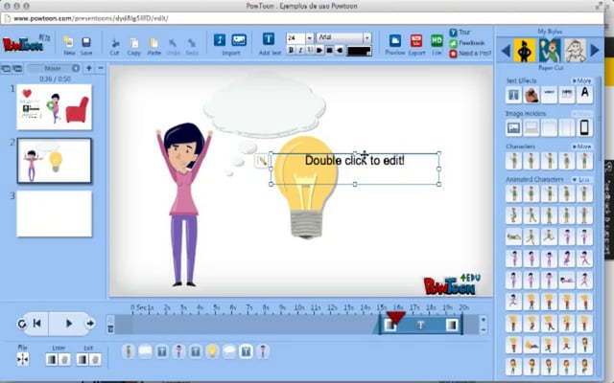
Content Delivery
There are many alternatives to PowerPoint…
SMARTBoard
Prezi
Voicethread
Powtoon
Back

Slide 33
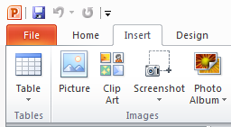
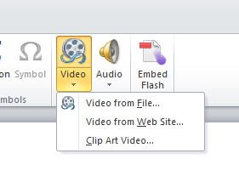
Embedding Video
Save the video from YouTube using Keepvid.com
In Power Point click Insert.
Click Video and Video from file.
Navigate to the file and click insert.
Back

Slide 34

Virtual Field Trips
Museums
History
Science
Art
Back

Slide 35

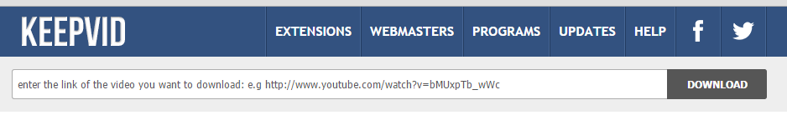
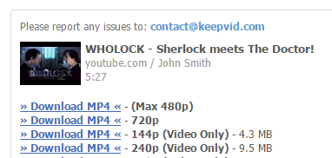
Convert YouTube Video
Go to YouTube and find the video you want.
Copy the link from YouTube.
Paste the link at www.keepvid.com
Download the link that is on the top with a right click and save as.
Back

Slide 36
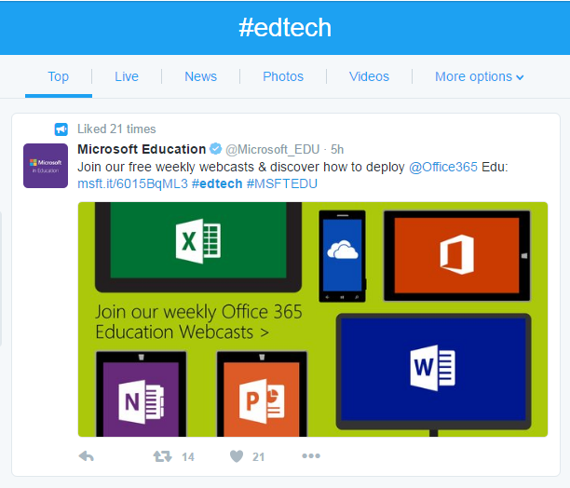
Personal Learning Networks
Curate collections of materials for your personal use…
  Twitter
  Teaching Channel
  Podcasts
  Pocket
  Blogs
Back

