Slide 1


ELAC Meeting
Valley view Elementary
April 20, 2020
Junta de ELAC
Escuela Primaria Valley View
20 de abril de 2020

Slide 2
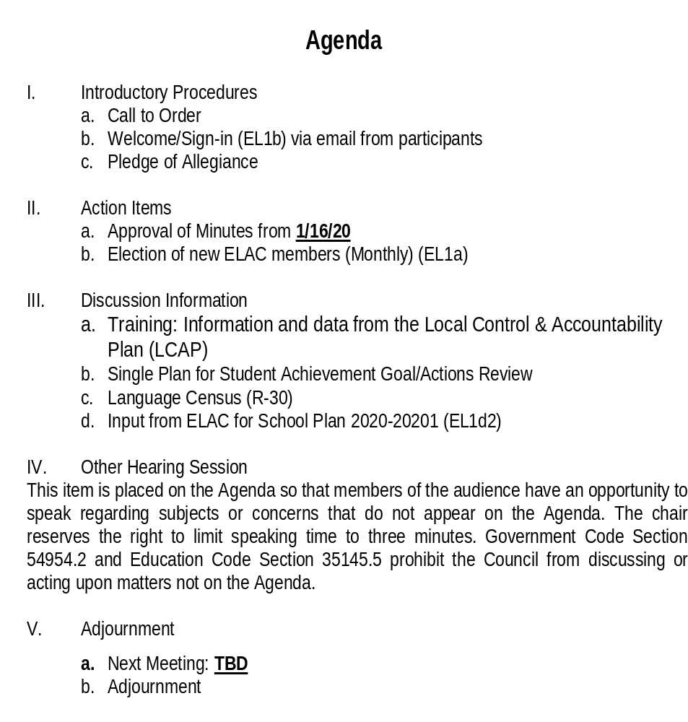
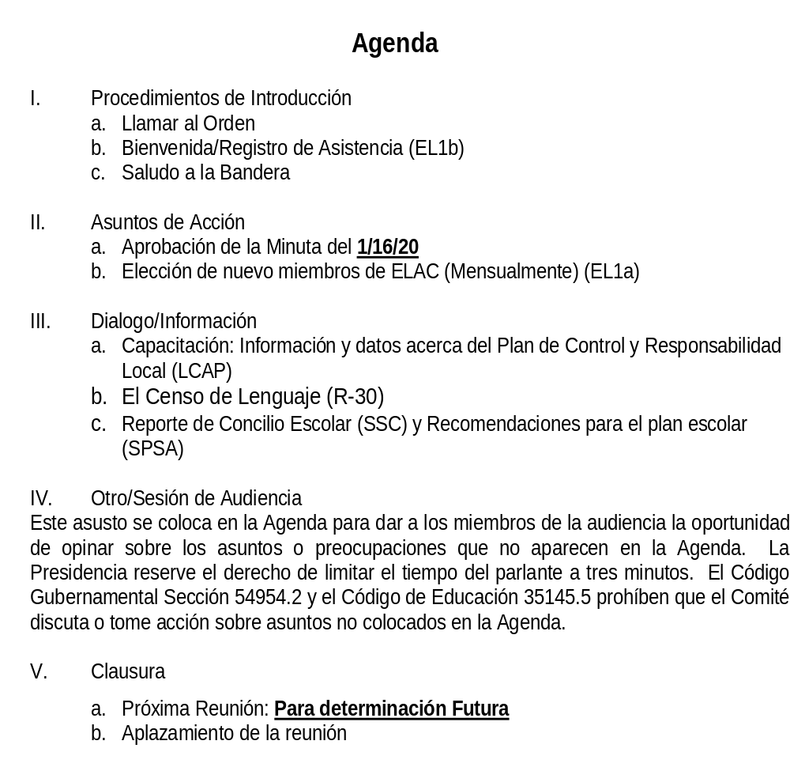

Agenda
Agenda
Notes:
Additionally, here are a few other ways that you can help your child be successful:
[For elementary schools]
Encourage your child to read daily.
[For middle and high schools]
Your child will likely have homework every day. You can help support their success by making sure your child has a quiet place at home to do that work that is free from distractions.
[For all students]
When it’s time for testing, talk to your child about the test. Make sure your child knows that the tests are important, but they are just one measure of learning. The teacher uses that information along with other information to make sure your child is getting the support they need.
If you’re interested, the California Department of Education has also developed ELPAC Practice Tests that you can access from home on the computer. You can look at sample test questions and get familiar with the way questions are presented on the computer. More information about the ELPAC Practice Tests are on the Parent Resources flyer that you received today/tonight.
[For elementary schools]
Animar a su hijo a leer diariamente.
[For middle and high schools]
Su hijo seguramente tendrá tarea todos los días. Puede ayudar a que tengan éxito asegurándose de que cuentan con un lugar tranquilo en la casa para hacer su tarea sin distracciones.
[For all students]
Cuando sea tiempo de presentar el examen, hable con su hijo acerca de ello. Asegúrese de que su hijo esté consciente de que los exámenes son importantes, pero son solamente un indicador de su aprendizaje. El maestro usa esa y otra información para asegurarse de que los alumnos reciben el apoyo que necesitan.
Si usted está interesado, el Departamento de Educación de California ha desarrollado un examen ELPAC de práctica que usted puede acceder por computadora desde su casa. En la computadora puede ver ejemplos de preguntas y familiarizarse con la manera en que se presentan. El volante de Recursos para Padres que recibió hoy/esta tarde, contiene más información acerca de los exámenes de práctica ELPAC.

Slide 3
Local Control and Accountability Plan (LCAP)
Plan de Control y Responsabilidad Local (LCAP)
https://youtu.be/Oy68M8YPJZY

Slide 4

Local Control and Accountability Plan
https://www.alvordschools.org/lcap
Plan de Responsabilidad y Control Local
https://www.alvordschools.org/lcap

Slide 5

Local Control and Accountability Plan (LCAP)
Plan de Responsabilidad y Control Local (LCAP)
Goal 1: Conditions of Learning-Students will be enrolled in a comprehensive course of study taught by highly qualified staff in schools that are clean and in good repair
Goal 2: Pupil Outcomes-Students will be prepared to be college and career ready when they graduate from high school
Goal 3: Engagement-Students will be educated in an environment which fosters connectedness and is inclusive of students, parents, and staff
Meta 1: Condiciones de aprendizaje-Los alumnos estarán inscritos en cursos de estudio integral impartido por personal altamente calificado en escuelas limpias y en buenas condiciones
Meta 2: Resultados Estudiantiles- Se preparará a los alumnos para que al graduarse de la secundaria estén listos para la universidad y profesión
Meta 3: Participación-Los alumnos recibirán instrucción dentro de un entorno que fomente la conectividad con la escuela e incluya a los alumnos, padres y personal escolar
https://youtu.be/QFaHBBQOVgc
Notes:
Review the three overarching goals within the LCAP for the current LCAP and the new LCAP.
Share that an essential part of the LCAP process is the voice of our stakeholders and their input into what we need to do as a district to achieve these goals.
Questions to consier:
Do we continue the current actions and services?
Are the goals, actions, and services appropriate?
Are we implementing the actions and services fully to meet the goals?
What more do we need to do?

Slide 6
Priority | Priority Area | State Indicator | Local Indicator
1 | Basic Services at Schools | Not Applicable (NA) | Basic Conditions at Schools
2 | Implementation of State Academic Standards | NA | Implementation of State Academic Standards
3 | Parental Engagement | NA | Parent Engagement
4 | Student Achievement | Academic Indicator (3rd - 8th , 11th) English Learner Indicator | NA
5 | Student Engagement | Chronic Absence Indicator(K-8th) Graduation Rate Indicator (HS) | NA
6 | School Climate | Suspension Rate Indicator | Local Climate Survey
7 | Access to a Broad Course of Study | NA | Access to a Broad Course of Study
8 | Outcomes in a Broad Course of Study | College/Career Indicator (HS) | NA
Prioridad | Área de Prioridad | Indicador Estatal | Indicador Local
1 | Servicios básicos en escuelas | No aplicable (NA) | Condiciones básicas en escuelas
2 | Implementación de están-dares académicos estatales | NA | Implementación de están-dares académicos estatales
3 | Participación de padres | NA | Participación de padres
4 | Rendimiento estudiantil | Indicador académico (Gr. 3-8, 11) Indicador de alumnos aprendiendo inglés | NA
5 | Participación estudiantil | Indicador de ausentismo crónico (K-8) Indicador de tasa de graduación (HS) | NA
6 | Entorno escolar | Indicador de tasa de suspensión | Encuesta del entorno local
7 | Acceso a un amplio curso de estudios | NA | Acceso a un amplio curso de estudios
8 | Resultados de un amplio curso de estudios | Indicador de universidad/profesión (HS) | NA
Notes:
Review the Priority areas and share that the CA School Dasboard is where our results as a school site and as a district can be found.
Share the goals within LCAP, as well as the actions and services address the 8 Priority areas.
Refer the participants back to your previous meetings where you’ve reviewed your site data and asked for input for the SPSA development. It is essential that there is a connection from the needs of school sites to LCAP, so that our goals are aligned and we are all working toward implementing actions and serivices that will lead to the success of our students.
(Note: You may want to include a slide regarding your Dashboard data)

Slide 7






Local Control and Accountability Plan (LCAP)
LCAP GOALS
8 Priority Areas
Conditions
of
Learning
Students will be enrolled in a comprehensive course of study taught by highly qualified staff in schools that are clean and in good repair
Development of
2020-2023
LCAP
State Indicators
Students will be prepared to be college and career ready when they graduate from high school.
Pupil
Outcomes
Students will be educated in an environment which fosters school connectedness and is inclusive of students, parents, and staff.
Local Indicators
Engagement
Notes:
As we are developing the new LCAP, we want feedback from our parents.
This is the 2nd 3 year accountability plan. The first was for 2017-2020, which we are finishing up.

Slide 8
Plan de Control y Responsabilidad Local (LCAP)
METAS LCAP
8 Areas de prioridad
Los alumnos estarán inscritos en un curso de estudio integral impartido por maestros altamente calificados en escuelas limpias y en buen estado.
Condiciones de
Aprendizaje
Desarrollo de LCAP
2020-2023
Indicadores estatales
Resultados Estudiantiles
Los alumnos estarán preparados para asistir a una universidad y listos para una profesión cuando se gradúen de la escuela secundaria.
Se educará a los alumnos en un ambiente escolar que fomente la conectividad escolar e incluya a todos los alumnos, padres y personal escolar.
Indicadores locales
Participación

Slide 9
Goal 1: Conditions of Learning
Students will be enrolled in a comprehensive course of study taught by highly qualified staff in schools that are clean and in good repair
Meta 1: Condiciones de aprendizaje
Los alumnos estarán inscritos en cursos de estudio integral impartido por personal altamente calificado en escuelas limpias y en buenas condiciones
Restrooms- scratches on mirrors
Newcomer program? District Newcomer center
Need for adopted math curriculum
Lack of technology, updated tech in all classrooms – SMART Boards/Promethean Boards
Color marque – community communication
Classrooms for growth
Shade structure for hot weather days & PE
Street traffic, crosswalk safety
Before and after school campus supervision
Fencing too low, allows weekend vandalism
Murals painted
Stage in MPR
Baños - arañazos en los espejos
¿Programa para recién llegado? Centro distrital de recién llegados
Necesidad de adoptar un currículo de matemáticas
Falta de tecnología, se necesita actualizar la tecnología en todas las aulas – Tableros SMART/Promethean
Una marquesina de color - comunicación comunitaria Aulas por el crecimiento
Estructura de sombra para días de clima cálido y EP Tráfico en la calle, seguridad en los cruces peatonales Supervisión escolar antes y después de clases
Cercado demasiado bajo, permite el vandalismo durante el fin de semana
Murales pintados
Escenario en el Salón de Uso Múltiple
Notes:
Record input related to Goal 1 within the LCAP

Slide 10
Goal 2: Pupil Outcomes
Students will be prepared to be college and career ready when they graduate from high school
District Benchmarks & Monitoring Tool
College & Career Weeks at every school
College Nights at all secondary schools
Scope & Sequence for math standards
ALL students at grade level, 5th graders must be ready for middle school success
Social Emotional Learning taught in the classrooms, training fro teachers
Universal Design for Learning training for all
Tutoring agencies brought in after school to allow teachers time for families and not get burned out
Notes:
Record input related to Goal 2 within the LCAP

Slide 11
Goal 2: Pupil Outcomes
Students will be prepared to be college and career ready when they graduate from high school
Tutoring mandatory if not at grade level
Designated program, materials, and time during the school day for newcomers to transition
Newcomers center at district level for family transition
Full-time classroom instructional assistants to support each K-2 classroom to ensure ALL students are reading at grade level by 3rd grade – maybe they provide the tutoring during the bells
Notes:
Record input related to Goal 2 within the LCAP

Slide 12
Meta 2: Resultados Estudiantiles
Se preparará a los alumnos para que al graduarse de la secundaria estén listos para la universidad y profesión
Puntos de referencia/herramienta de monitoreo nivel distrito
Semanas universitarias y profesionales en cada escuela
Noches universitarias en todas las escuelas secundarias
Alcance y secuencia para los estándares de matemáticas
TODOS los estudiantes a nivel de grado, los estudiantes de 5to grado deben estar listos para el éxito en la escuela secundaria
Aprendizaje social y emocional impartido en las aulas, capacitación para los maestros
Diseño universal para la formación de aprendizaje de todos
Agencias de tutoría incorporadas después de la escuela para dar tiempo a los maestros con sus familias y no consumirse
Tutoría obligatoria si no esta a nivel de grado
Programa designado, materiales y tiempo durante el día escolar para la transición de los recién llegados
Centro de recién llegados a nivel de distrito para la transición familiar
Asistentes de instrucción en el aula de tiempo completo para apoyar cada aula de K-2 para garantizar que TODOS los estudiantes estén leyendo a nivel de grado para cuando lleguen al 3er grado, quizá brinden la tutoría durante horas escolares
Notes:
Record input related to Goal 2 within the LCAP

Slide 13
Goal 3: Engagement
Students will be educated in an environment which fosters connectedness and is inclusive of students, parents, and staff
Chronic Absenteeism- Saturday School for ADA recovery but model needs a catchy name to entice families. Open to ALL aged children and their families. Parent education- First 5, pre-school strategies, literacy skills, hands-on activities (fine and gross motor skills), how to read aloud at home, social emotional learning/how to discipline/set boundaries, how to find community resources/agencies, how to fill out job applications/create a resume/interview for employment.
To avoid teacher burn-out hire outside agencies to provide a ‘wheel of rotations’ to engage in: cooking/nutrition, yoga, Zumba, local hike or bike, sports game students against parents, VAPA offerings: singing/choir/instruments, Art in a Box (Riverside Art Museum), drama or assembly (Imagination Machine), STEAM – science experiments.
Notes:
Record input related to Goal 3 within the LCAP

Slide 14
Meta 3: Participación
Los alumnos recibirán instrucción dentro de un entorno que fomente la conectividad con la escuela e incluya a los alumnos, padres y personal escolar
Absentismo crónico: Escuela sabatina para la recuperación de los fondos de asistencia escolar, el modelo necesita un nombre atrayente para obtener la atención de las familias. Abierto a TODOS los niños de edad y sus familias.
Educación para padres: primeros 5, estrategias preescolares, habilidades de alfabetización, actividades prácticas (habilidades motoras finas y gruesas), cómo leer en voz alta en el hogar, aprendizaje social emocional, cómo disciplinar/establecer límites, cómo encontrar recursos comunitarios/agencias, cómo llenar solicitudes de empleo/crear un resumen profesional, entrevista para empleo.
Para evitar el agotamiento de los maestros, contratar agencias externas para proporcionar una ‘sistema de rotaciones' para participar en: cocina/nutrición, yoga, zumba, caminata local o en bicicleta, juegos deportivos alumnos contra padres, ofertas de VAPA: canto/coro, instrumentos, arte en caja (Riverside Art Museum), drama o asambleas (Maquina de Imaginacion), STEAM - experimentos científicos.
Notes:
Record input related to Goal 3 within the LCAP

Slide 15

LCAP
Questions?
¿Preguntas?

Slide 16

Programas Estatales y Federales
(951) 509-6178 ext. 225178
State and Federal Programs
(951) 509-6178 ext. 226178
Angela Gallardo-Hopkins, Director
ahopkins@alvordschools.org
Pauline Kawahara, Assistant to the Director pauline.kawahara@alvordschools.org
Angie Arzaga, Bilingual Clerk II
angie.Arzaga@alvordschools.org
Business Services
(951) 509-5095
Dusty Nevattt, Chief Business Officer dusty.nevatt@alvordschools.org
Fernando Cubias, Director
fernado.cubias@alvordschools.org
Cynthia Shipley, Administrative Assistant
cynthia.shipley@alvordschools.org
Servicios Empresariales
(951) 509-5095

Slide 17

California Dashboard: Our District Results https://www.caschooldashboard.org/
Tablero Escolar de California: Datos de nuestro Distrito
https://www.caschooldashboard.org/
Notes:
Good Evening Families!
My name is [insert name] and I’m very excited about all the learning that will take place this year here at [insert school name].
Tonight, I’d like to share with you a few of the ways that we measure our school’s performance and progress from year to year using a system called the California School Dashboard, which is developed and maintained by the California Department of Education.
Let’s get started!

Slide 18






State Indicators/Indicadores estatales
Índice de Graduación de la Secundaria
Índice de Suspensión
Rendimiento Académico
Absentismo Escolar Crónico
Preparación para la Universidad/ Profesión
Progreso de el Aprendiz de Inglés
Notes:
There are six state measures. Lets go through them quickly.
Academic performance looks at our scores on the Smarter Balanced Summative Assessment, specifically how far above or below our students are from the grade-level standard. A separate score is provided for both mathematics and English language arts/literacy (also called ELA).
This measure is important because it allows us to see, on average, the performance of our students and if they are above or below standards.
The Graduation rate looks at how many of our students attending comprehensive high schools, within four years.
This measure is important because graduation from high school leads to more opportunities for our students in the long term and enables them to pursue a higher education.
The Suspension Rate looks at how many of our students were suspended.
This measure is important because it allows us to see if all student groups are receiving equal treatment and whether discipline policies are working.
College/Career Readiness looks at how many of our students graduate better prepared for success after high school.
This measure is important because it allows us to see how well high schools and districts are preparing students for likely success after high school graduation.
Chronic Absenteeism looks at how many of our students were chronically absent.
This measure is important because attendance is important to student success, and it is difficult for students to learn if they are absent from the classroom.
And English Language Progress looks at how well our English learners are progressing from year to year.
This measure is important because having all English learners reach English proficiency is the goal for California.

Slide 19
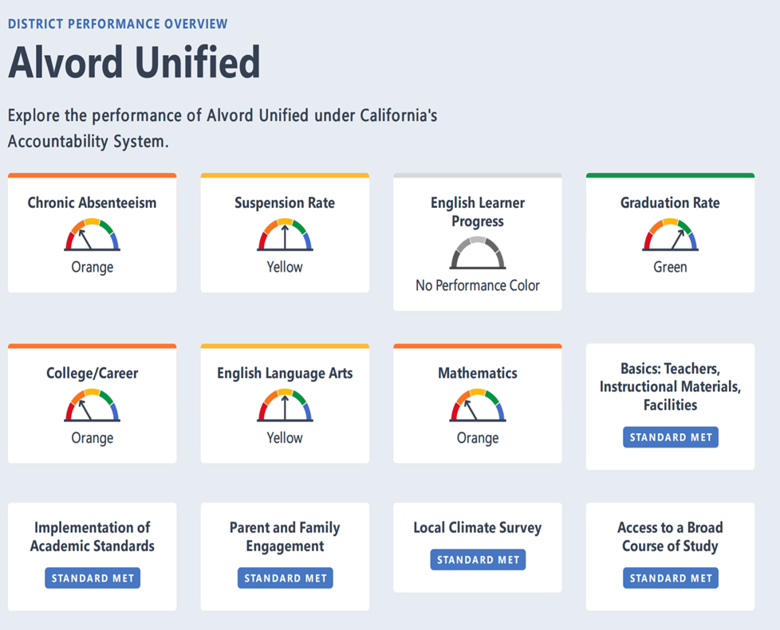
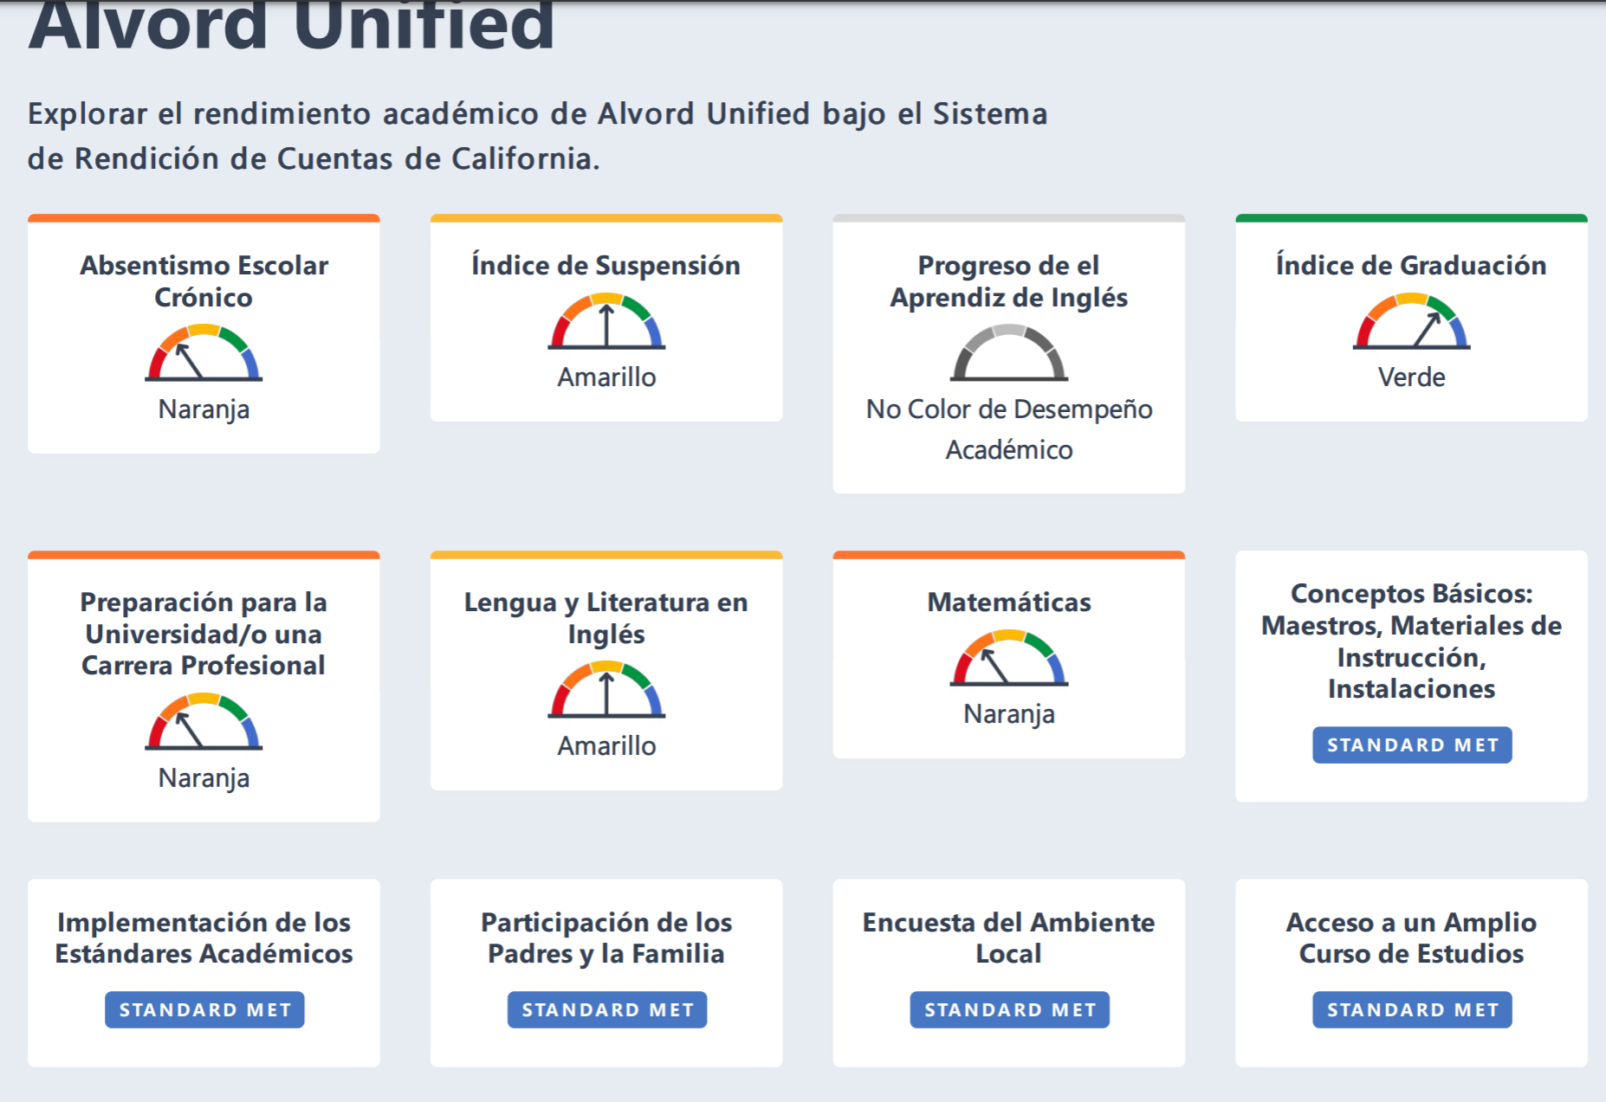
2019 California School Dashboard ~ Tablero Escolar de California
Notes:
The Academic Measure for ELA is calculated using student scores from the Smarter Balanced Summative Assessment in ELA.
Students in grades three through eight and grade eleven take this test every spring.
Our current year data is _____________
Our current year minus prior year is ____________________
These come together to give us a performance level, or color, of [insert color here]
[site can discuss more about their color, what it means for the school, and what they plan to do to continuously improve]
It is still unclear how K-12 school data will be displayed. Note for Jenny: Unified School Districts and K-12 schools. Unified districts and K-12 schools will receive only one performance color for math and one for ELA, which will include results from grade 3-8 and grade 11. The performance level, or color, is based on the cut scores established for Grades 3-8. High schools and high school districts, schools that only serve 9-12 or 7-12 students, will have their results based grade 11 assessments. Their performance level (color) is based on the high school cut scores.

Slide 20
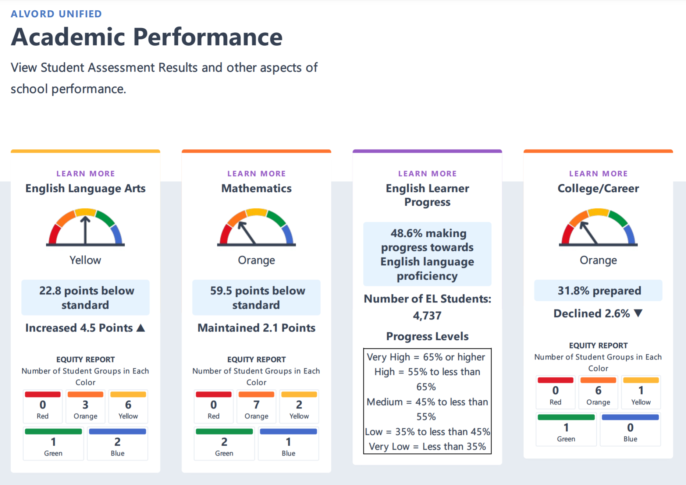
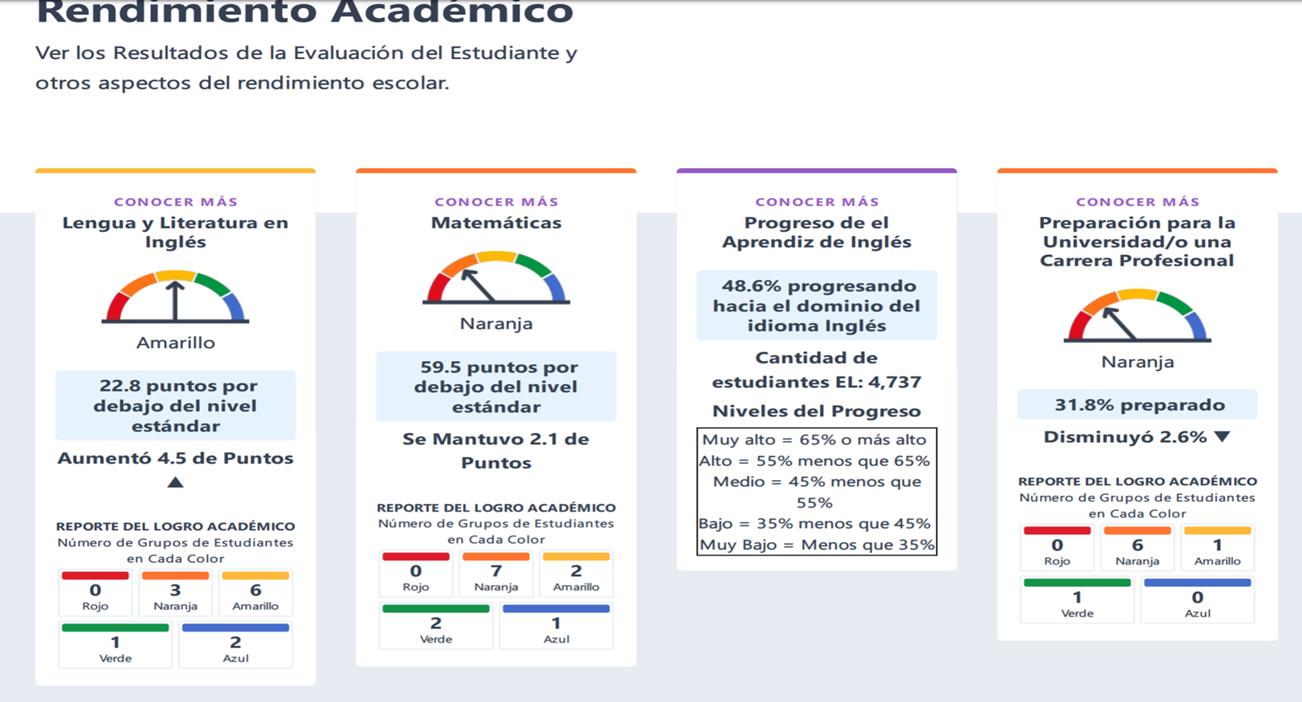
2019 California School Dashboard ~ Tablero Escolar de California
Notes:
The Academic Measure for ELA is calculated using student scores from the Smarter Balanced Summative Assessment in ELA.
Students in grades three through eight and grade eleven take this test every spring.
Our current year data is _____________
Our current year minus prior year is ____________________
These come together to give us a performance level, or color, of [insert color here]
[site can discuss more about their color, what it means for the school, and what they plan to do to continuously improve]
It is still unclear how K-12 school data will be displayed. Note for Jenny: Unified School Districts and K-12 schools. Unified districts and K-12 schools will receive only one performance color for math and one for ELA, which will include results from grade 3-8 and grade 11. The performance level, or color, is based on the cut scores established for Grades 3-8. High schools and high school districts, schools that only serve 9-12 or 7-12 students, will have their results based grade 11 assessments. Their performance level (color) is based on the high school cut scores.
The Academic measure for mathematics is calculated using student scores from the Smarter Balanced Summative Assessment in mathematics.
Students in grades three through eight and grade eleven take this test every spring.
Our current year data is _____________
Our current year minus prior year is ____________________
These come together to give us a performance level, or color, of [insert color here]
[site can discuss more about their color, what it means for the school, and what they plan to do to continuously improve]
The College/Career measure is calculated based on graduating classes and uses the courses and exams that students took during their four-years in high school.

Slide 21
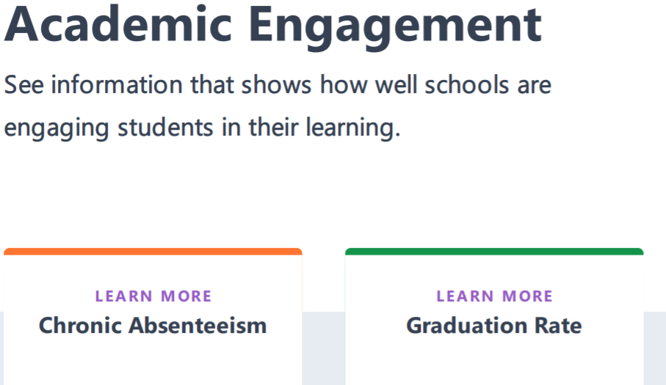
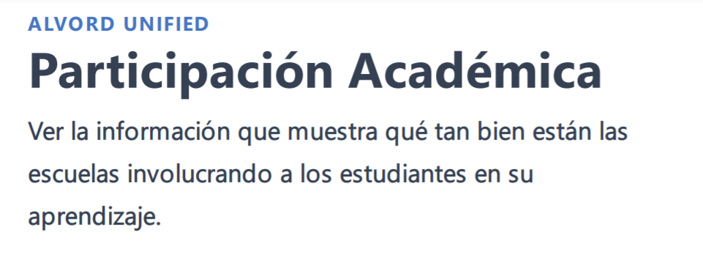
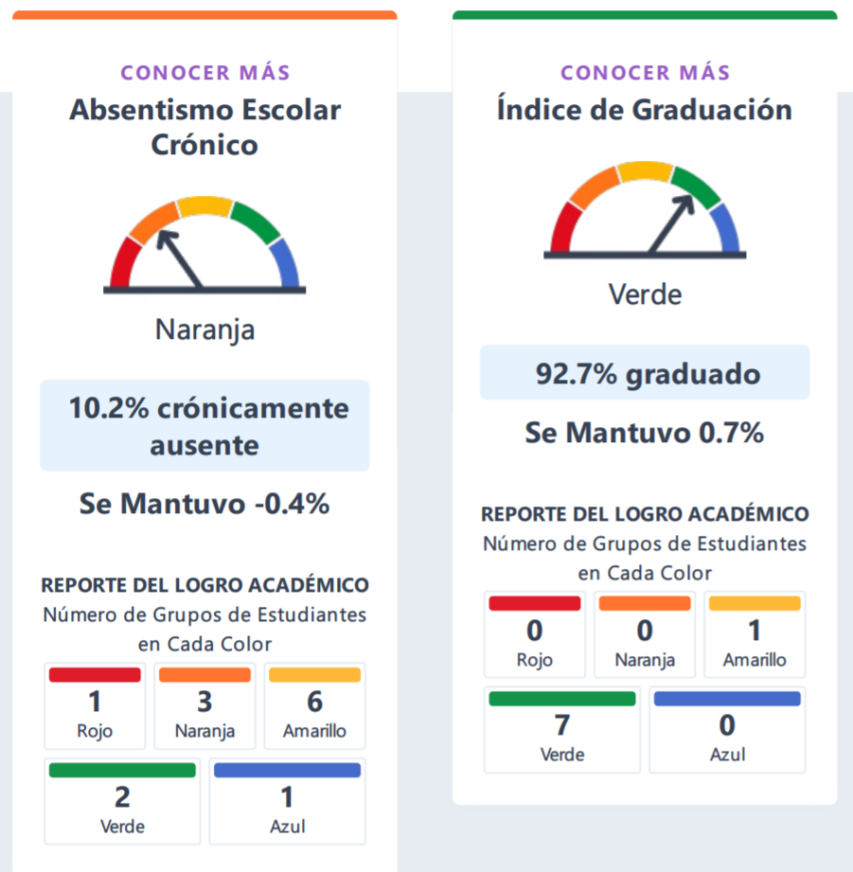
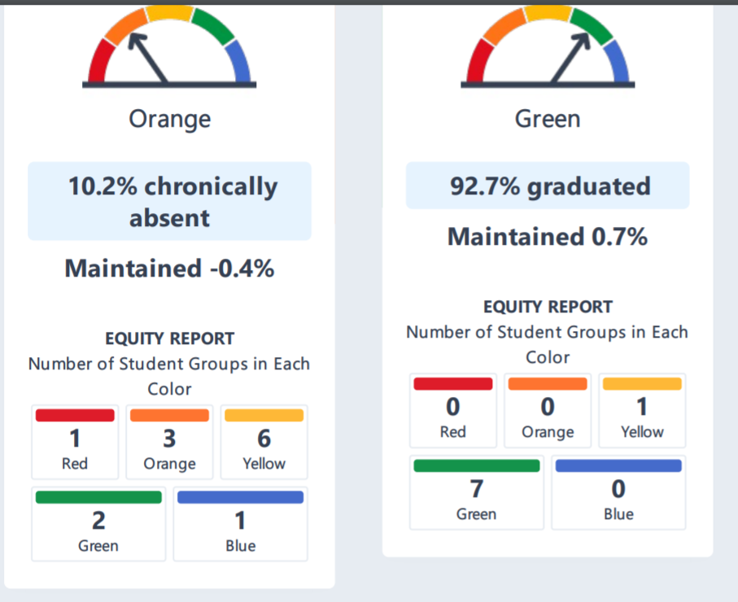
2019 California School Dashboard ~ Tablero Escolar de California
Notes:
The Chronic Absenteeism measure is calculated using attendance data that our district provides to the state.
The Graduation Rate measure is calculated using graduation data that our district provides to the state every year.
The Suspension Rate measure is calculated using suspension rate data that our district provides to the state.

Slide 22
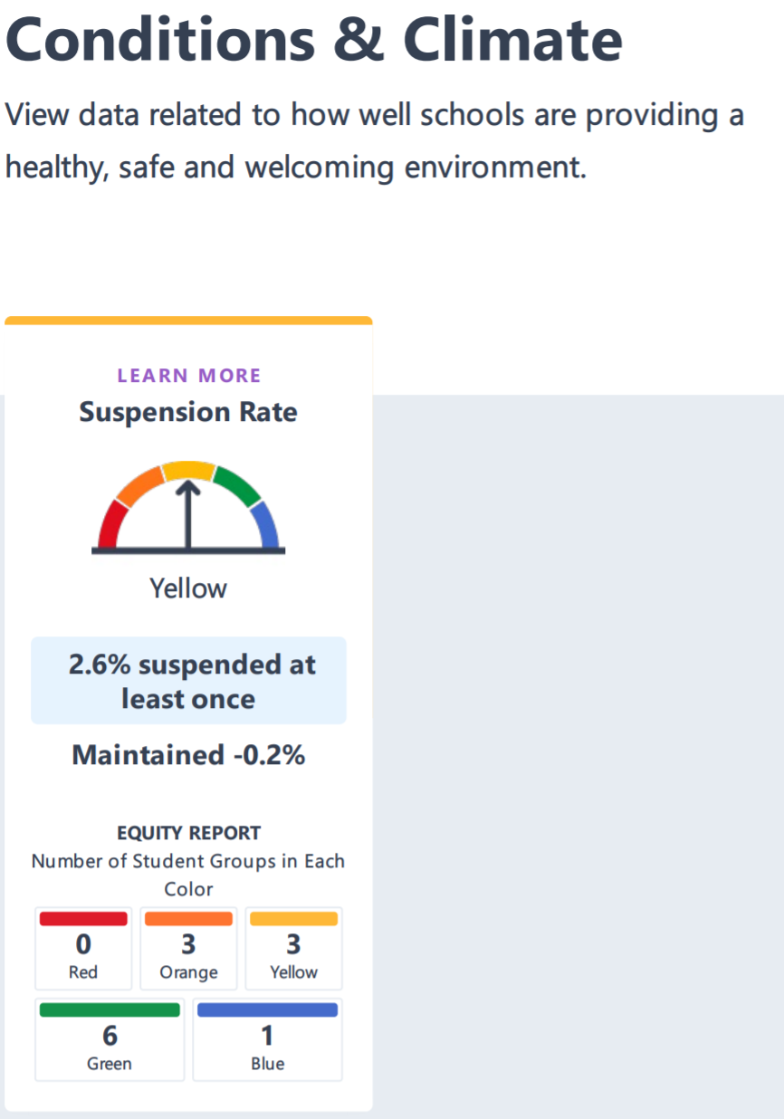
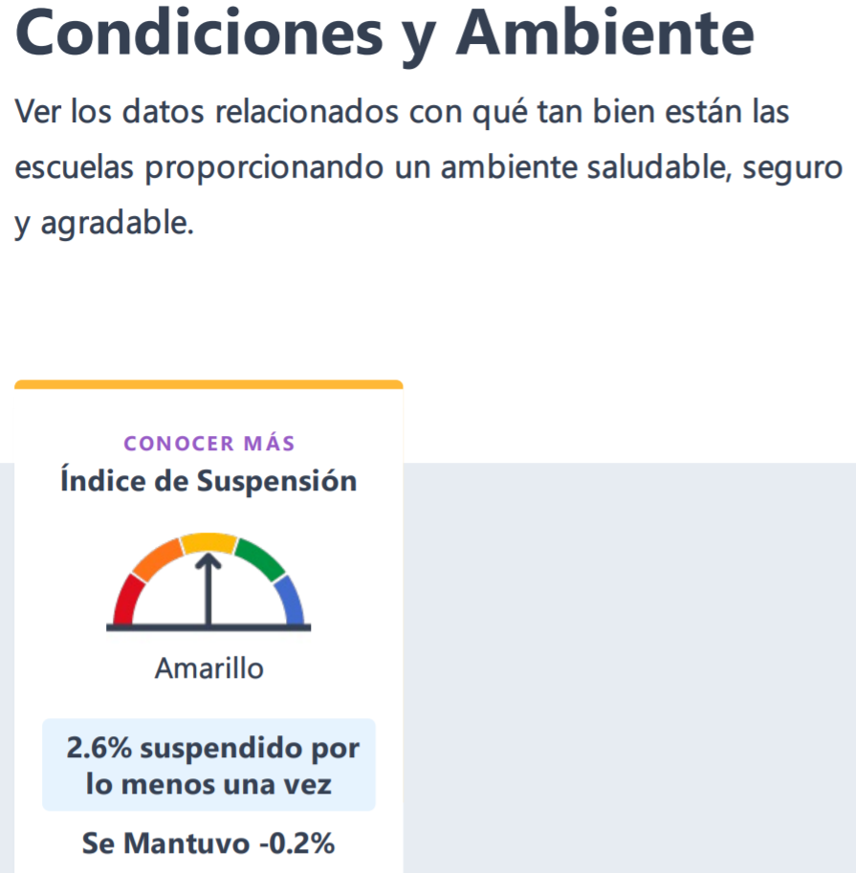
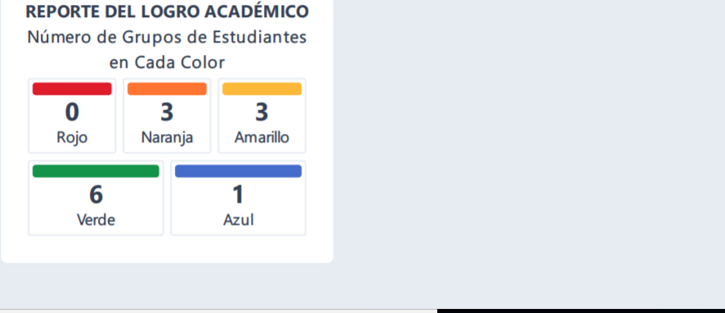
2019 California School Dashboard ~ Tablero Escolar de California

Slide 23


Information about the Language Census 2018-19
~ CDE Data Quest Reports
Información del Censo de Idiomas en la Escuela
~ Reportes de Búsqueda de Datos del
Departamento de Educación de California
Notes:
Good Evening Families!
My name is [insert name] and I’m very excited about all the learning that will take place this year here at [insert school name].
Tonight, I’d like to share with you a few of the ways that we evaluate the progress of our students whose primary language is not English and what we do with that information.
I’ll also talk to you about important ways that you can work in partnership with your child’s teacher to ensure their success.
Let’s get started!
¡Buenas tardes familias!
Soy [insert name] y me entusiasma todo el aprendizaje que se llevará acabo este año aquí en [insert school name].
Esta tarde, quiero compartir con ustedes información sobre algunas de las maneras en que evaluamos el progreso de nuestros alumnos cuyo idioma natal no es inglés y sobre que se hace con esa información.
También quiero hablar sobre importantes maneras en que ustedes pueden trabajar en asociación con los maestros para garantizar el éxito de sus hijos.
¡Empecemos!

Slide 24

Language Census (R-30)
Censo de Idiomas (R-30)

Slide 25
Enrollment by English Language Acquisition Status and Grade
Inscripción por Posición de Adquisición del Idioma Inglés y Grado
Grade | English Only (EO) | Initial Fluent English Proficient (IFEP) | English Learner (EL) | Reclassified Fluent English Proficient (RFEP) | Total
KN | 74 | 8 | 37 | 0 | 119
01 | 54 | 0 | 50 | 0 | 104
02 | 58 | 0 | 54 | 0 | 112
03 | 48 | 0 | 53 | 0 | 101
04 | 34 | 1 | 35 | 0 | 70
05 | 26 | 1 | 30 | 8 | 65
Name | English Only (EO) | Initial Fluent English Proficient (IFEP) | English Learner (EL) | Reclassified Fluent English Proficient (RFEP) | To Be Determined (TBD) | Total
Valley View Elementary | 294 | 10 | 259 | 8 | 0 | 571
Alvord Unified | 8,960 | 210 | 6,425 | 2,907 | 2 | 18,504
Riverside County | 268,615 | 12,975 | 78,514 | 67,890 | 500 | 428,494
State | 3,582,707 | 260,529 | 1,195,988 | 1,131,092 | 15,962 | 6,186,278

Slide 26
"Ever-ELs" by Years as EL and Reclassification (RFEP) Status & Grade
“Siempre-ELs" Por los Años como EL, estatus de Reclasificación (RFEP) y por grado
Grade | English Learners |  |  | RFEP | Total (Ever-EL)
 | EL 0-3 Yrs | EL 4-5 Yrs | EL 6+ Yrs
KN | 37 | 0 | 0 | 0 | 37
01 | 50 | 0 | 0 | 0 | 50
02 | 54 | 0 | 0 | 0 | 54
03 | 39 | 14 | 0 | 0 | 53
04 | 1 | 34 | 0 | 0 | 35
05 | 0 | 22 | 8 | 8 | 38
Ever ELs includes all students ever classified as an EL, and therefore is the current and former EL groups combined.
Level | English Learners |  |  | RFEP | Total (Ever-EL)
 | EL 0-3 Yrs | EL 4-5 Yrs | EL 6+ Yrs
Valley View Elementary | 181 | 70 | 8 | 8 | 267
Alvord Unified | 2,416 | 1,261 | 2,748 | 2,907 | 9,332
Riverside County | 35,270 | 14,870 | 28,374 | 67,890 | 146,404
State | 607,888 | 222,947 | 365,153 | 1,131,092 | 2,327,080
Siempre-ELs incluye a todos los estudiantes clasificados como EL y, por lo tanto, son los grupos EL actuales y anteriores combinados.

Slide 27
English Learner Students by Language by Grade
Language Code | Language Name | Kindergarten | Grade 1 | Grade 2 | Grade 3 | Grade 4 | Grade 5 | Total | Percent of Total
01 | Spanish | 36 | 48 | 53 | 53 | 35 | 29 | 254 | 98.07%
02 | Vietnamese | 0 | 0 | 1 | 0 | 0 | 0 | 1 | 0.39%
03 | Cantonese | 1 | 0 | 0 | 0 | 0 | 0 | 1 | 0.39%
05 | Filipino/Pilipino/Tagalog | 0 | 0 | 0 | 0 | 0 | 1 | 1 | 0.39%
17 | French | 0 | 1 | 0 | 0 | 0 | 0 | 1 | 0.39%
32 | Thai | 0 | 1 | 0 | 0 | 0 | 0 | 1 | 0.39%
AGENCY
Valley View | All Languages | 37 | 50 | 54 | 53 | 35 | 30 | 259
Alvord USD | All Languages | 508 | 577 | 597 | 621 | 633 | 592 | 6,425
Riverside Co. | All Languages | 8,762 | 8,354 | 8,244 | 7,778 | 7,407 | 6.895 | 78,514
California | All Languages | 146,160 | 142,849 | 134,177 | 119,218 | 110,399 | 100,045 | 1,195,988
Estudiantes de inglés por idioma por grado

Slide 28
Language Group Data to Determine 15% and Above Translations Needs for 2018 - 19
Language | Enrollment | Number of English Learners (EL) | Number of Fluent English Proficient (FEP) Students | Total Number of EL and FEP Students | Percent of Total Enrollment that is EL and FEP
Spanish |  | 254 | 18 | 272 | 47.64%
Thai |  | 1 |  | 1 | 0.18%
Cantonese |  | 1 |  | 1 | 0.18%
Filipino/Pilipino/Tagalog |  | 1 |  | 1 | 0.18%
French |  | 1 |  | 1 | 0.18%
Vietnamese |  | 1 |  | 1 | 0.18%
Valley View Total | 571 | 259 | 18 | 277 | 48.51%
Alvord USD Total | 18,504 | 6,425 | 3,117 | 9,542 | 51.57%
Riverside County Total | 428,494 | 78,514 | 80,865 | 159,379 | 37.2%
California Total | 6,186,278 | 1,195,988 | 1,391,621 | 2,587,609 | 41.83%
Datos de Grupos de Idiomas para Determinar las Necesidades de Traducciones 15% o mas alto porcentaje para 2018 - 19

Slide 29
Recommendations for the School Plan
Recomendaciones para el plan escolar

