Slide 1
School Site Council
Valley View Elementary School
April 30, 2020
Notes:
Provide members with the SSC Member Roles & Responsibilities Training Notes
Present this training at the first meeting. Do not break it down over several meetings as members should know their role by the end of the first meeting.
Remember to refer to the notes to explain each slide.

Slide 2
I. Introductory Procedures
Call to Order
Establishment of Quorum
Pledge of Allegiance
Welcome and Introductions

Slide 3
II. Action Items
Approve minutes from February 26, 2020

Slide 4
III. Discussion/Information
Budget Reports by Funding Source
Local Control and Accountability Plan Input
School Plan for Student Achievement (SPSA)
  Monitor student progress
  Continue monitoring and analyzing of the effectiveness of the SPSA goals/actions to inform the development of the 2020-2021 SPSA
  Document SSC input
School Compact
Site Parent Involvement Policy
Principal’s Report

Slide 5

SSC Input - LCAP
Consider the LCAP Goals:
  Conditions of Learning
  Pupil Outcomes
  Engagement
What are the most important things to focus on as we continue our work to support all students?
https://my.thoughtexchange.com/#753760041

Slide 6
School Plan for Student Achievement (SPSA)
Analyze/evaluate 2019-20 academic achievement
Develop the 2020-2021 SPSA
Approve the 2020-2021 SPSA (May SSC)
Provide on-going monitoring of implementing the plan
Notes:
At the first meeting of each year, approve an expenditure limit. If no limit, than SSC must approve all expenditures regardless of amount.
The expenditure limit is set at $500 or lower.
By approving a limit, SSC is authorizing the site to make a purchase up to the approved limit without SSC’s approval of the expenditure.
The most important role of SSC is to oversee the development, implementation and evaluation of the school plan for student achievement
Bullets explain the council’s role:
Analyze/evaluate academic achievement. - Usually done in the fall and part of a comprehensive needs assessment to determine how to best support needs of Title I and unduplicated students.
Develop/approve the school plan - Which includes all related supplemental funds’ budgets with proposed expenditures. Services must adhere to all state and federal regulations.
Provide on-going monitoring of the plan’s implementation -SSC should review common formative assessments periodically given to students throughout the year and discuss if students are making progress.
Conduct an annual evaluation of the effectiveness of the school’s progress towards meeting school goals -This annual evaluation is the backbone of the comprehensive needs assessment required by Title I and provides quantitative evidence that guides the site’s decisions on what Title I and LCAP low income/English learner services to offer
Participate in local, state and federal reviews of the school’s program for compliance and quality -Example: Federal Program Monitoring occurs every two years. Federal Title programs are reviewed by CDE.
Also note that each expenditure must be accounted for in the school plan.

Slide 7
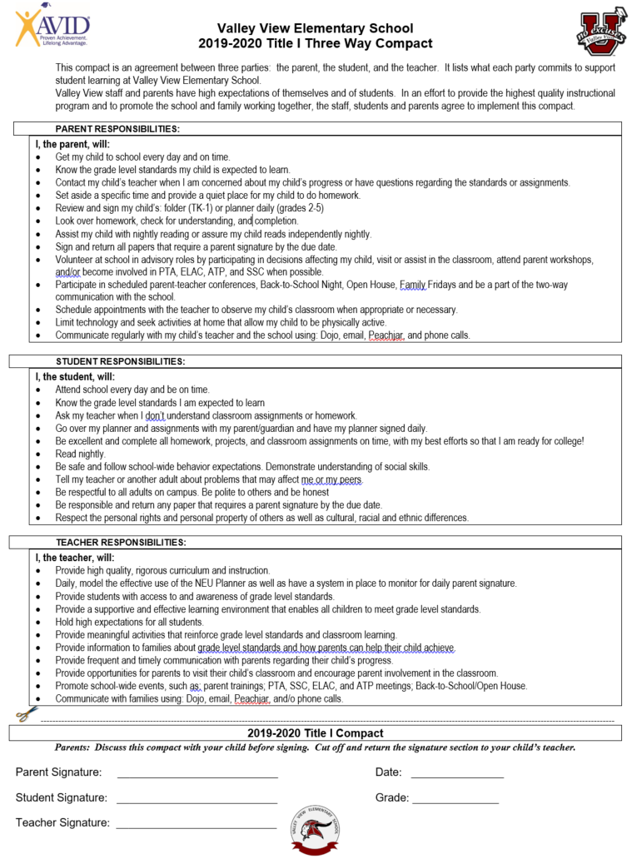
2019-2020 School Compact
Notes:
Provide a brief overview, get input, update for May SSC approval.
Document input in minutes

Slide 8
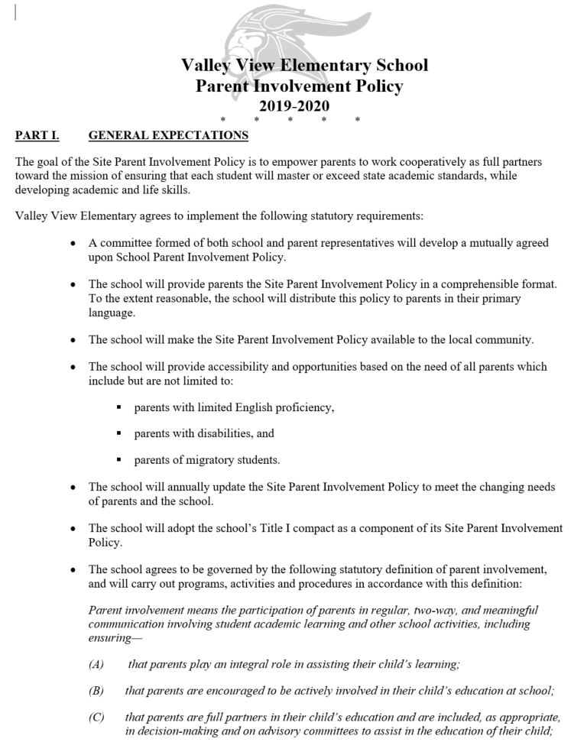
2019-2020 SITE PARENT INVOLVEMENT POLICY
Notes:
Provide a brief overview, get input, update for May SSC approval.
Document input in minutes

Slide 9
Council Meetings – The Greene Act
(FYI only-this slide can be deleted)
Education Code §35147 specifies:
  Open all meetings to the public
  Allow the public address SSC
  Post notice of meeting 72 hours before meeting
  Do not act on items not included on the posted agenda
Notes:
All councils must adhere to the education code.
Exception - If an action is needed and was not known at posting time, by unanimous vote the council may add the item to the agenda
If procedures are violated and any person demands, the council must reconsider the item at its next meeting after allowing for public comment
Placing the agenda in a binder in the school office is not considered public posting.
Agenda must include date/time/location of the meeting and all motions to be considered during the meeting.

