Slide 1
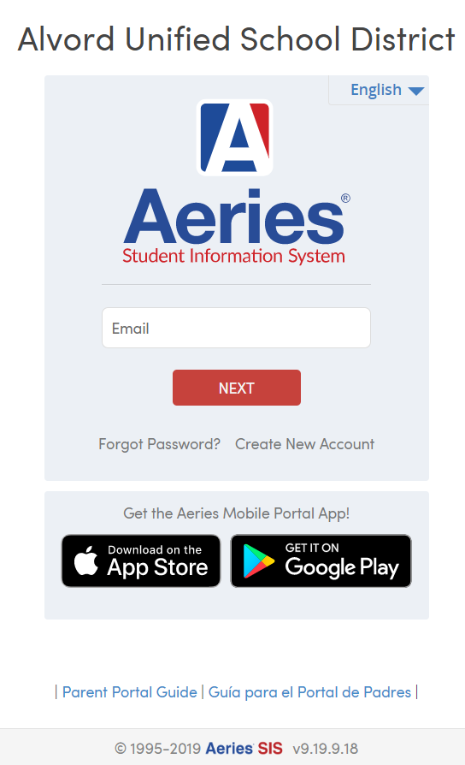


How To Add/Delete Contacts
In your Aeries Parent Portal

Slide 2
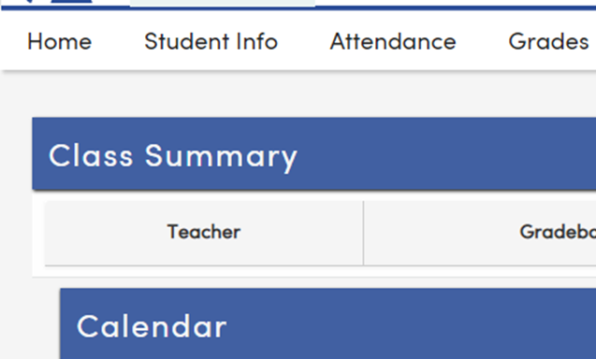
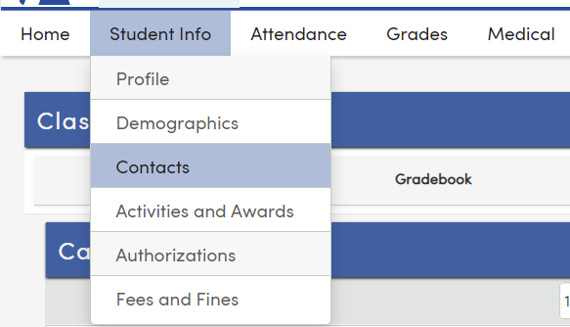
Portal Home Screen
Student Info
Contacts
Click on Student Info
Select Contacts

Slide 3
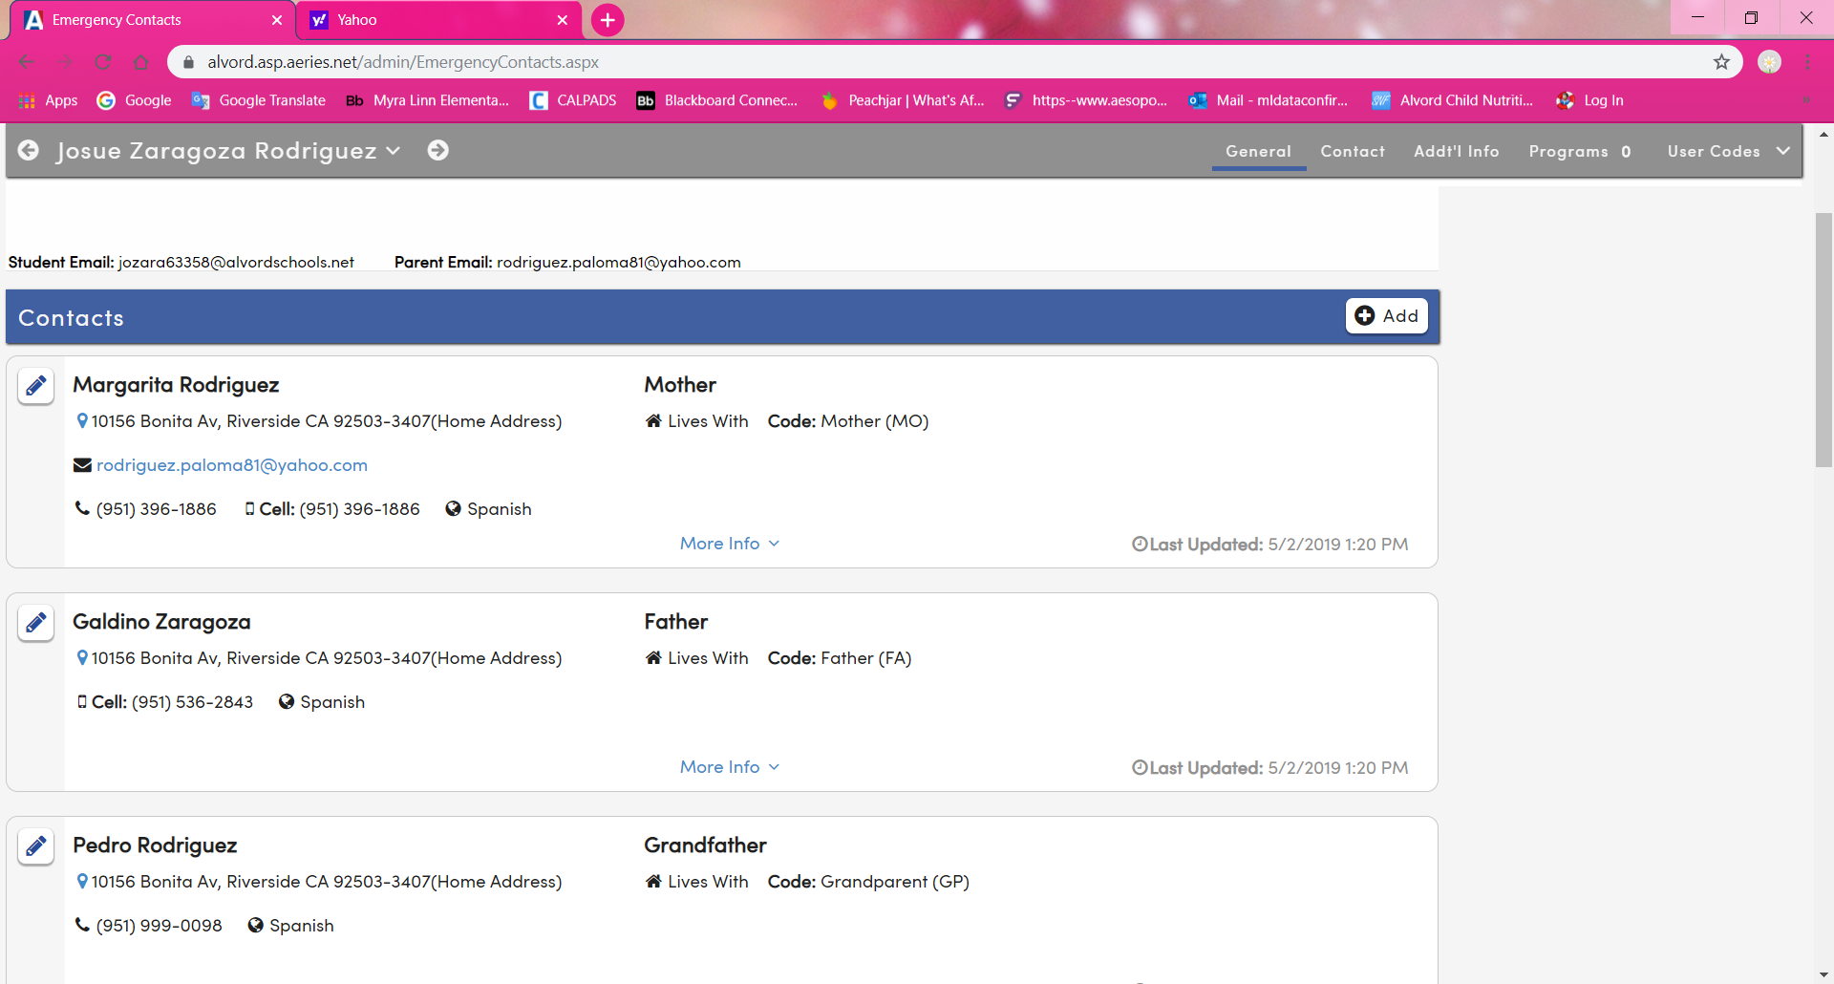
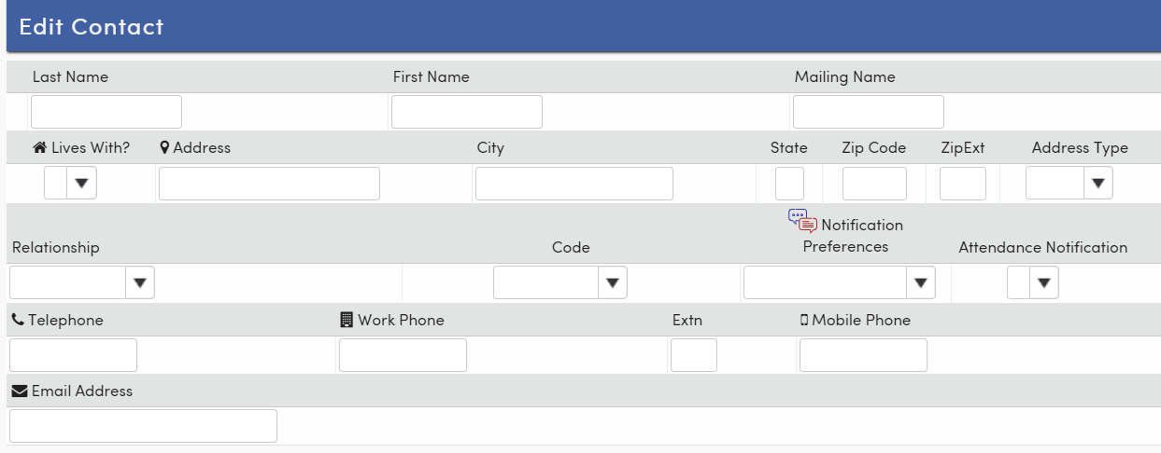
To add new contact
Click on the Add button
You will see a box titled Edit Contact.
Complete Last and First Name
Indicate if contact lives in the home
Add Relationship to student
Notification Preferences needs to be filled out
Attendance Notification needs to be filled out

Slide 4
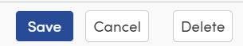
To Edit a Contact
Click on the Pencil Icon next to contact’s name, make correction and select save.
To delete a contact click on Pencil Icon and select Delete.
Your done! ☺

