Slide 1
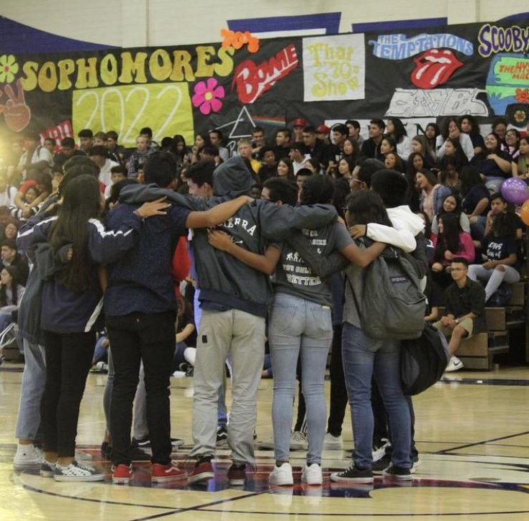
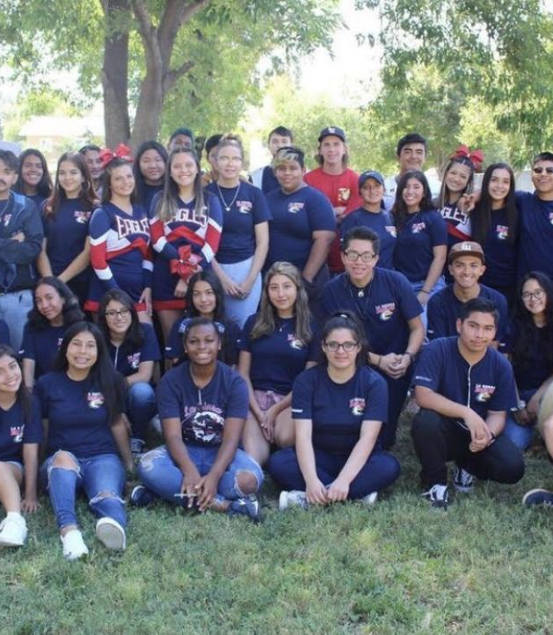
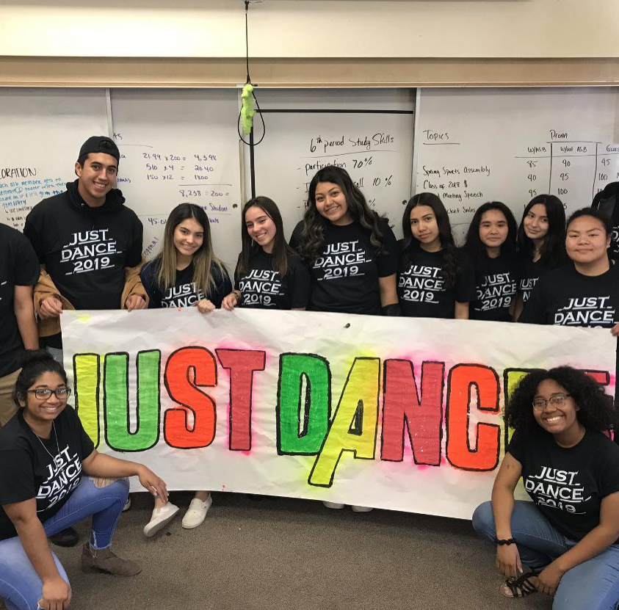
Leadership
ASB / Link Crew

Slide 2
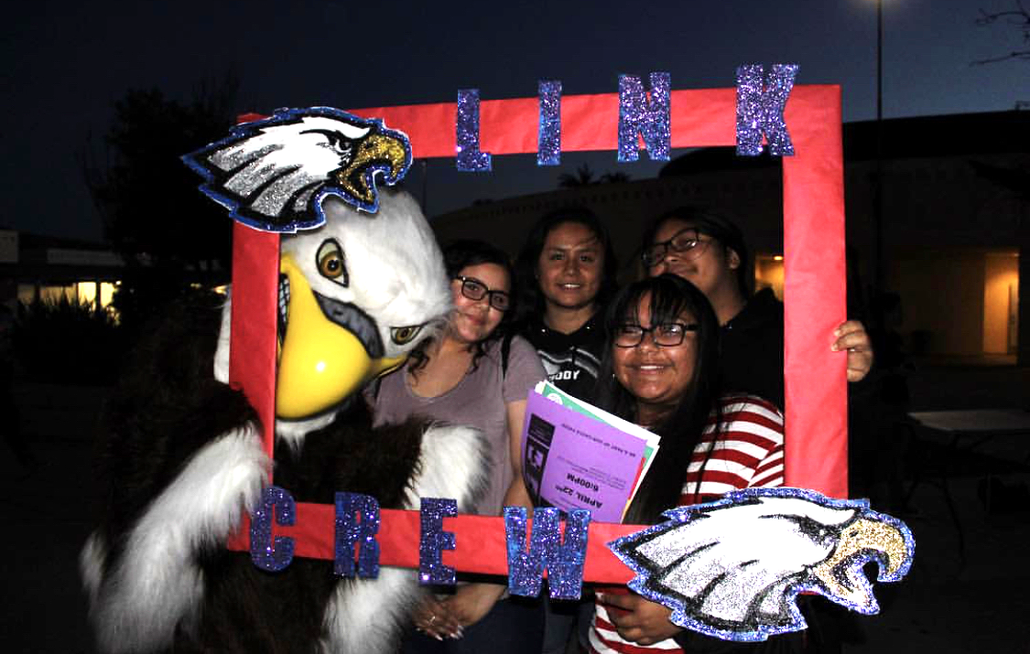
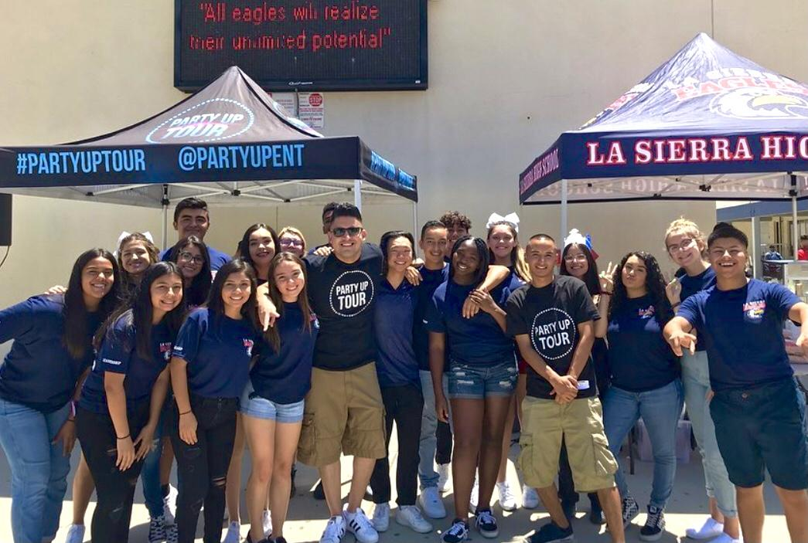
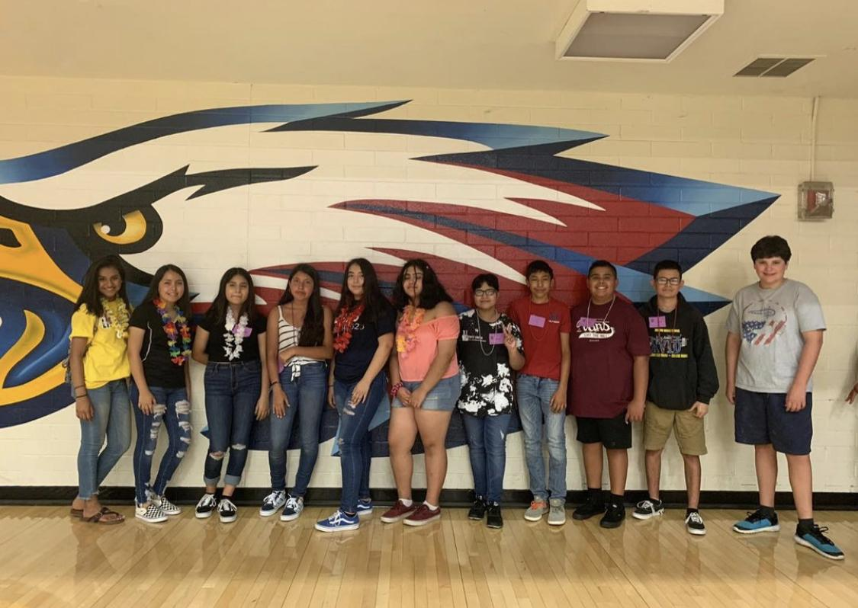
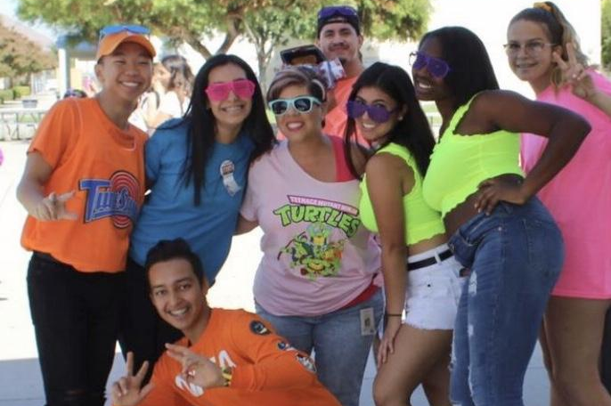
LINK CREW
Join us!! :D🦅💙❤️.
ASB

Slide 3


Slide 4
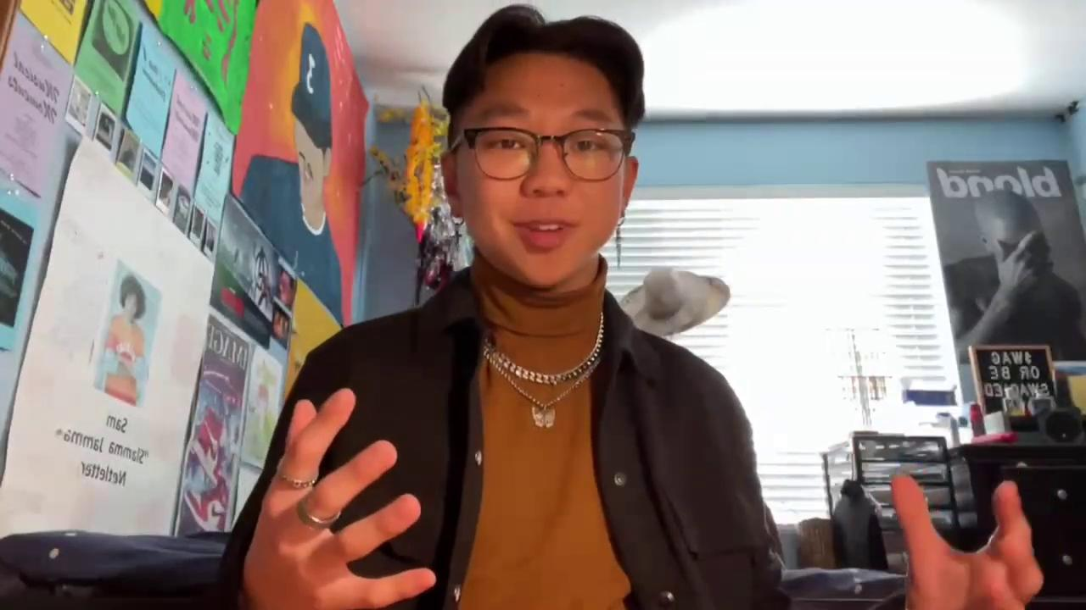


Slide 5
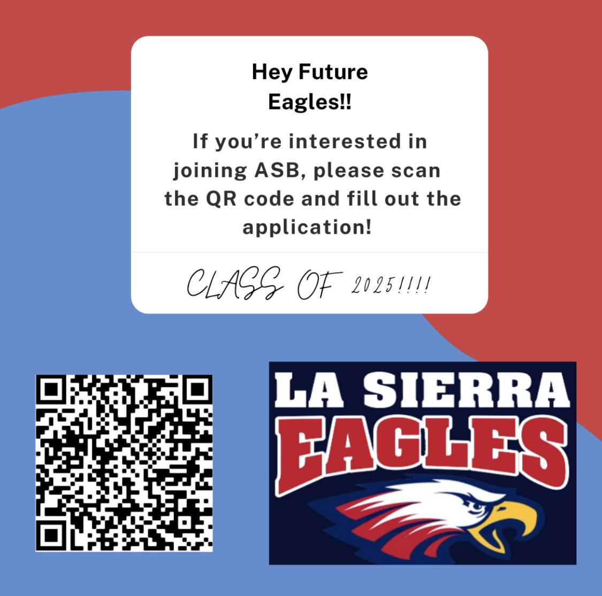

Slide 6
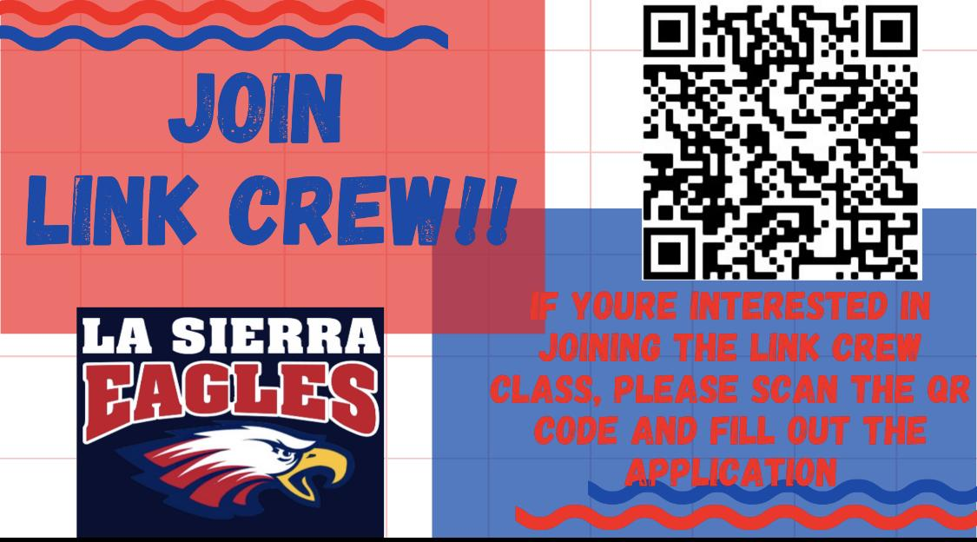

Slide 7
Any questions? :)
Have an idea for your school?
Interested in seeing what we’ve done in the past?
Want to stay in the loop about current/future events??
How to contact Mrs. Ayala:
Email:
mikaela.ayala@alvordschools.net
Reach out to us/ stay in touch:
.H
Contact us! :)
ASB Link Crew
IG: @lasierraasb
IG:
@lshs_link_crew

