Slide 1















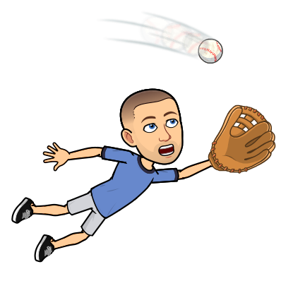












La Sierra’s VIRTUAL Club Rush
Cadet Corps
#1
Boys/girls
Water polo &swim
#2
Book club
#3
College club
#6
Drama
#7
Choir
#8
Girls soccer
#9
National Honor Society
#10
Cancer awareness
#11
PALS
#4
ASB
#5
Yearbook
#13
Mecha
#15
Travel Club
#12
Girl’s volleyball
#14
Hopes Club
#16
Key Club
#17
Track
#18
Baseball
#19
.
https://docs.google.com/document/d/1O_6vLuBCg7Ut2YqnWoRw0geYIIPJ_r32ATQ3XRR6Af0/edit?usp=sharing
Friendship
Club
GSA
Mr.
Gonzalez
Interact Club
Sign language club
Click on the advisor for the club you’re interested in!!
Notes:
This page is a work in progress!

Slide 2
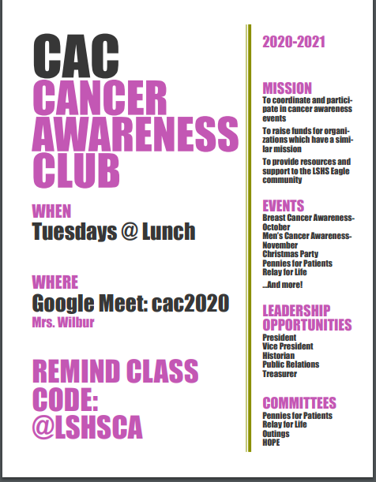
Cancer Awareness club

Slide 3
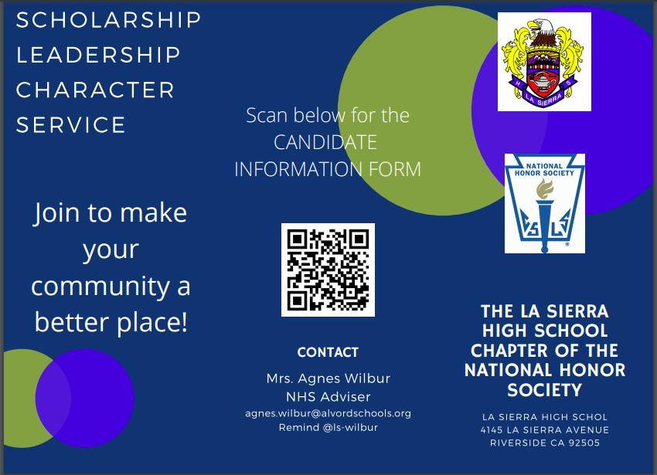
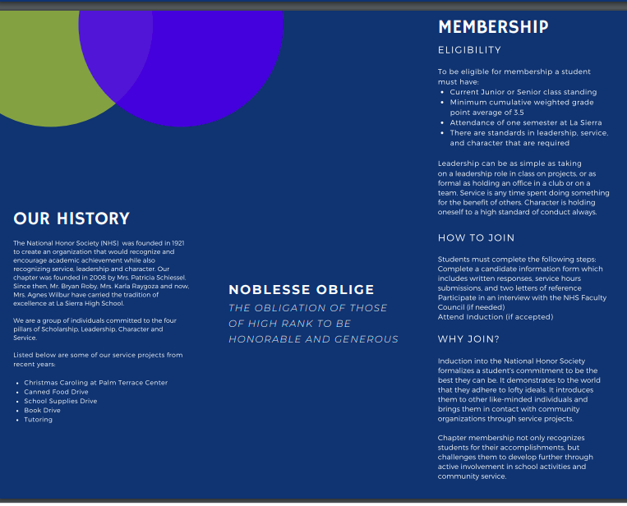
NHS

Slide 4
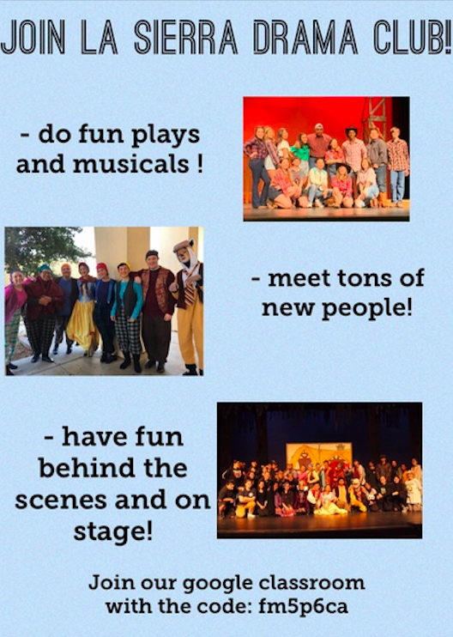
Drama club
Informational video link:
https://drive.google.com/file/d/1iZxqMf4TUx21Z0Q-rE8TJk2lOkv5KqXB/view?usp=drivesdk

Slide 5
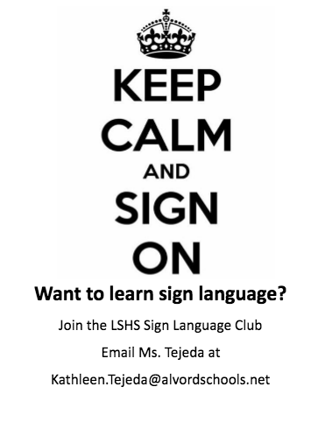
Sign Language club

Slide 6
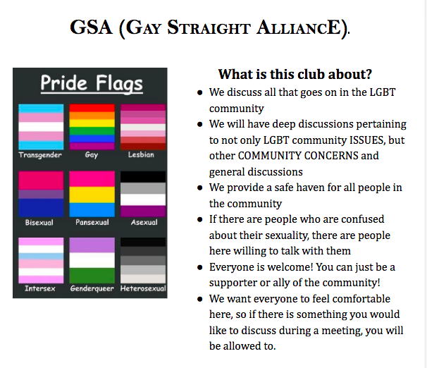
Gsa club

Slide 7
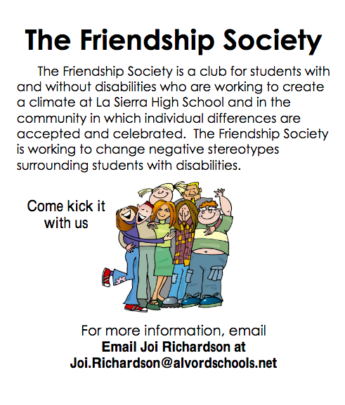
The friendship society

Slide 8

Soccer club
Informational Video link:
https://drive.google.com/file/d/10YDaRtdRLvqIxhzepn31lL_Bv_-215Dc/view?usp=drivesdk

Slide 9

College Club
Informational video link:
https://drive.google.com/file/d/1e8OY88AYPppb5pNyfFMmS-Cq5xN7e7OZ/view?usp=drivesdk

Slide 10
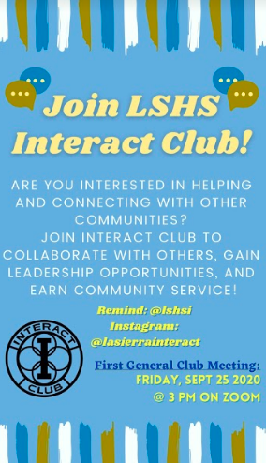
Interact club
Informational video link:
https://drive.google.com/file/d/1uc-H6UzdIYo6AnCKhMywMfFudCzXcuKP/view?usp=drivesdk

