Slide 1
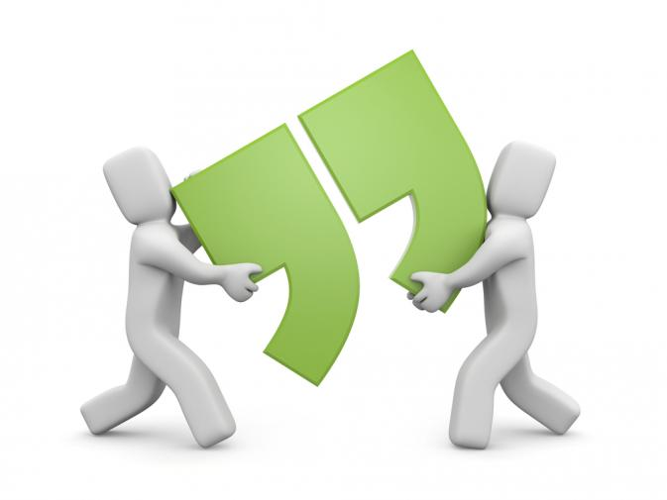
Sentence Unit Two
Unlocking the Secrets of Dialogue and Quotations
“Would you like to learn about commas?” our teacher asked.
Using Commas in Direct Address
Using Commas with Words at the Beginning of Sentences
Using Commas, Quotation Marks, and End Punctuation for Dialogue and Direct Quotes
I responded quickly, “Yes, I would love to learn more about commas.”
Name: _____________________ Period ________

Slide 2

Essential Questions
How do writers vary sentence structure?
How can I use commas to create more interesting sentences?
How does the comma allow readers to judge rhythm, direction, pace, and flow of writing?
Why is the comma such a useful and necessary punctuation mark?
How do writers use commas in direct address situations?
How do writers use commas to set off words at the beginning of sentences?
How do writers use commas, quotation marks, and end punctuation when writing dialogue and direct quotes?
How do writers use dialogue effectively in writing?

Slide 3
Lenny, I’ve been expecting you since Friday .
We have been expecting you, Lenny.
Of course, Lenny, we have been expecting you.
Direct Address
Rule
Use commas to separate a noun of direct address (the person being spoken to) from the rest of the sentence.

Slide 4
Direct Address
Three sentences I found
Three sentences I wrote

Slide 5
Words at the Beginning of Sentences
Yes, I can always use additional hockey equipment.
Well, that does it for this year.
Anyway, there is no reason we can’t study harder.
Rule
Place a comma after words like oh, yes, and no at the beginning of a sentence.

Slide 6
Words at the Beginning
Three sentences I found
Three sentences I wrote

Slide 7
Dialogue at the Beginning of Sentences
“Today must be Tuesday,” she muttered.
“What month is it?” I asked.
“Happy Fourth of July 4th!” the announcer screamed.
Rule
Use quotation marks to set off the words of the speaker from the rest of the sentence. A comma is used after a declarative or imperative sentence within the quote. If the words being spoken are a question, end the quote with a question mark. If the quote is an exclamatory sentence, end the quote with an exclamation point.
If you are explaining what someone said or thought but are not using the person’s exact words, do not use quotation marks.
Ex. Jim told me long ago that he would move to Utah.
Ex. I wondered if I would ever make it out of this jam.

Slide 8
Dialogue at the Beginning
Three sentences I found
Three sentences I wrote

Slide 9
Dialogue Ending a Sentence
Then he asked, “How did you get here without a balloon?”
I replied, “We took an airplane.”
The commentator screamed, “The Yankees win!”
If you are explaining what someone said or thought but are not using the person’s exact words, do not use quotation marks.
Ex. Jim told me long ago that he would move to Utah.
Ex. I wondered if I would ever make it out of this jam.
Rule
Use a comma and quotation marks to set off the words of the speaker from the rest of the sentence when dialogue is at the end of a sentence.

Slide 10
Dialogue Ending a Sentence
Three sentences I found
Three sentences I wrote

Slide 11


When Should I Use Dialogue?
Is the dialogue realistic? Would the dialogue you are writing actually take place?
Does it help tell the story? Ask yourself if you are using dialogue for a purpose or just using dialogue for the sake of using dialogue.
Does the dialogue help explain your big idea?
Example #1:
“Odds or evens?” Coach Fasulo asked, holding his right hand behind his back.
“Odds,” I said, which surprised everyone who knew me. It wasn’t just that I’d spoken first with such absolute confidence, but that I limited myself to a single syllable. Coach Fasulo held out the formerly hidden hand. His index finger pointed at me. I’d won first choice. I looked around the gym, tempted to pick the smallest first and strike a blow for the underdog. But I wasn’t that dumb. “I’ll take Red,” I said. And even though I was the one doing the picking, it earned me a smile from Red that every kid just can’t help showing when he’s first chosen.
Example #2
“Hi, Jen,” said Sarah.
Jen replied, “Hi, Sarah.”
“Where are you going?” Sarah asked.
“I am heading to school. Where are you going?” Jen inquired.
Sarah replied, “I am going to school too.”
Jen said, “Oh.”
Sarah said, “Sounds good.”

